Slide 1
The participation of children and young people in inspection – a journey
Dr Suzanne Conneely, Department of Education and Youth Inspectorate Ireland
October 2026

Slide 2

Introduction
Today …
why
how
what

Slide 3
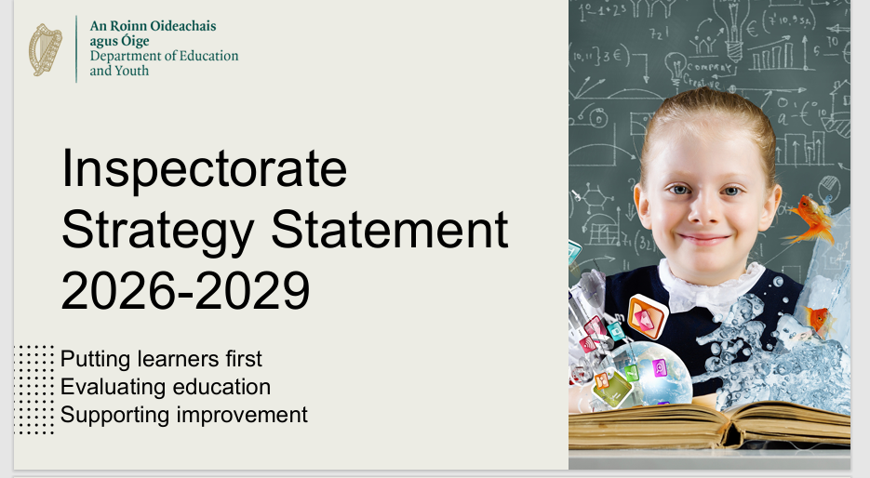
Inspectorate - Ireland
Education Act 1998
Evaluation, advisory and research roles
Building capacity
144
1831 – Inspectorate established

Slide 4
The beginning of ‘why’?
“School inspection is a
matter affecting children ….
entitled to have their views sought,
listened to and taken into account”
2003 Focus groups
2010 Student surveys
Student Participation Conference
    Research
Evolving context
Article 12
“Parties shall assure to the child who is capable of forming his or her own views the right to express those views freely in all matters affecting the child, the views of the child being given due weight in accordance with the age and maturity of the child”
UNCRC, 1989

Slide 5
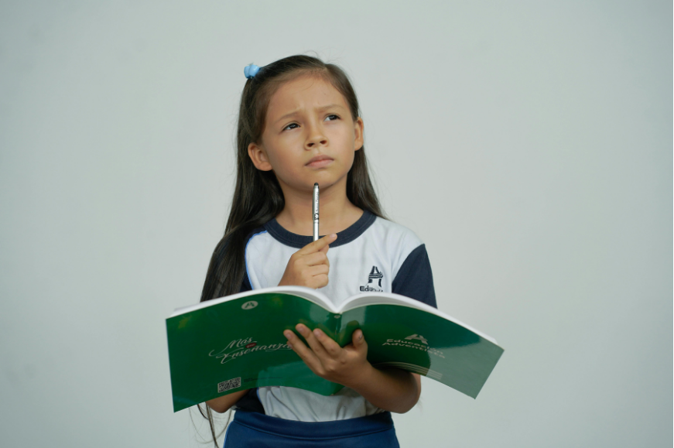
Time to reset?
Did the purpose and method
of our engagements with children emphasise their agency sufficiently and do justice to Article 12?
A rights-respecting approach?

Slide 6
Time to reset?
A rights-respecting approach
acknowledge fundamental right to be part of every decision that affects them, as a matter of principle
takes their views seriously bearing in mind their age and maturity
recognises unique and invaluable contribution
ensure appropriate conditions for enabling children to express views, however young they are
combat negative attitudes towards the participation of children and lead to multiple benefits including improved decision-making and outcomes (Lansdown, 2011)
Social child with different, though not necessarily inferior, social competencies
Research with children – taking account of their views
Competent and sophisticated thinkers and communicators

Slide 7
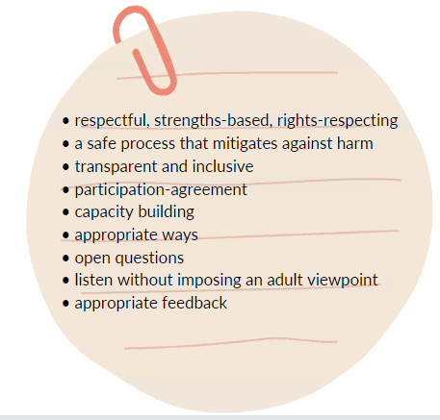

Children as advisors … synergistic benefit
A right to information and adult guidance while views are in formation in order to be assisted in determining and expressing what will then be both a formed and informed view (Lundy and McEvoy, 2011).
Capacity building
Voluntary

Slide 8

Supportive national context
2023: Young Ireland: the National Policy Framework for Children and Young People 2023-2028
2024: Participation of Children and Young People in Decision Making Action Plan
2024-2028
National Participation Office

Slide 9
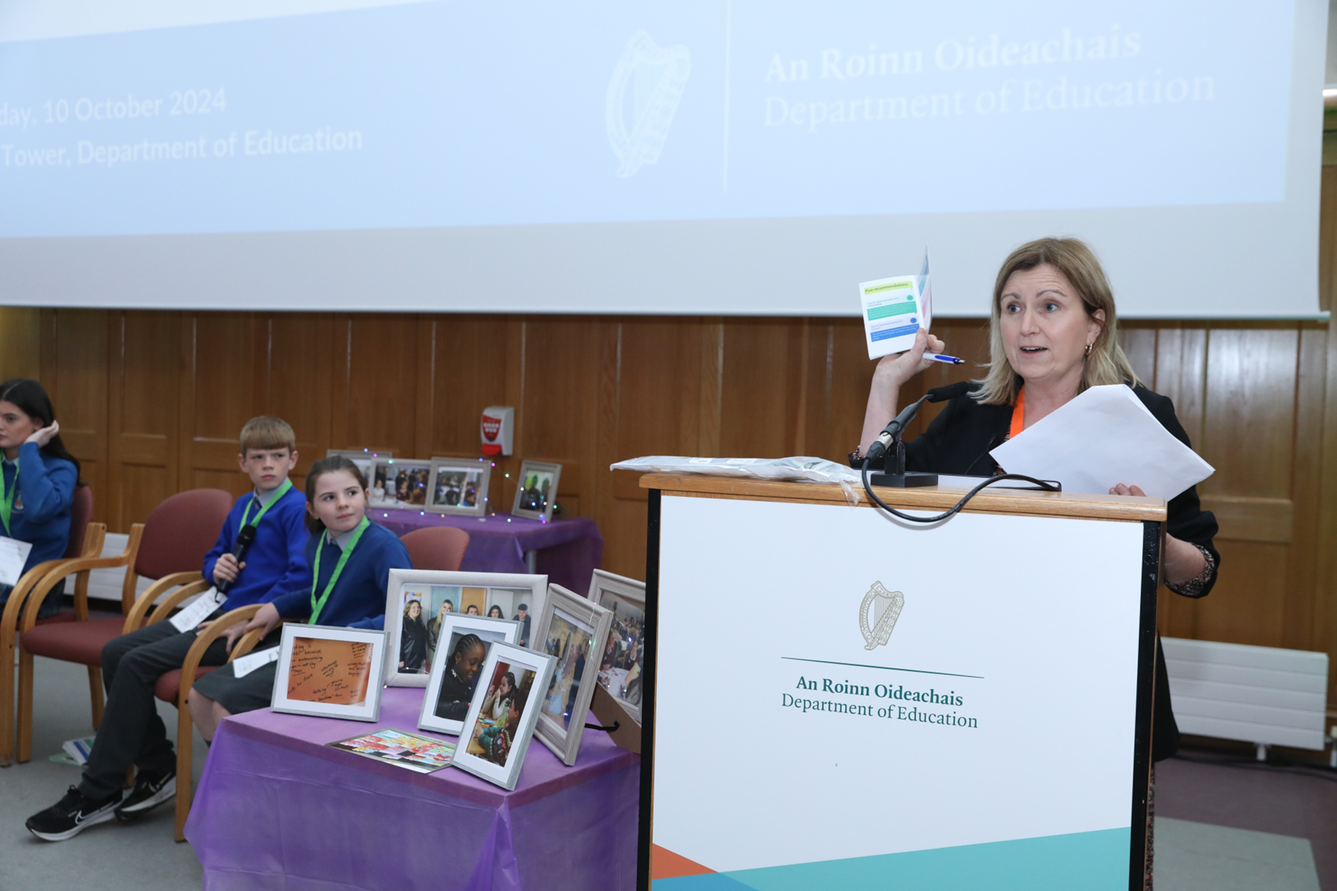

Supportive Ministry context
Student Participation Unit
Student Participation Implementation Plan
Convention on Education: Our schools, our future

Slide 10


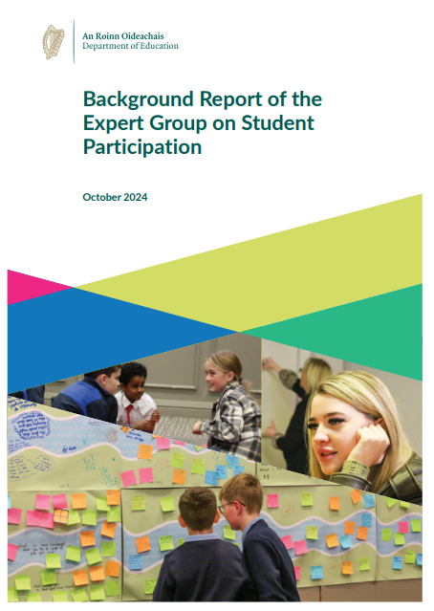
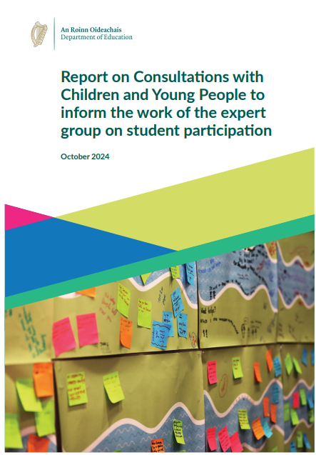
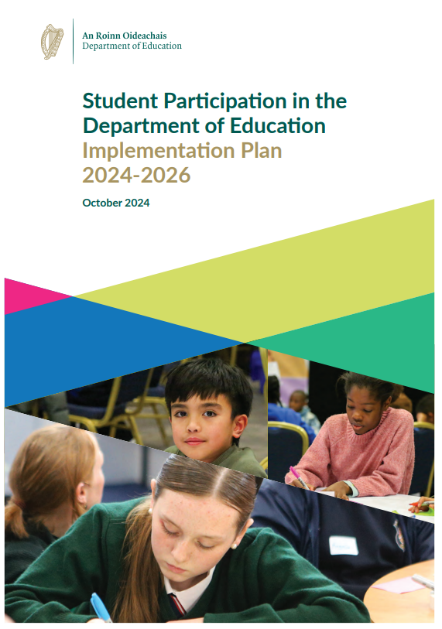
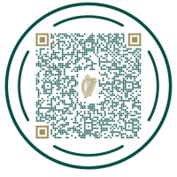


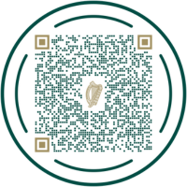
Information and Resources
Student Participation in Education
gov.ie - Student Participation in Education

Slide 11

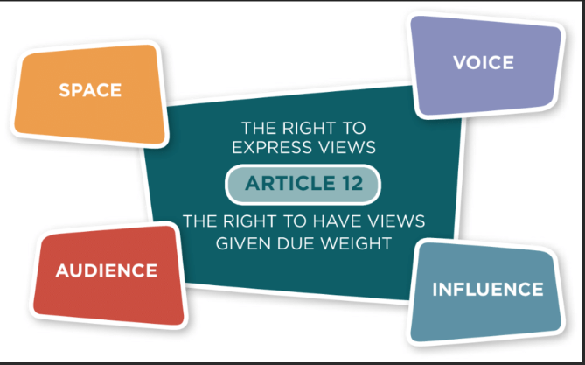
Whole-of-government approach
Lundy Model of Participation
Inspectorate Research
Children's right to be heard during whole-school evaluation in Irish primary schools: students’ and teachers' perspectives. Conneely, S. (Author). July 2015 Doctoral Thesis

Slide 12
How? A three-phase approach
Phase one: Before inspection
Phase 1
Before an inspection
Phase 2
During an inspection
Phase 3
After an inspection
Phase 1
Advice from children and young people
what information about inspection is relevant before inspection happens, and the most effective ways for sharing
Bespoke methodology to consult in a rights-respecting and strengths-based way

Slide 13
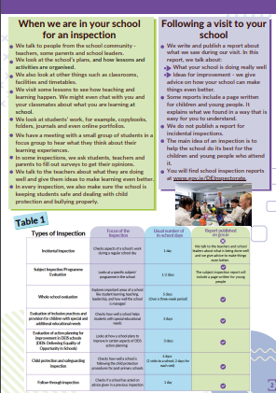
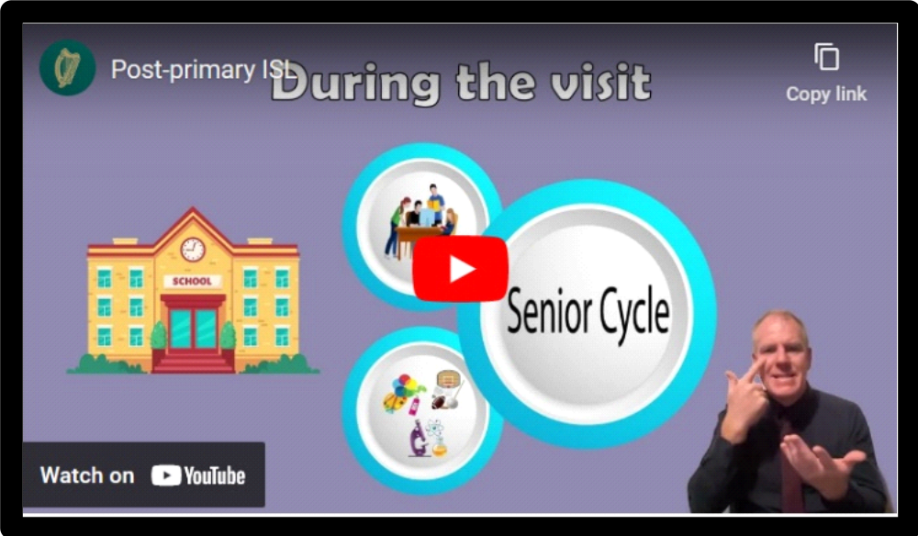
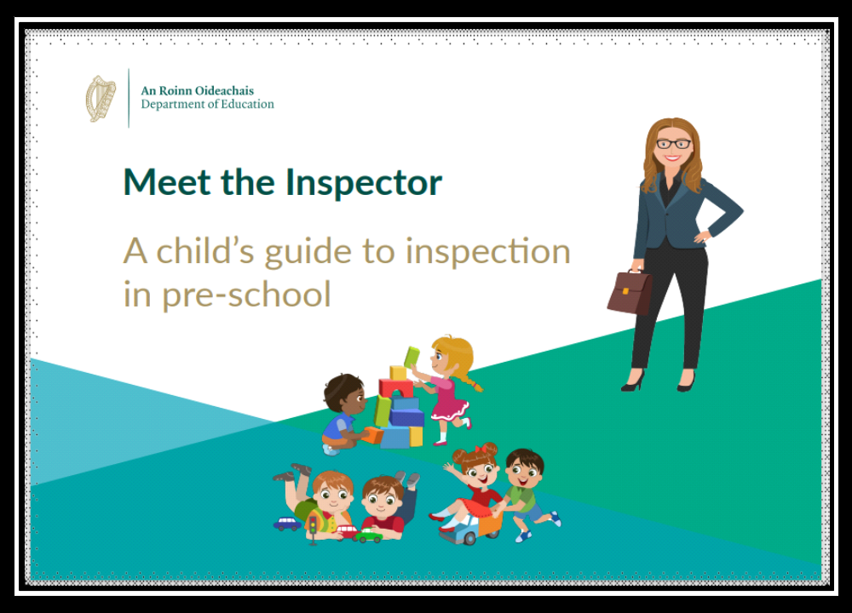
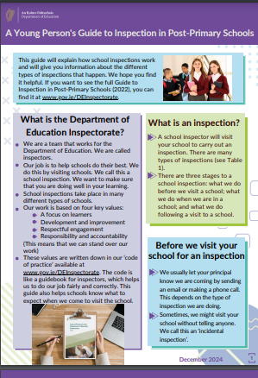
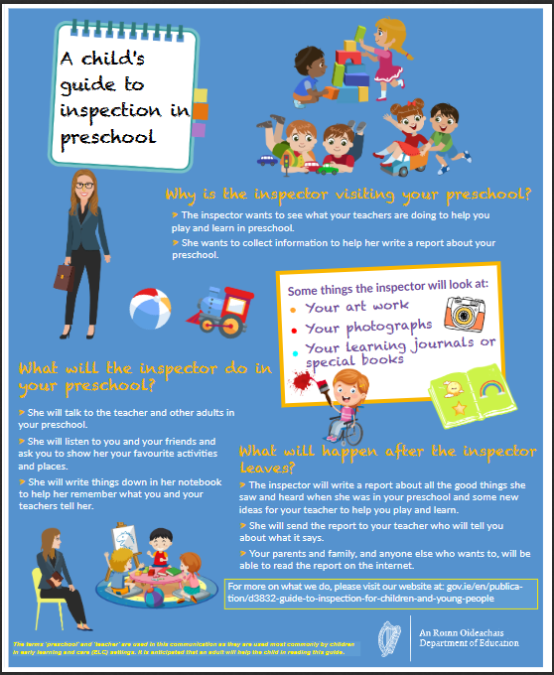
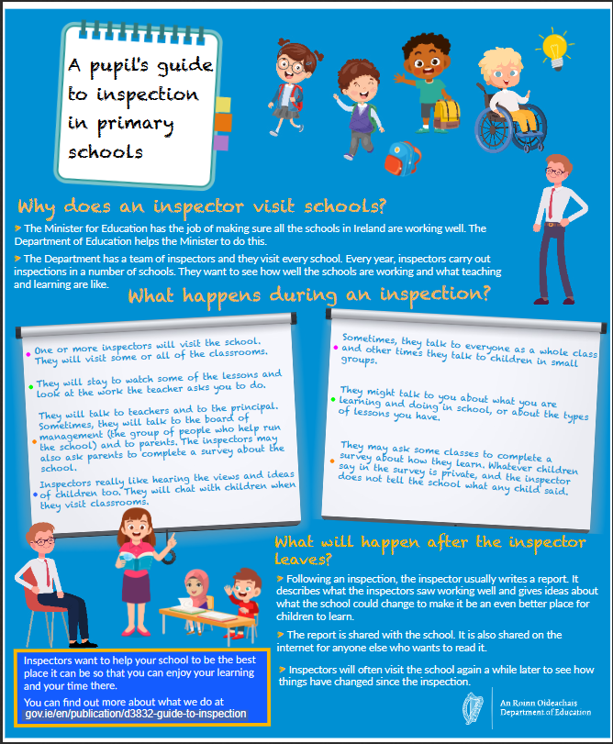
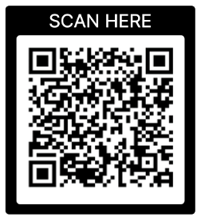
Resources developed
Phase 1 Resources – for early years, primary and post primary
Meet the inspector an
E-book
About inspection- videos created for children and young people
Young persons guide to inspection
A child's guide to inspection- Poster/leaflet

Slide 14
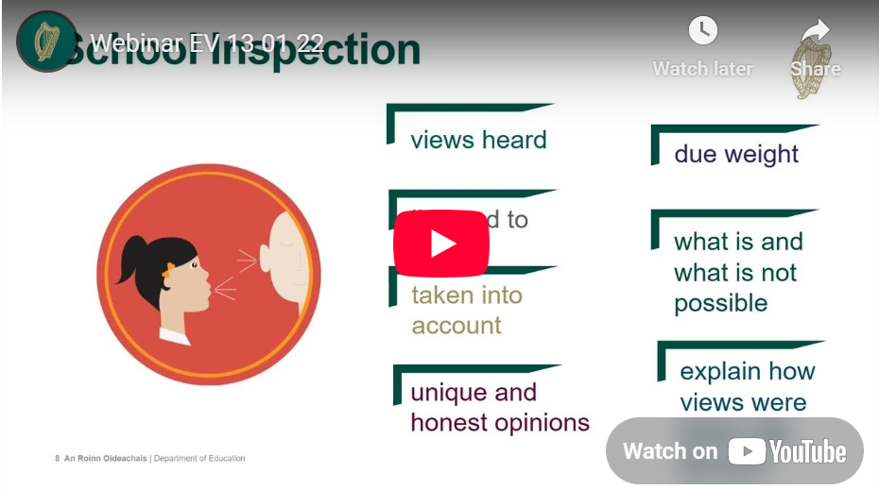

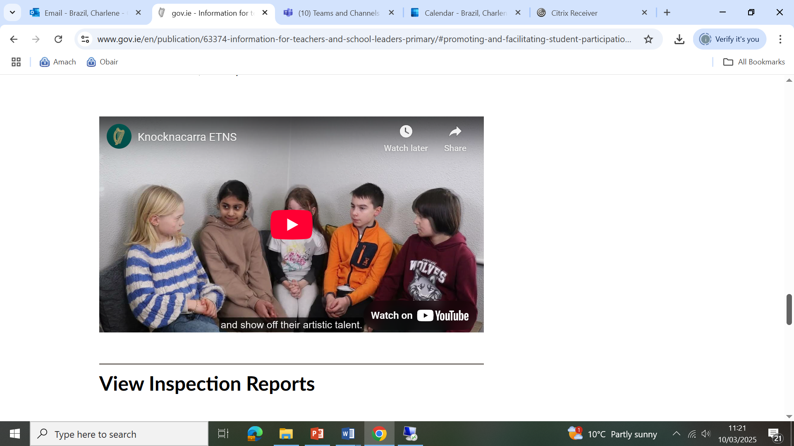
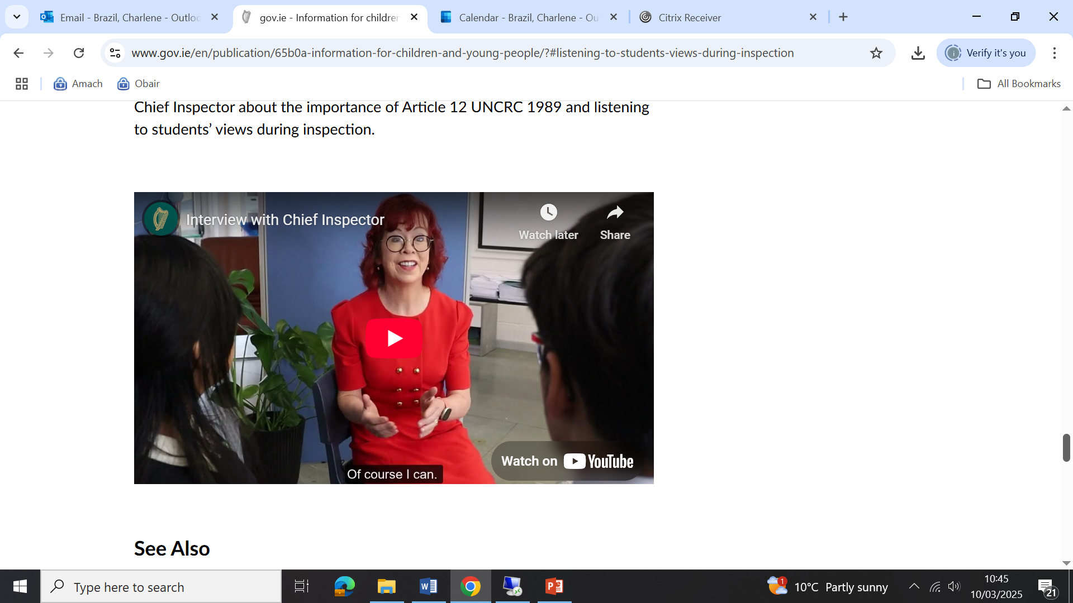
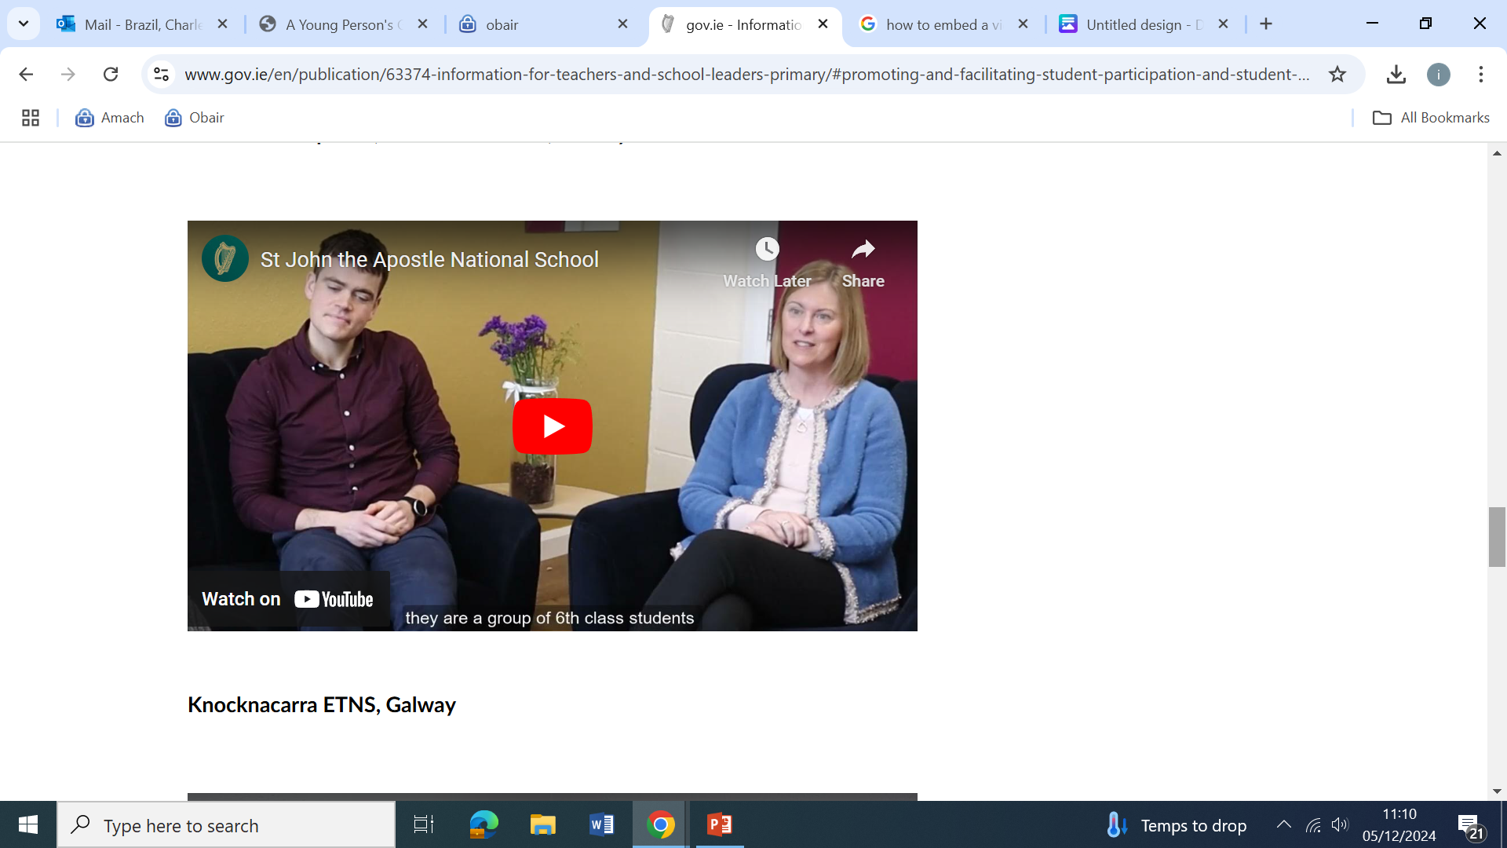
Resources developed
Video series
Sharing good practice in student participation and leadership
Phase 1: Participation Resources
Webinar for educators
Chief Inspector Newsletter to children and young people
Students' interview with Chief Inspector about the right to be heard during inspection

Slide 15
How? A three-phase approach
Phase two: During Inspection
Phase 1
Before an inspection
Phase 2
During an inspection
Phase 3
After an inspection
Phase 2
How inspectors seek, listen and take on board the views of children and young people during inspection
What is a Focus Group?
an empowering, emancipatory process
about ‘knowledge creation’ rather than ‘knowledge extraction’

Slide 16
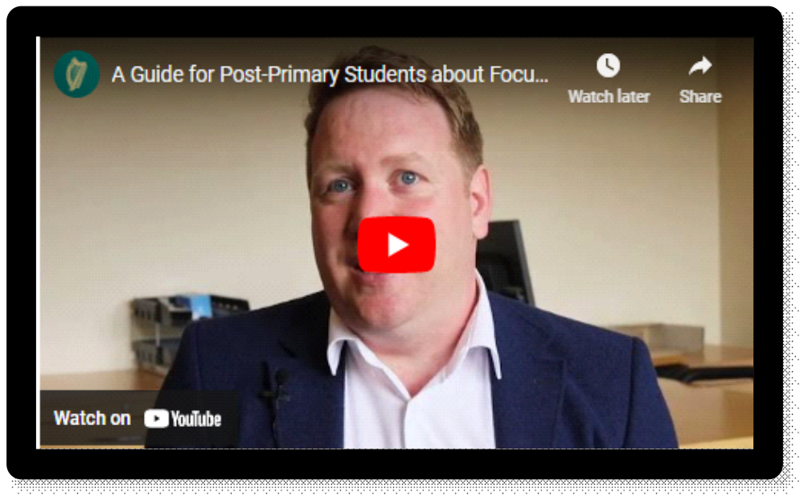
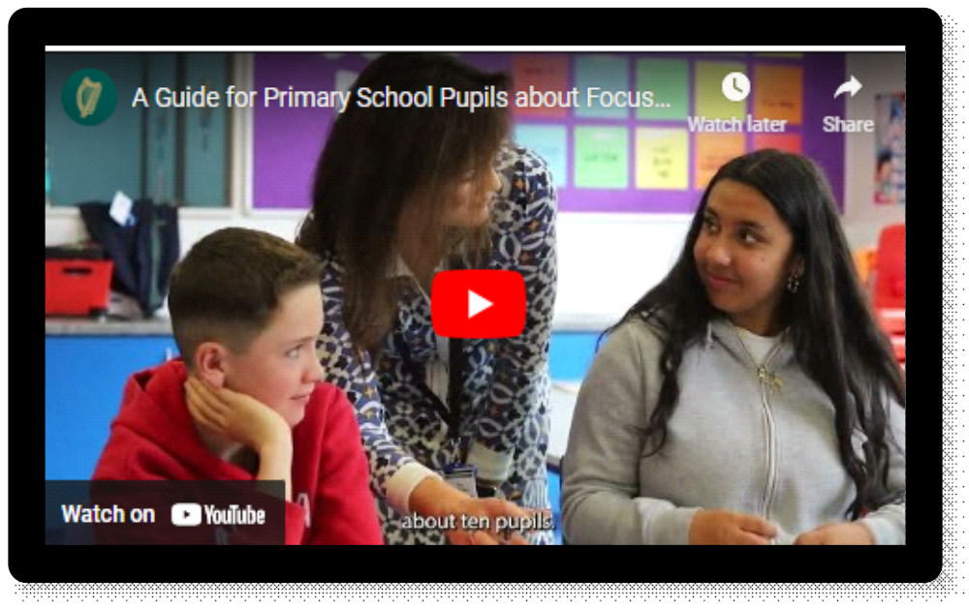
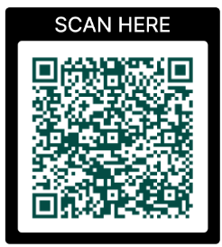
What we did
Phase 2: Participation Resources – for primary and
post-primary children and young people

Slide 17
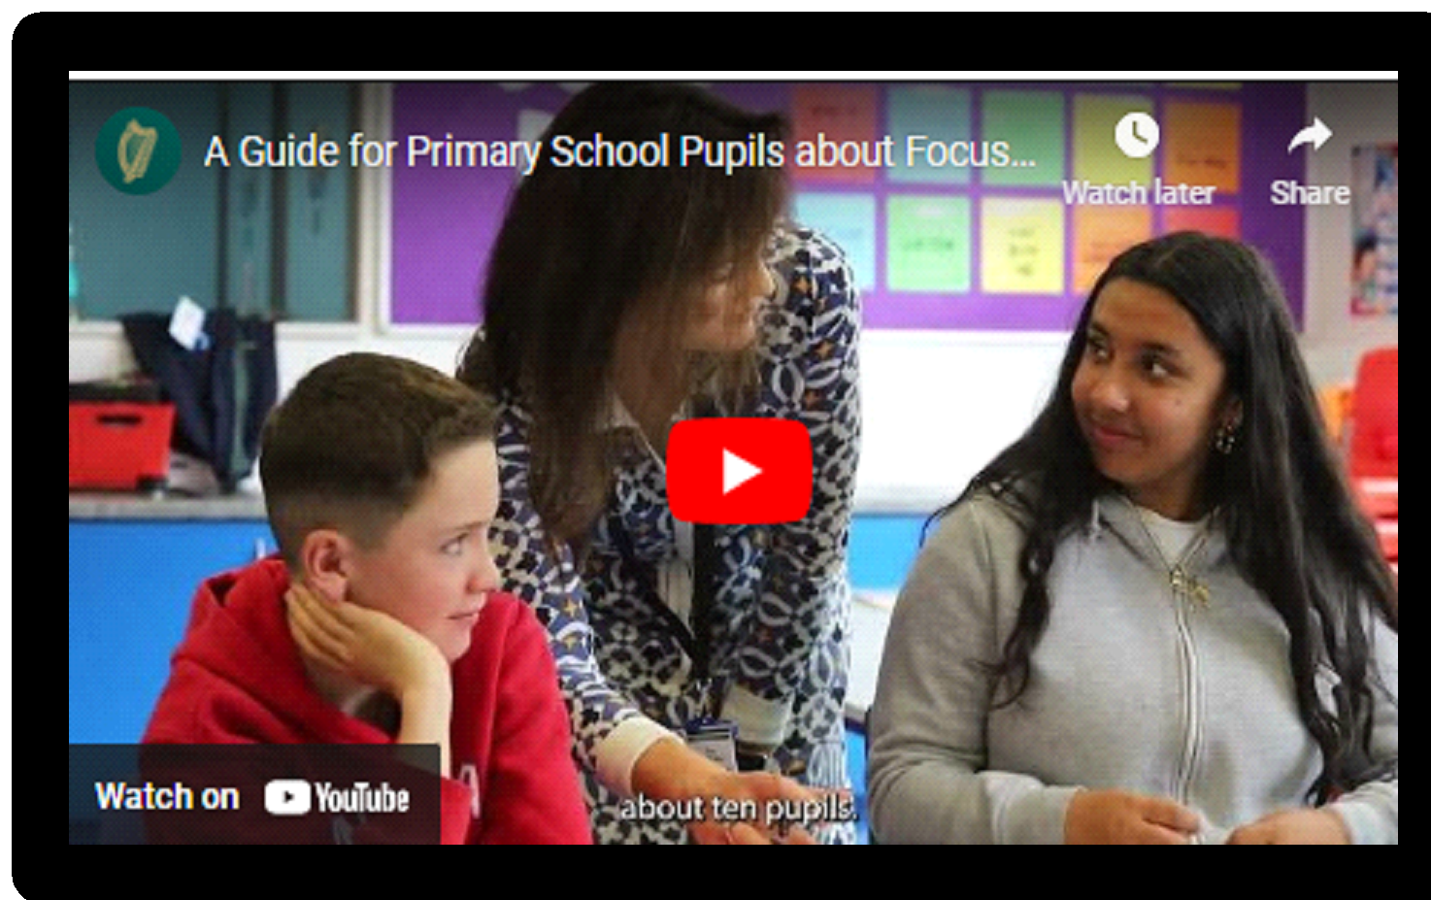

A Guide for Primary School Pupils about Focus Groups during Inspection.

Slide 18
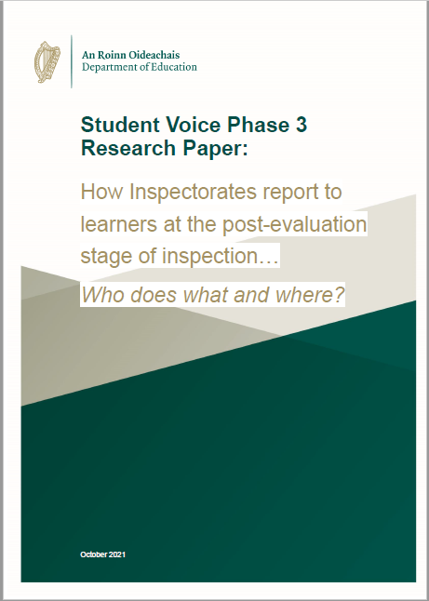
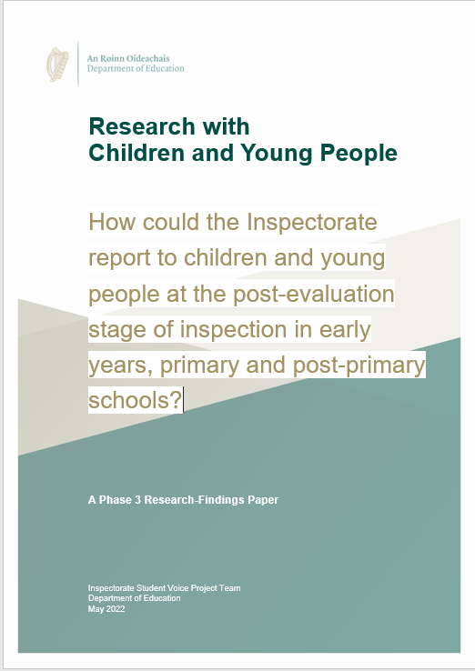
How? A three-phase approach
Phase 3: After Inspection
Phase 1
Before an inspection
Phase 2
During an inspection
Phase 3
After an inspection
Phase 3
What and how we report to children and young people following an inspection

Slide 19
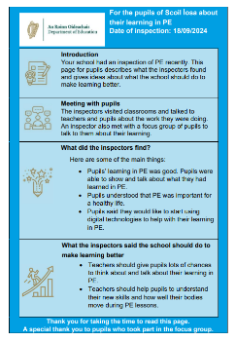
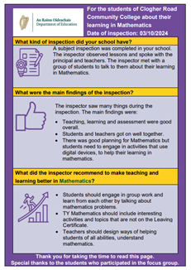
How? A three-phase approach
“You could write a report for the children” (EY)
“If we find out about our school in a way that we could understand, it would be better” (P)
“Inspectors need to be more open and honest with students and tell them how things are in classes and in the school” (PP)
Phase 3: After Inspection
Children and Young Person’s (CYP) page
The page is included in all published curriculum evaluations (Primary)
and subject inspection (Post-Primary) reports.

Slide 20
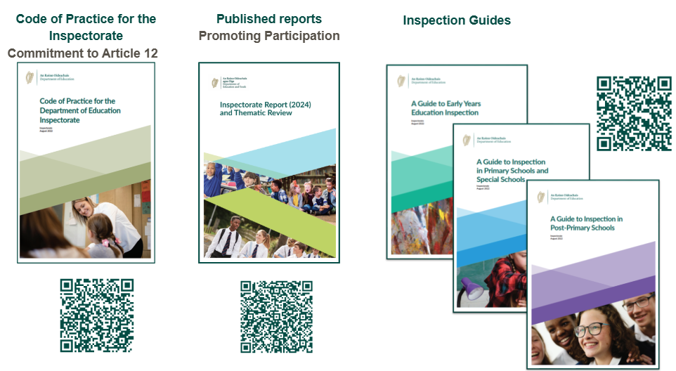
How? Publications and engagements

Slide 21
Journey is ongoing …
Do-and-then-Do More
Informed
Incremental
Committed

Slide 22


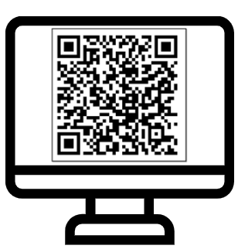
Thank you / Go raibh maith agat
oci@education.gov.ie
www.gov.ie/DEInspectorate

