Slide 1

Listening to Learners, Improving Schools
Joa BAUM (CODIR EF) & Somia SALAH (OEJQS)
2026 SICI Workshop, Edinburgh, 1-2 October 2026

Slide 2

Questions
How do children and young people help us see school quality?
How does their evidence bring change into a school?
Notes:
When we evaluate education systems, we often look at outcomes, indicators and performance measures.
But these data alone cannot fully capture how students experience school on a daily basis.
Therefore, our first question is: how do children and young people help us see school quality?
Their answers provide information about aspects that are not always visible through traditional indicators, such as belonging, relationships, safety or feeling heard.
The second question is: how can this evidence contribute to change within schools?
Collecting students’ views is only the first step. The challenge is to transform these insights into reflection and action.
→ This leads us to three interconnected levels where evaluation data can play a role.

Slide 3
Three linked levels
System: national evidence and independent analysis
School: interpretation with local context
Practice: priorities agreed with the school committee
Notes:
In Luxembourg, we consider three complementary levels when using evidence for school improvement.
First, at system level, national data help us identify patterns and better understand the situation of children and young people across the country.
Second, at school level, these findings need to be interpreted within the local context of each school, because every school has its own population, organisation and challenges.
Finally, at the practice level, evidence can support discussions with school teams and help define concrete development priorities.
The objective is to create a link between data, dialogue and action.
→ Let me now briefly present the evaluation landscape in Luxembourg.

Slide 4
Evaluation, Feedback and Practice
Ministry
Observatory
Inspection
Schools
IDS
Parliament
LUCET
ÉpStan
Notes:
In Luxembourg, different sources of evidence contribute to our understanding of education quality.
At classroom level, teachers assess students’ learning progress and adapt their support according to individual needs.
At national level, standardised assessments such as ÉpStan provide information about learning outcomes at key stages of schooling, as well as students’ motivation and attitudes towards school.
The OEJQS has a complementary role: we examine broader questions related to education quality, school climate and the experiences of children and young people.
These different perspectives are complementary and together provide a more complete picture of the education system.
Transition:
This brings us to an important question: what information do we miss if we only look at test results?

Slide 5
What test scores cannot tell us alone...
Whether pupils feel, included and heard
How daily routines shape their experience
Why the same result may have different local causes
Notes:
Achievement data are essential, but they do not tell us everything about students’ experiences at school.
They cannot directly tell us whether pupils feel safe, included or listened to.
They do not fully explain how daily routines, relationships or teaching practices are experienced by students.
They also cannot always explain why similar results may have different meanings in different school contexts.
This is why listening directly to learners is an important complement to other forms of evaluation.
Transition vers la partie étude OEJQS :
I will now present how the OEJQS addresses these questions through a concrete example: our national study on school climate.

Slide 6

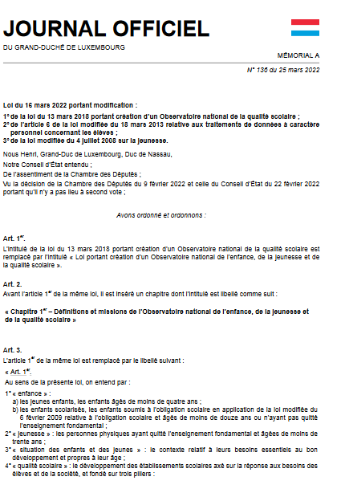
National Observatory for Children, Youth
and Quality in Education (OEJQS)
Evaluate the quality of the education system (political, institutional, schools)
Make recommandations for the development of school quality (parliament)
Contribute to an objective debate (bridgebuilder)
Notes:
At the OEJQS, our mission is to provide evidence on the quality of the education system and on the situation of children and young people.
We do not only focus on academic outcomes. We also examine broader aspects of school life, such as inclusion, equal opportunities, guidance and support, multilingualism, and students’ well-being.
Our role is to contribute to an objective understanding of educational issues and to support informed discussions about school quality.
Transition:
One of the areas where listening to learners is particularly important is school climate.

Slide 7



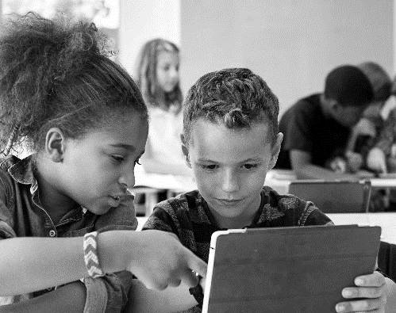

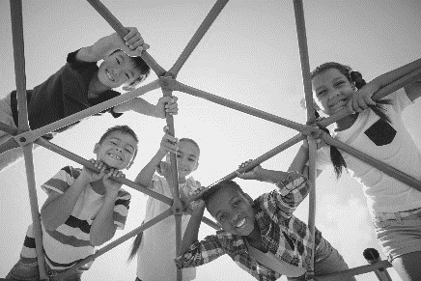
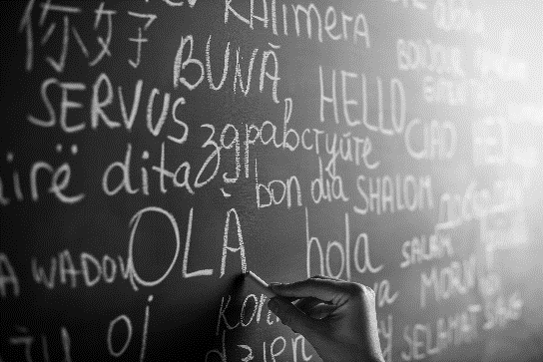
OEJQS : Evaluation topics
Guidance and support for students
School entry
Grade repetition
and its alternatives
Quality of life at school
Project School Climate
Inclusion
21st century
key skills
Equal opportunity
Multilingualism

Slide 8

Case study: School Climate
National study with pupils and teachers, in 2024
objectives
Assess student and teacher well-being
Examine perceptions of the school environment
Explore school climate, relationships, motivation, stress and support
Generating evidence to support healthier, safer and more inclusive school environments
Notes:
I will now present a concrete example: our national study on school climate.
This study was conducted in 2024 and included both students and teachers across different school settings.
The objective was to better understand how students and teachers perceive school life, including well-being, relationships, motivation, stress and support.
By collecting these perspectives, we aim to generate evidence that can contribute to healthier, safer and more inclusive learning environments.
Transition:
Let me briefly explain how we collected this information.

Slide 9





Methodology and tools
All secondary schools (ES), primary schools (EF) – Sampling (n=70)
National level
Target population
Tool: questionnaire
Teacher, students and pupils
Online multilingual (4) questionnaires
Validated questionnaire items
(ex : Benacer, ...)
Notes:
The study was conducted at national level and included students and teachers from primary and secondary education.
We used multilingual online questionnaires, with validated items covering different aspects of school experience.
The questionnaires addressed both students’ and teachers’ perspectives, allowing us to compare different experiences within the school environment.
This methodological approach helps us capture dimensions of school life that are not visible through administrative data alone.
Transition:
The questionnaire was structured around several dimensions of school climate.

Slide 10
School climate dimensions tested in the survey
Emotional dimension
Relational dimension
Pedagogical dimension
Violence
Sense of belonging
Relationships with peers
Educational practices
Sense of justice
Relationships with teachers
Class group management
Sense of security
Evaluation
Sense of performance
School climate
Notes:
School climate is a multidimensional concept.
In our study, we examined several dimensions, including emotional aspects such as belonging and feelings of safety, relational aspects such as relationships with peers and teachers, and pedagogical aspects such as educational practices and evaluation.
We also included questions related to justice, violence and students’ perception of their learning environment.
Together, these dimensions provide a more complete picture of students’ experiences at school.
Transition:
I will now share some of the main findings from the analysis.

Slide 11
Some findings : Correlations between dimensions
 | Belonging | Justice | Violence | Relationships with peers | Relationships with teachers | Educational practices | Evaluation | Safety
Belonging | 1.000
Justice | 0.3491 | 1.000
Violence | 0.2073 | 0.2615 | 1.000
Relationships with peers | 0.5482 | 0.2483 | 0.2909 | 1.000
Relationships with teachers | 0.5761 | 0.3814 | 0.2039 | 0.3978 | 1.000
Educational practices | 0.4253 | 0.3003 | 0.1417 | 0.3217 | 0.5927 | 1.000
Evaluation | 0.4479 | 0.2647 | 0.0938 | 0.3366 | 0.5410 | 0.5189 | 1.000
Safety | 0.2911 | 0.2292 | 0.4692 | 0.3373 | 0.2407 | 0.1837 | 0.1837 | 1.000
Notes:
The correlations show that several dimensions of school climate are closely connected.
For example, belonging is strongly related to relationships with teachers and peers.
This confirms that students’ school experience is multidimensional and that these aspects should be interpreted together rather than separately.
Transition:
We then looked more closely at the individual factors associated with these perceptions.

Slide 12
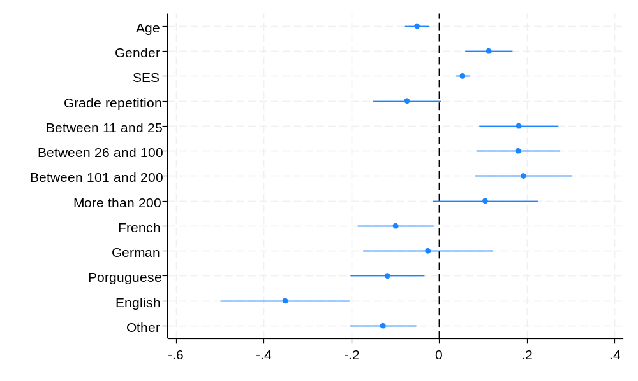
Determinants of the perceived school climate at the individual level
Note: OLS regression controlling for school fixed effects. Reference categories: boys, between 0 and 10 books, Luxembourgish as a first language.
Notes:
This analysis identifies the individual-level factors associated with students’ perceived school climate, controlling for school-level differences.
Age, gender, socioeconomic background and first language are significantly related to students’ perceptions of school climate.
Younger pupils tend to report a more favourable perception, while girls and students with more cultural resources report a more positive perception.
Differences are also observed across linguistic groups, compared to Luxembourgish-speaking students as the reference category.
Transition:
But these associations are not identical for every dimension of school climate.

Slide 13
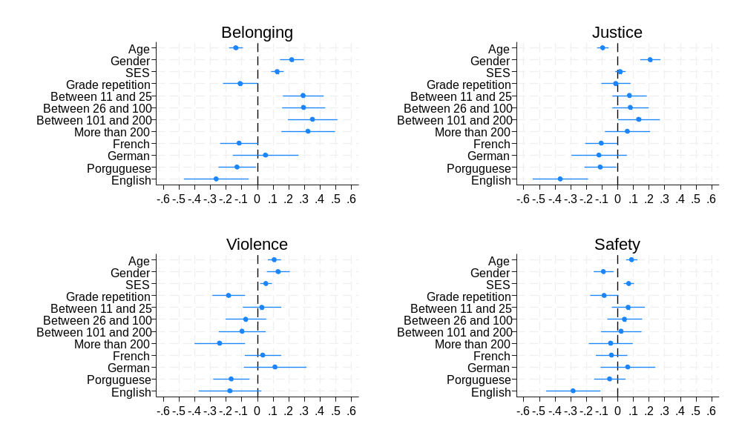
Determinants of various dimensions of school climate
Note: OLS regression controlling for school fixed effects. Reference categories: boys, between 0 and 10 books, Luxembourgish as a first language.
Notes:
When we look at the different dimensions separately, the picture becomes more nuanced.The factors associated with belonging, justice, violence or safety are not exactly the same.We also observe differences according to age, gender, socioeconomic background and first language.This highlights the importance of looking beyond an overall school climate score.Transition:Individual characteristics are only part of the picture, because the school context itself also matters.
"English-speaking students face a profound, systemic institutional mismatch that spans the entire distribution of school climate."

Slide 14
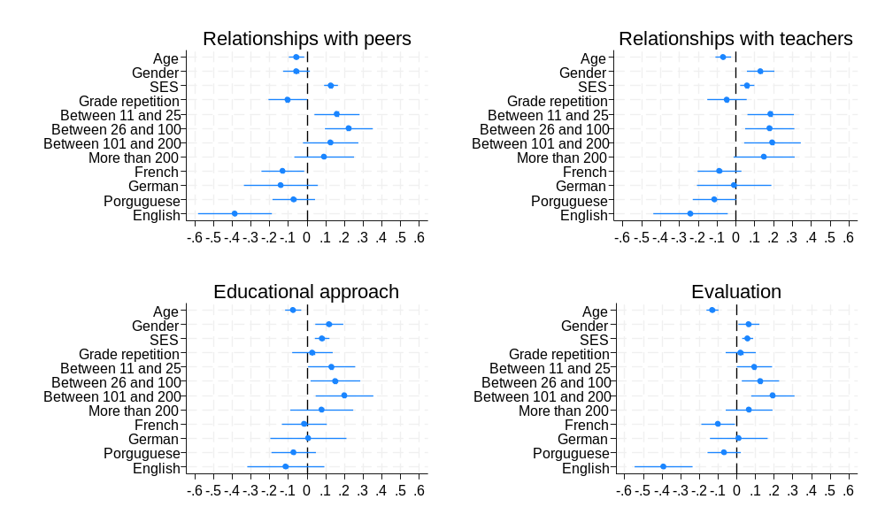
Determinants of various dimensions of school climate
Note: OLS regression controlling for school fixed effects. Reference categories: boys, between 0 and 10 books, Luxembourgish as a first language.
Notes:
Looking more closely at these dimensions helps us identify where specific groups of students may experience school differently.
It also reminds us that an overall average can sometimes hide important differences in students’ experiences.
This is particularly useful when we want to move from national findings to more targeted questions.
Transition:
And this brings us to the differences we observe between schools themselves.

Slide 15
Across-schools differences in school climate
Note: Only schools with at least 5 responding students were retained (N=44).
Notes:
This figure presents the variation in average school climate scores across schools.
While some schools show more positive perceptions of school climate, others report lower scores, highlighting differences between school contexts.
These differences are important because they show that national averages do not tell the whole story.
Beyond measuring school climate, these data can also be used as a basis for feedback and improvement at school level.
Transition:
This is exactly where the feedback process becomes important.

Slide 16
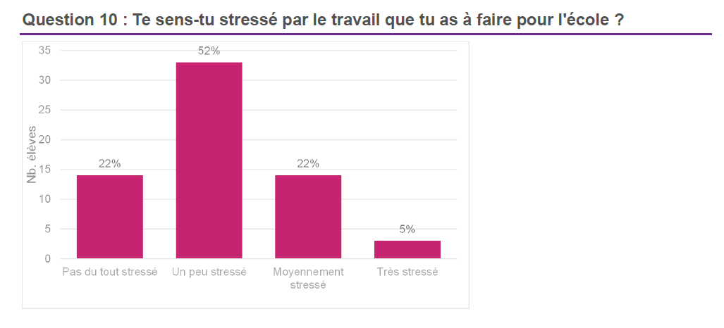
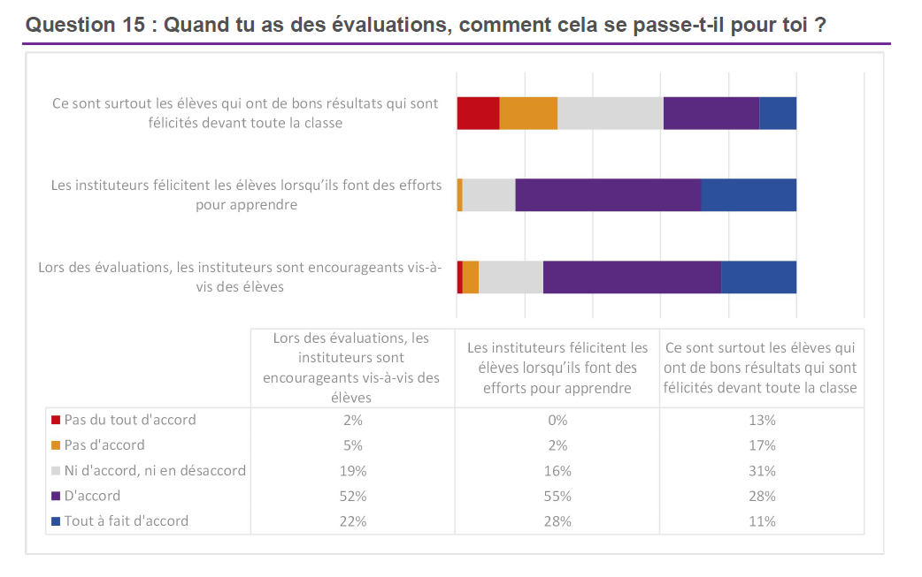

Feedback
Notes:
The results of the school climate survey are also used to provide meaningful feedback to schools.
These feedback reports give schools concrete information about students’ experiences, for example stress, assessment practices or feelings of recognition.
The objective is not only to measure school climate, but also to support reflection, discussion and improvement at school level. SICI Edinburgh 26.10.02-OEJQS_C…
Transition:
But providing data is not enough. Schools also need support to interpret and use the results.

Slide 17

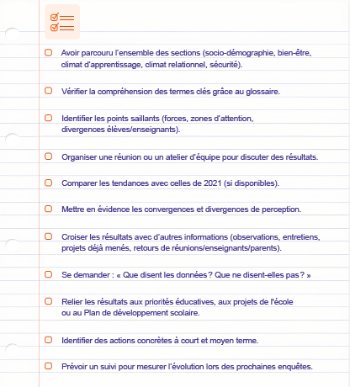
From Data to Action
Guidelines for
the use of the report
Notes:
To facilitate the use of the results, we developed a data literacy guide for schools.
It helps school teams interpret the indicators, reflect on their own context and identify possible areas for action.
The aim is to move from simply receiving data to actually using evidence as part of the school improvement process. SICI Edinburgh 26.10.02-OEJQS_C…
Transition:
This is also where inspection can play an important role.

Slide 18
Our role in regional inspection
Bring evidence into dialogue with the school committee
Compare it with local observations and school data
Help choose a manageable development priority
Notes:
At school level, the role of inspection is to bring evidence into dialogue with the school committee.
National findings can be compared with local observations, school data and the experiences of pupils.
The objective is then to help the school identify a realistic and manageable development priority. SICI Edinburgh 26.10.02-OEJQS_C…
Transition:
This dialogue can start with a few very simple questions.

Slide 19
A school development conversation
“What do our pupils experience?”
“Where does that match or challenge our assumptions?”
“What shall we change, and how will we know?”
Notes:
The first question is: What do our pupils actually experience?
Then we can ask: Does this confirm or challenge what we already think we know about our school?
And finally: What can we change, and how will we know whether that change has made a difference?
Transition:
And importantly, this process should not end once a decision has been made.

Slide 20
Closing the feedback loop
Tell pupils what we heard
Show which decision their views informed
Return to them to test whether it helped
Notes:
If we ask pupils for their views, it is important to come back to them afterwards.
We should tell them what we heard, explain how their views informed a decision, and then ask again whether the change actually helped.
In this way, student voice becomes part of an ongoing cycle of evaluation and improvement, rather than a one-off consultation. SICI Edinburgh 26.10.02-OEJQS_C…
Transition:
Of course, moving from student voice to real change is not automatic, and there are still some important challenges.

Slide 21
Limits
A lot of schools have put in place class- or school committees/parliaments.
But what are they discussing?
Teachers are not all ready for Feedback literacy
Who turns that evidence into a school decision?
Role of the inspection in the school developpment process
Accept that the pupils can have a voice
Notes:
Many schools already have class councils, school committees or student parliaments, but the key question is: what are students actually invited to discuss?
Another challenge is feedback literacy: not all teachers or school teams are equally prepared to receive, interpret and act on feedback from pupils.
We also need to clarify who is responsible for transforming this evidence into decisions and what role inspection can play in supporting the school development process.
Ultimately, meaningful participation also requires adults to accept that pupils can have a genuine voice in discussions about school quality. SICI Edinburgh 26.10.02-OEJQS_C…
Transition vers la conclusion :
So the challenge is not only to listen to learners, but to create the conditions for their voices to have meaning within evaluation and school development.

Slide 22
Thank you!
Listening is only the first step — what matters is what we do with what we hear.
Notes:
To conclude, listening to learners gives us access to an important part of school quality that traditional indicators cannot capture on their own.
But collecting student voice is only the beginning. The real value comes when this evidence is interpreted, discussed and translated into action.
Thank you very much for your attention. We look forward to discussing these questions with you.

