Slide 1
Learner Voice as Evidence: Finnish experiences from national evaluation
Niina Rumpu, FINEEC

Slide 2
Evaluation instead of inspection
In Finland, the roots of evaluation of education are in school inspection activities and international school examinations.
The inspection system was abandoned in the 1990s.
Our current education system is based on guidance, autonomy and trust.
Education providers have a legal duty to
  evaluate the education they provide (self-evaluation)
  participate in external evaluations (e.g. the national assessments of learning outcomes, thematic and system-wide evaluations, international assessments)
  publish the results
“The purpose of the evaluation of education is […] to support educational development and to improve conditions for learning.”

Slide 3
Enhancement-led evaluation
An evaluation method which engages and assigns responsibility to the participating educational organisation for developing its activities
The method is based on trust between the evaluators and participants
Evaluation methods are customised to each individual case
Builds a shared understanding of the theme to be evaluated
The enhancement-led approach is based on law: “The operations of the Finnish Education Evaluation Centre shall be based on the principles of independent evaluation and enhancement-led evaluation.”

Slide 4
Why enhancement-led evaluation?
High level of autonomy of teachers and schools
High-quality teacher education
Culture of trust (no rankings)
The concept of using evaluation to support improvement

Slide 5
Why is it important to hear learners as part of the evaluations?
The Finnish National Core Curriculum strongly emphasizes the participation of learners as part of the school’s activities → therefore FINEEC is also interested in hearing learners’ voices in our evaluations
Learners have important information about the theme in question, sometimes from a different angle than the school staff or the evaluators → pre-testing and pre-hearings can bring out new and important views
Learners are the most authentic source of information on issues that affect their own lives.
Gives learners an opportunity to be heard and see how they can influence education.

Slide 6
How do learners participate in FINEEC’s evaluations?
Questionnaires
  Pre-testing the questions
    Are the themes and questions relevant from the learners’ perspective?
    Have we overlooked any important aspects?
  Informants
    Personal opinion
    Sensitive questions (bullying, health, social relationships etc.)
Why wasn’t there a single question in the whole survey asking what’s wrong with the assessment? It’s as if people think the assessment is absolutely brilliant and always works. It isn’t.
How often do you skip lessons even though you’ve come to school?
How often do you miss school without a valid reason?

Slide 7
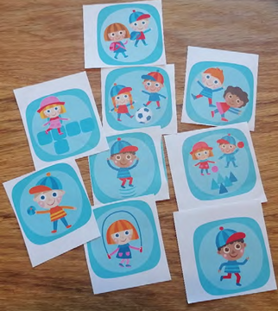
How do learners participate in FINEEC’s evaluations?
Interviews
  Pre-interviews help focus the evaluation on the most relevant issues.
  Individual or group interviews
    To gain a deeper understanding on the phenomenon
    Help evaluators gain a better understanding of schools’ or classrooms’ practices
    It is easier for young learners to talk to a stranger if they are accompanied by friends they know

Slide 8
How do learners participate in FINEEC’s evaluations?
Members of the evaluation group
  Usually representatives of the students’ union
  Help FINEEC’s advisors in the evaluation process: planning, interpreting the results, making recommendations

Slide 9
How learner voice is reported in evaluation findings

Slide 10
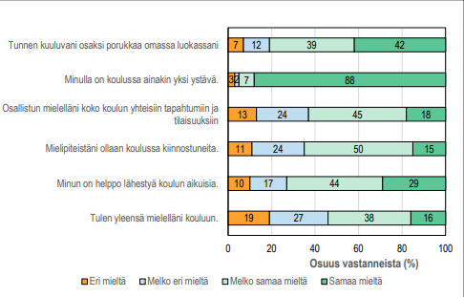
Learners’ views on the evaluated theme
I feel that I belong to the group in my class.
I have at least one friend at school.
I gladly participate in events and activities organized for the whole school.
People at school are interested in my opinion.
I find it easy to approach adults at school.
I usually enjoy coming to school.
Percentage of respondents (%)
Disagree
Somewhat disagree
Somewhat agree
Agree

Slide 11
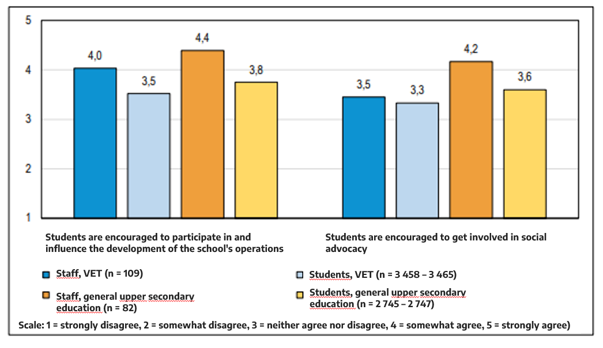
A comparison of staffs and learners’ views on the same thing

Slide 12
More detailed analysis of the open-ended questions
In my opinion, good assessment is … (number of statements) | Frequency (f) | Percentage (%)
Fair, just and equitable | 1201 | 37
Honest and well-justified honest, truthful, recognizes actual competence (247) reasoned, well-considered (178) explained in a way that learners can understand (65) identifies individual mistakes (36) | 526 | 17
Versatile and multifaceted | 504 | 16
Encouraging and developmental encouraging, constructive, positive (254) developmental, forward-looking, essential for learning (146) appropriately strict and lenient (163) | 461 | 14
Effective communication numerical grading (163) written and oral feedback (81) interactive (32) | 276 | 9
A good grade (grades 8–10) | 145 | 4
Other characteristics of good assessment | 93 | 3
Total | 3206 | 100

Slide 13
Making categories and presenting the main points of the interviews
In the context of hobbies, the opportunity to talk with other participants was considered important. For many, simply engaging in an enjoyable activity was not enough if there was no opportunity to discuss things and share personal experiences. The presence of friends and doing things together with them added value to the hobby. Hobby activities also provided an opportunity to spend leisure time with friends outside of school.
“In our group, we're allowed to chat. In fact, the instructor often tells us to talk a bit more because we're usually so quiet.” (Primary school student)
“If there are other people there that you know, it's nice to go with someone. And if someone tells you what's planned for the next session, it makes you want to go.” (Lower secondary school student)

Slide 14
How is the information used?

Slide 15
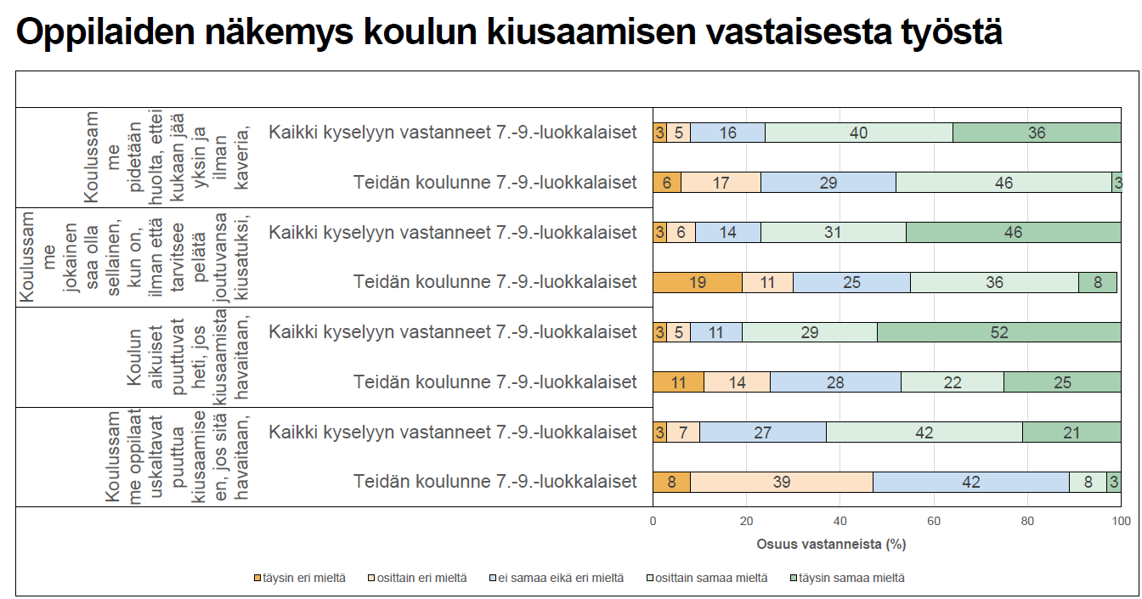
School-specific feedback
In every evaluation we give feedback to the sample schools of their results compared to the national level.
Students’ views on the school’s anti-bullying work
At our school no one is left alone.
All survey respondents
Students at your school
At our school everyone can be themselves without having to fear being bullied.
All survey respondents
Students at your school
School staff intervene immediately when they observe bullying.
All survey respondents
Students at your school
At our school, students dare to intervene when they witness bullying.
All survey respondents
Students at your school
Persentage of respondents (%)

Slide 16
Recommendations
In every evaluation FINEEC gives recommendations on what should be improved.
Recommendations are based on the results of the evaluation.
Recommendations can be directed to different levels (teachers, school, education providers, national level)

Slide 17
Example: Students’ growth into active and critical citizens in upper secondary education
According to the results: Students’ opportunities to participate in decision-making are usually well communicated at educational institutions, and for the most part students are aware of how and what they can influence. Educational institutions collect feedback about their operations, but the processing of this feedback with students is infrequent.
Recommendation: Education providers and educational institutions should offer students diverse ways of participating and exerting influence.
Students should be provided with various and alternative ways to participate and influence the operations of the educational institution.
The collection of student feedback and the processing of feedback with students should be a systematic part of the educational institution’s everyday operations in order to strengthen community cohesion.

Slide 18
Example: Evaluation of anti-bullying methods
Recommendation: The role of pupils and guardians in the anti-bullying work of schools should be strengthened.
According to the evaluation results, pupils would like to be more involved in the anti-bullying work of their own schools. The involvement of pupils is relevant from the point of view of the outcomes of anti-bullying work. The school community should provide sufficient opportunities and space for the pupils’ own activities that strengthen anti-bullying norms among pupils and support everyone being able to feel like an important member of the school community.

Slide 19
What impact do FINEEC’s evaluations have?
We have reviewed the results with our staff and, based on them, have considered concrete development ideas for our upper secondary school.
Schools and education providers can focus on the issues they consider most important to improve.
Evaluation findings support national decision-making, policy development and the allocation of targeted funding.
We discuss the matter in the school's student welfare team and leadership team. We consider how we can make use of the information gathered in the everyday life of the school. Our goal is to engage both students and guardians, together with the school staff, in working for the benefit of the entire school community.

Slide 20
Conclusion
Learner voice is evidence
  Learners provide information that others cannot.
Learner voice improves evaluation quality
  Evaluations become more relevant and accurate.
Learner voice promotes participation
  Being heard encourages learners to engage in improving education.

