Slide 1
Using student voices through survey data for inspections
Malin Karikoski
The Swedish Schools Inspectorate
SICI – Oct 2026

Slide 2
Presentation outline
A brief introduction to the Swedish Schools Inspectorate
Introduction to the Swedish School Survey: what is it and what do we learn?
Cognitive interviews – why?
Using the results in our inspection
Final remarks & questions

Slide 3
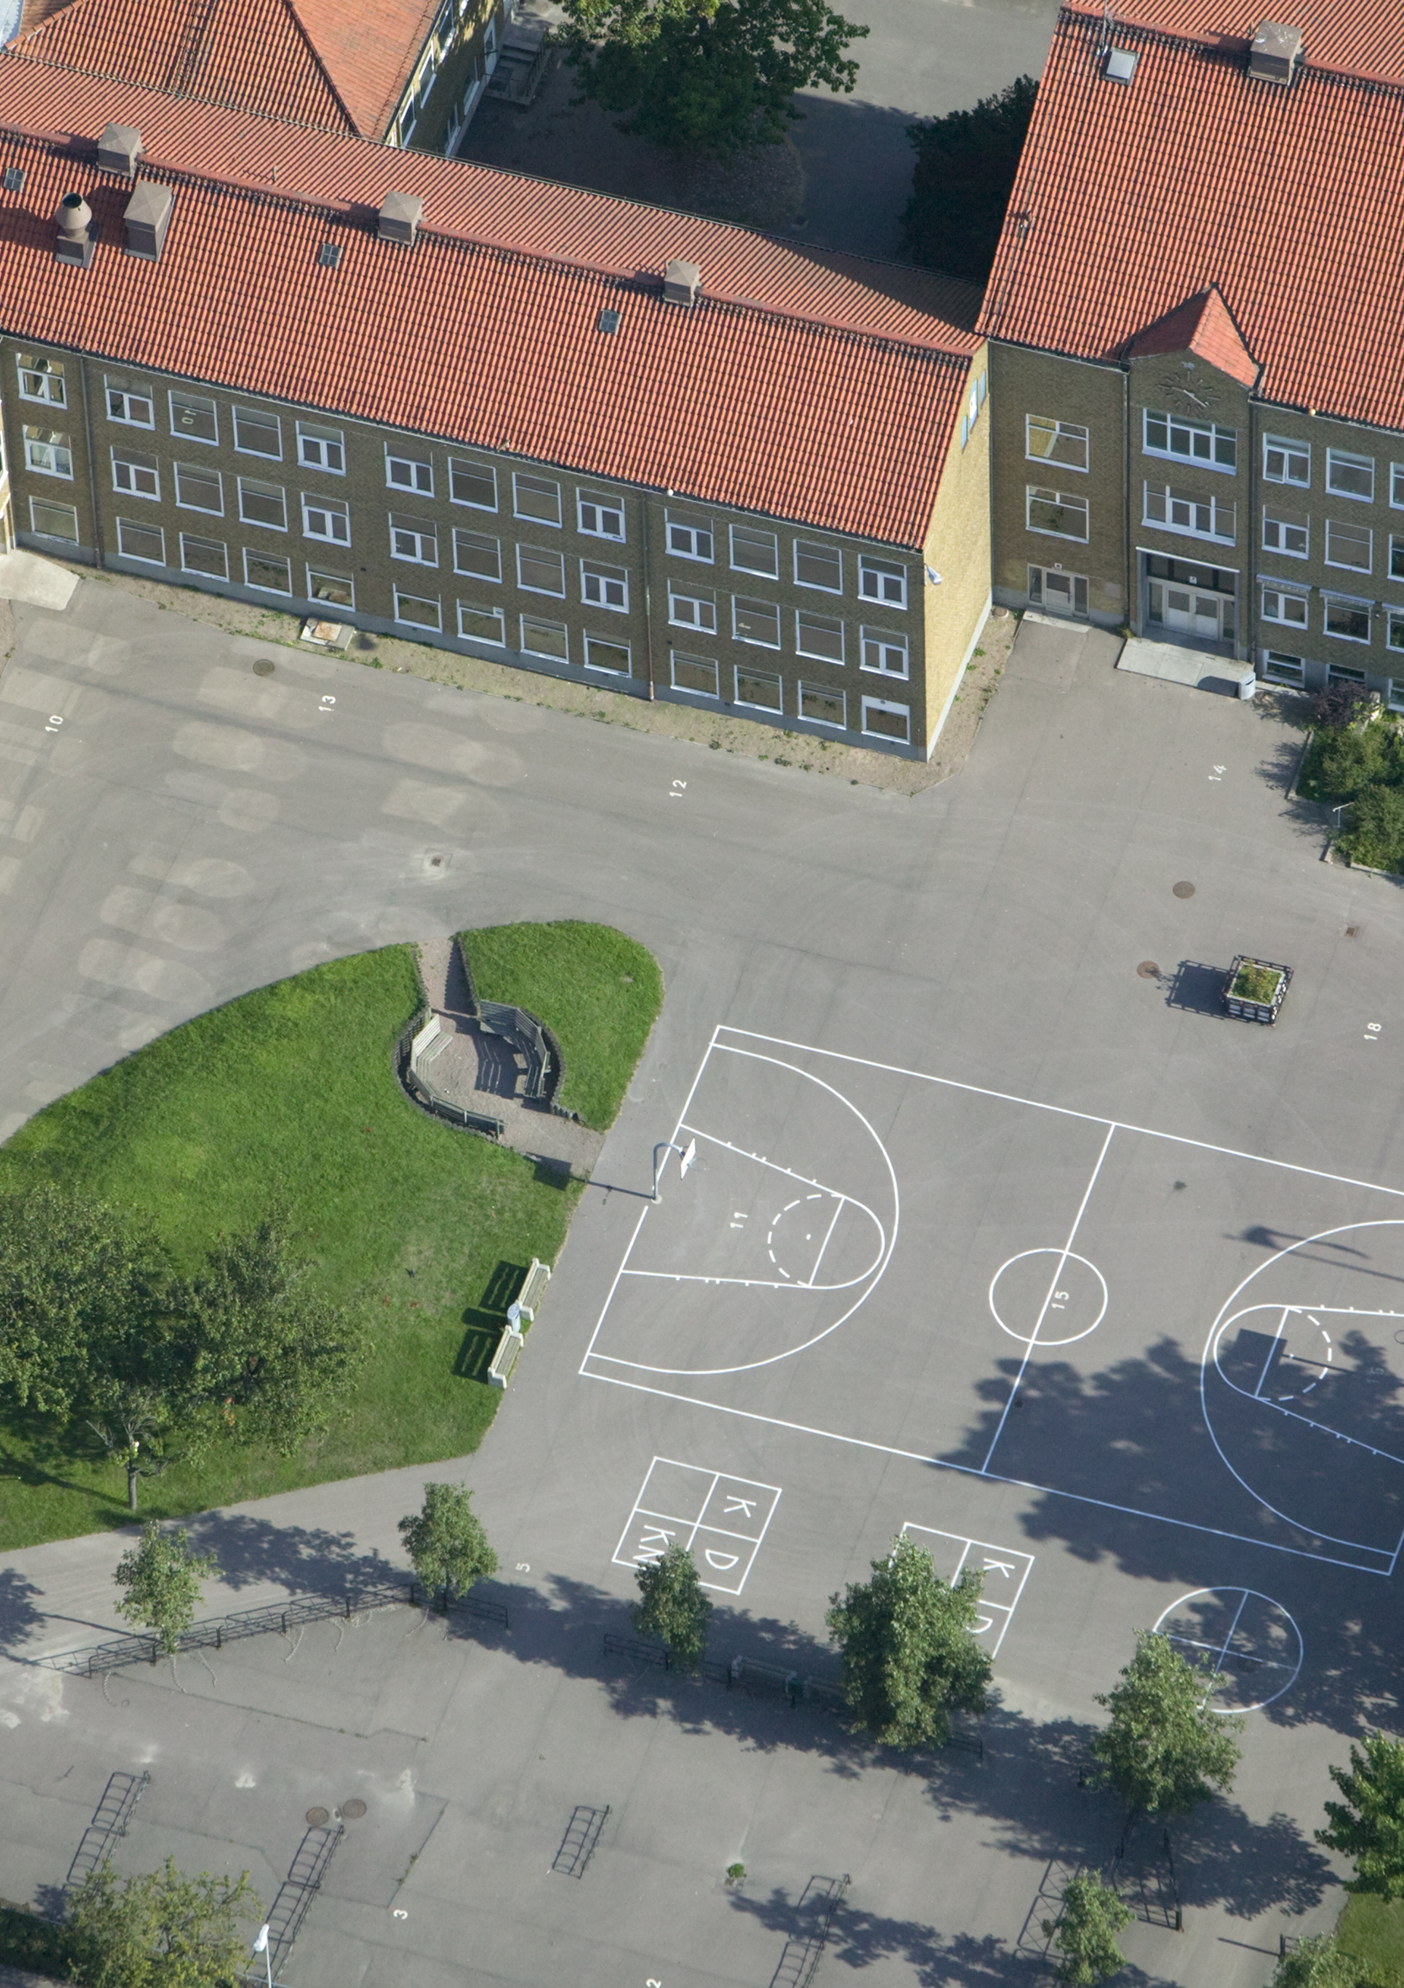
The Swedish Schools Inspectorate
“The Swedish Schools Inspectorate shall through the inspection of education providers and schools promote that all children and pupils have access to educational equity and education of good quality in a safe environment”
Risk-based selection of schools or providers
Supervision
Quality audits

Slide 4


The Swedish School Survey
A yearly online survey
All schools within a 2-year period
Three questionnaires:
  Students ages 11, 14 and 17
  Guardians
  Teachers

Slide 5

Why do we do the survey?
The School Survey results are used…
The Swedish Schools Inspectorate assesses schools throughout the country to ensure that they comply with applicable laws and regulations. The aim is to contribute to every child’s and student’s equal right to a high-quality education in a safe environment. The School Survey is one of several sources of information used in the inspection of schools, and the responses help us gain as accurate a picture of each school as possible.
… by inspectors when planning and performing inspections
… in the risk-analysis of schools (to select schools in need of inspection)
… in Goverment-sponsored site: ”the school guide”
… for a national analysis and follow-up of central topics

Slide 6
Some School Survey Stats - 2026
3089 schools
385 000 responses from:
153 000 students
47 000 teachers
186 000 guardians

Slide 7
Some topics in the questionnaires
 | Pupils | Teachers | Parents
Study environment | X | X | X
Student safety | X | X | X
Support in teaching | X | X | X
Stimulating teaching | X | X | X
Pupils´ health team | X | X | X
Pupils´ influence | X | X
Critical thinking | X | X
School leadership |  | X
Special support |  | X

Slide 8

Questions about student safety
Parents are asked:
Do you believe your child feels afraid of other children in school?
Do you believe your child feels afraid of teacher or other adults in school?
Do you believe your child can be themselves in school?
Do you believe your child feels safe in school?
Students are asked:
Do you feel afraid of other students in school?
Do you feel afraid of teachers or other adults in school?
Do you feel like you can be yourself in school?
Do you feel safe in school?
Teachers are asked:
Do you believe students can be themselves in school?
Do you believe students feel safe in school?

Slide 9
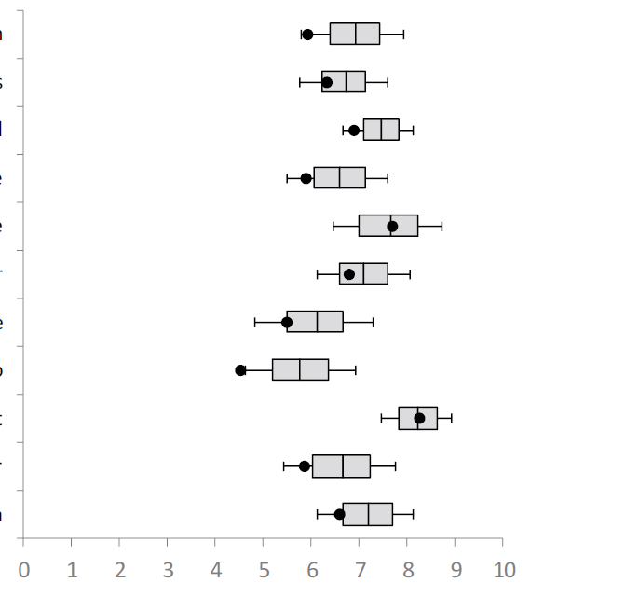
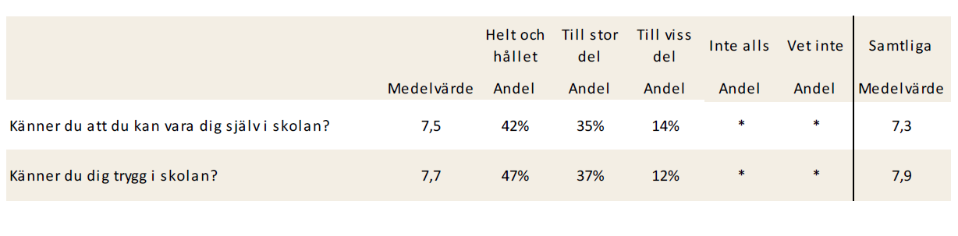
Example results from latest survey
Information from teachers
Stimulating teaching
Support in teaching
Chritical thinking
Treatment by teachers
Treatment by pupils
Pupils´ influence
Study environment
Student safety
Prevention of violations
Pupils’ health team
Do you feel like you can be yourself in school?
Do you feel safe in school?

Slide 10
Redevelopment of the survey
From students in Year 9 to Year 8
From statements to direct questions
Reduction in amount of survey versions
Simplification of questions

Slide 11

Cognitive interviews
A method used to test responses to survey questions and the process they go through to answer a question.
Ensures questions that are easy to understand and correctly interpreted.
14
What are they?
How many?
What did we find?

Slide 12

The journey of the survey results: risk-analysis
Survey results are used in risk-analysis for selection of schools for inspection
Grades & test scores
Low teacher qualifications
Signals
Other information
Safety and study environment

Slide 13
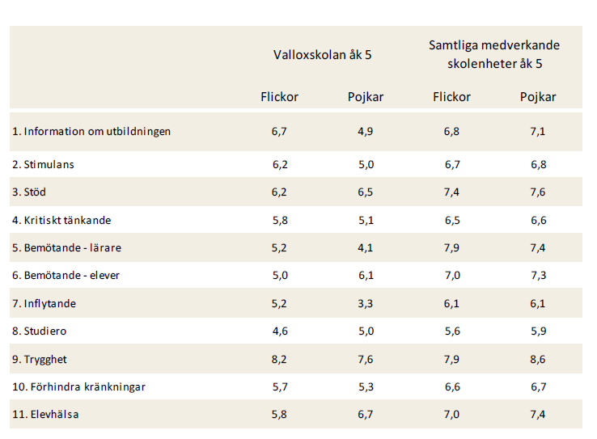
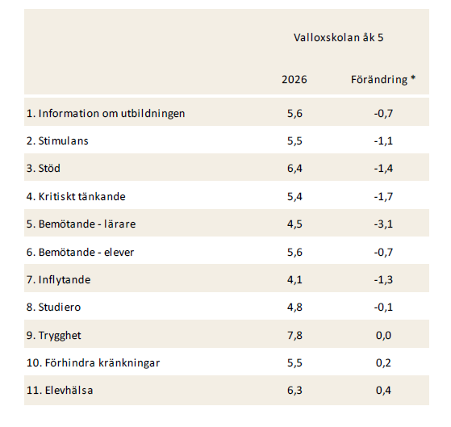
The journey of the survey results: pre-analysis
Girls / Boys
Change from last time the school participated
Analysis of various statistics using “inspector tool” and survey reports

Slide 14


The journey of the survey results: during and after inspections
Using survey results in interviews with students during inspections
Using survey results when writing assessments for the school

Slide 15
Questions?

