Slide 1

Presentation from proposed new members National Education Inspectorate, Jamaica State Education Quality Service (SQES), Latvia

Slide 2
Business Meeting
General Assembly
Malta
21.11.2024

Slide 3
Agenda
1. Policy & strategy
The strategic plan 2021-2025
2. Activities report
Activities and cooperation between SICI members
Calendar
Priority theme 2024
3. EC
Elections and re-elections
4. Financial report
Auditors
Financial statements
SICI budget 2024
SICI budget 2025
Agenda
Policy & strategy
Activities report
EC
Financial report

Slide 4

1. Policy & strategy

Slide 5
Aims from Strategic plan 2021-2025: Overview of realization of activities
Agenda
Policy & strategy
Activities report
EC
Financial report
AIM 1: Support improvement of inspectorates and the professional competence of inspectors
AIM 2:
Promote and support partnership and cooperation between inspectorates
AIM 3:
Participate actively in the international debate about evaluation and quality improvement in education

Slide 6
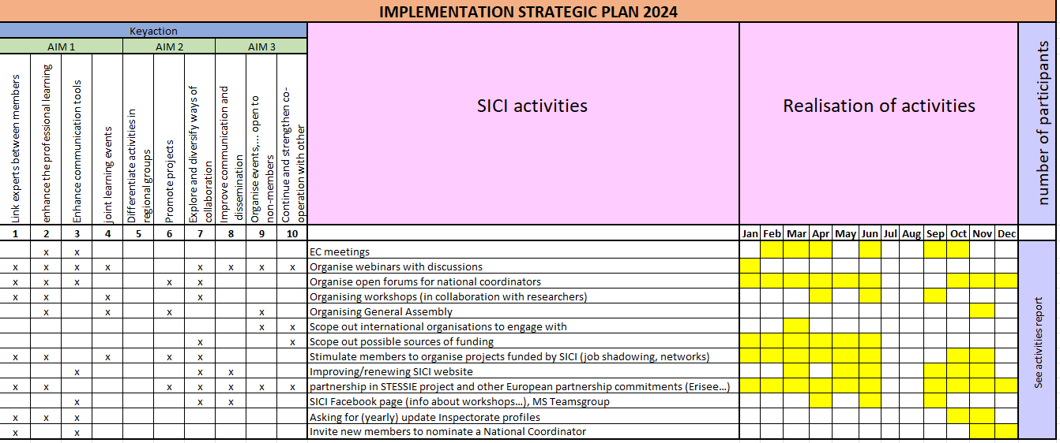
Aims from Strategic plan 2021-2025: Overview of realization of activities

Slide 7
2. Activities report

Slide 8
Activities between two General Assemblies 2023-2024
Agenda
Policy & strategy
Activities report
EC
Financial report
Date | Online/on site | Title | NoP
15 – 17 November 2023 | Bilbao, Basque Country | SICI General Assembly 2023 | 66
25 January 2024 | (Webinar) MS Teams | SICI project on “Supervision of education related to the development of civic values and skills” | 201
11 – 12 April 2024 | Limassol, Cyprus | Inspection in a challenging world: “Navigating change and adapting inspection practices” | 50
13 – 14 June 2024 | Tartu, Estonia | Inspection and school autonomy: benefits and challenges in a changing world | 55
18 – 20 September 2024 | Predeal, Romania | AI Frontiers in Inspection Adapting to a New Era | 26

Slide 9
Comparison of the number of participants and the number of members that participated in the workshops in two periods
 | 2014 (GA + 4 WS) | 2015 (GA + 4 WS) | 2016 (GA + 3 WS) | 2017 (GA + 3 WS) | 2018 (GA + 3 WS) | 2019 (GA + 3 WS) | 2020 (GA + 2 WS) | 2021 (GA + 6 WS) | 2022 (GA + 4 WS) | 2023 (GA + 4 WS) | 2024 (GA + 4 WS)
No. of participants including hosts | 288 | 211 | 277 | 170 | 159 | 241 | 224 | 664 | 536 | 259 | 398
No. of SICI members | 30 | 35 | 36 | 37 | 37 | 39 | 42 | 42 | 43 | 42 | 43
No. of members that participated in workshops | 22 | 31 | 32 | 28 | 32 | 35 | 35 | 40 | 38 | 34 | 41
No. of members that did not participate in workshops | 8 | 4 | 4 | 9 | 5 | 4 | 7 | 2 | 5 | 8 | 2
Agenda
Policy & strategy
Activities report
EC
Financial report

Slide 10
Other activities
Agenda
Policy & strategy
Activities report
EC
Financial report
National Coordinators Open Forums
ETF – Skills lab network of experts
BIBESOIN → STESSIE
Job shadowing and study visits
Update inspection profiles
New SICI website

Slide 11

Other activities - STESSIE
Agenda
Policy & strategy
Activities report
EC
Financial report

Slide 12
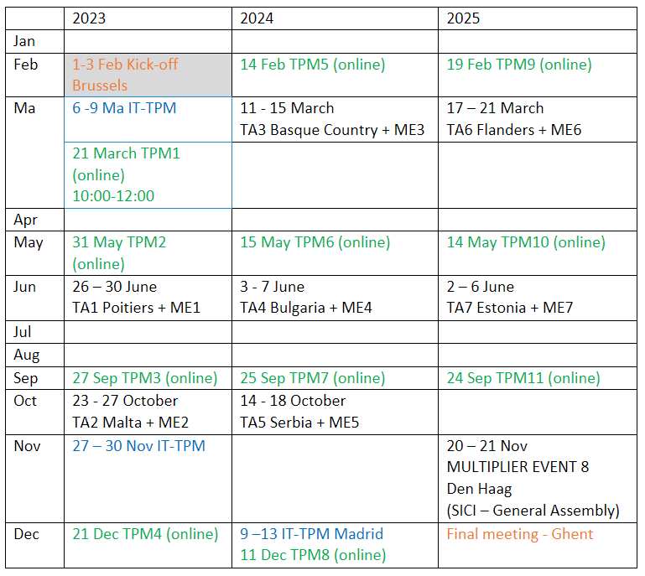
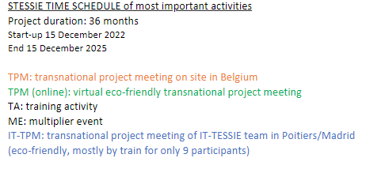
Other activities - STESSIE
Agenda
Policy & strategy
Activities report
EC
Financial report

Slide 13
Other activities
Agenda
Policy & strategy
Activities report
EC
Financial report
National Coordinators Open Forums
ETF – Skills lab network of experts
BIBESOIN → STESSIE
Job shadowing and study visits
Update inspection profiles
New SICI website

Slide 14
Other activities – new SICI website
Agenda
Policy & strategy
Activities report
EC
Financial report
Launch new website
www.sici-inspectorates.org

Slide 15
Calendar 2024-2025
Agenda
Policy & strategy
Activities report
EC
Financial report
Date | Online/on site | Title
(20) - 21 – 22 November 2024 | Malta | “General Assembly”
(28) – 29 – 30 April 2025 | Kosovo* | SICI Workshop
(11) - 12 - 13 June 2025 | Georgia | SICI Workshop
(24) - 25 -26 September 2025 | Bavaria | SICI Workshop
(19) - 20 – 21 November 2025 | The Netherlands | “General Assembly”

Slide 16
Priority theme 2024-2025
Agenda
Policy & strategy
Activities report
EC
Financial report
Continuation of the theme on “Inspecting in a rapidly changing environment”
Subthemes:
Inspection skills and competences in a changing educational and evaluation context (Kosovo)
Navigating the intersection between national/regional inspection systems and international/European programmes and audits in a transformative education landscape (Georgia)
The essential role of inspection in a dynamic educational environment: challenges, opportunities and impact (Bavaria)

Slide 17
New SICI members
Agenda
Policy & strategy
Activities report
EC
Financial report
2024:
National Education Inspectorate, Jamaica
State Education Quality Service (SQES), Latvia

Slide 18
New members
VOTE
for the new SICI members
Agenda
Policy & strategy
Activities report
EC
Financial report

Slide 19
3. EC

Slide 20
Executive Committee
Agenda
Policy & strategy
Activities report
EC
Financial report
Pathway into our fourth decade
From a community of 8 to an organization of 43
30th anniversary
Future action:
New strategic plan in 2025
Revision of statutes

Slide 21
Executive Committee
Agenda
Policy & strategy
Activities report
EC
Financial report
Name | Nominated | Last re-election | Re-eligible
Ana Pires | November 2020 | November 2023 | November 2026
Janie McManus | November 2020 | November 2023 | November 2026
Wilma Brings | November 2022 |  | November 2025
Joa Baum | November 2022 |  | November 2025
Pádraig Mac Fhlannchadha | November 2022 |  | November 2025
Erik De Bou (development officer) | Appointed | November 2024
Joa Baum | Secretary-general

Slide 22
4. Financial report

Slide 23
Auditors
Agenda
Policy & strategy
Activities report
EC
Financial report
2024:
Denise Gatt (Malta)
Ronny Alver Gursli (Norway)
Margit Schmidbauer (Germany-Bavaria)
→ online meeting before the General Assembly:
The auditors have approved the financial statements and expressed their support of the proposed budget 2025 during the online meeting on 19/11/2024.

Slide 24
Auditors
Agenda
Policy & strategy
Activities report
EC
Financial report
VOTE
for the auditors in 2025

Slide 25
SICI budget categories
SICI budget 2018
Fixed costs – managing SICI
Variable costs – implementing SICI priorities
Salaries secretariat
Liability insurance AIG Europe
Bookkeeping
Cooperation - projects of members
SICI refunds
General Assembly
Website
Operational costs EC
Development officer
Miscellaneous costs
National coordinators
Organisation Workshops
Agenda
Policy & strategy
Activities report
EC
Financial report

Slide 26
Financial statements 31.12.2023
Agenda
Policy & strategy
Activities report
EC
Financial report
Statement of revenue and expenditure in 2023
Expenditure | Revenue
€ 89 654,18 | € 112 299,53
Difference: € 22 645,35
Account Balance
01.01.2023 | € 276 741,54
31.12.2023 | € 334 905,20
 | Difference = € 58 163,66

Slide 27
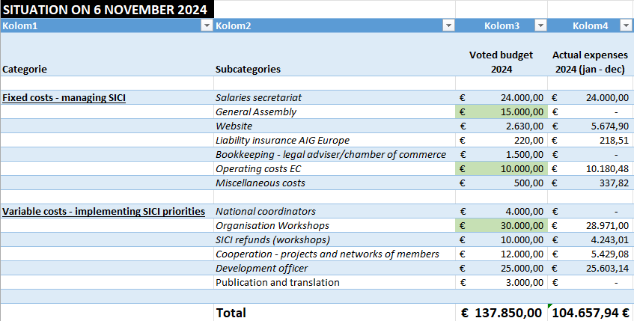
SICI budget 2024 (Financial situation on 6.11.2024)
Agenda
Policy & strategy
Activities report
EC
Financial report

Slide 28
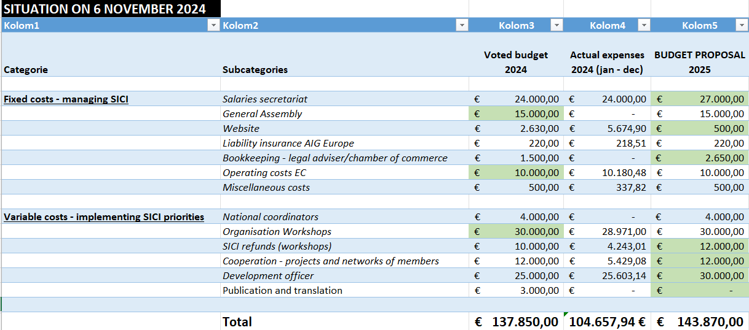
SICI budget proposal 2025
Agenda
Policy & strategy
Activities report
EC
Financial report

Slide 29
SICI budget 2025
VOTE
for the proposed budget 2025
Agenda
Policy & strategy
Activities report
EC
Financial report

Slide 30
AOB

