Slide 1
Polycentric inspections in Bulgaria to evaluate and solve local and context-specific problems
Assoc. Prof. Dr. Rossitsa Simeonova Dr. Vanya Kastreva Sofia University “St. Kliment Ohridski” Regional Department of Education
Sofia-city
SICI workshop
Tirana, 24 November 2016

Slide 2
Contents
An EU-funded study on ‘polycentric inspections’
PINS project’s aim and partners in Sofia
Education system and school inspections in Bulgaria - the context of testing new modes of inspection
PINS project’s phases and Sofia network activities
Polycentric inspection of Sofia network of schools – activities, products and results
Dissemination activities of Sofia network
Q&A session
Erasmus+ 2014 Key Action 2 (KA2), Strategic Partnerships Project
Project name: | Polycentric inspections of networks of schools
Reference number: | 2014-1-UK01-KA200-001798

Slide 3
1. An EU-funded study on ‘polycentric inspections’
Research question:
How can Inspectorates evaluate the functioning of these networks (through ‘polycentric inspections’)?
How can Inspectorates improve the performance of these networks?
Polycentric inspections:
Evaluate and assess the quality and functioning of networks of schools and/or their stakeholders, with the purpose of validating and supporting improvement and decision-making at the local level.
Erasmus+ 2014 Key Action 2 (KA2), Strategic Partnerships Project
Project name: | Polycentric inspections of networks of schools
Reference number: | 2014-1-UK01-KA200-001798

Slide 4
An EU-funded study on ‘polycentric inspections’
We are addressing these questions in EU Erasmus+ KA2 funded study which started in September 2014 and will end in September 2017. In this project we have four countries which all have examples of schools working in partnerships and Inspectorates of Education who face the challenge of adapting their inspection methods to this networked education system.
In England, academies are collaborating in Multi-Academy Trusts and OFSTED has developed focused inspections and MAT reviews to evaluate the collaboration between schools in the Trust and how the Trust supports school improvement.
In Netherlands, schools are required to cooperate in networks to provide inclusive education under a new education authority, so that, each student with special education needs becomes the responsibility of the whole network. Inspections include the effectiveness of the network in providing such inclusive education.
In Northern Ireland we have an example of stakeholders in the West Belfast area who have regular meetings to agree on provision and improvement. The Inspectorate is part of these meetings and evaluates the outcome of the partnership work.
In Bulgaria, a network of 10 schools is developing peer review models and the Inspectorate of Education aims to adapt their inspections to the topics and outcomes of these peer review models.
In our project we aim to map these good practices and aim to evaluate the impact that school inspections have on the partnership work of schools.
In our EU funded study we have suggested ways in which inspections can change their working methods to fit a more polycentric education system.
Erasmus+ 2014 Key Action 2 (KA2), Strategic Partnerships Project
Project name: | Polycentric inspections of networks of schools
Reference number: | 2014-1-UK01-KA200-001798

Slide 5
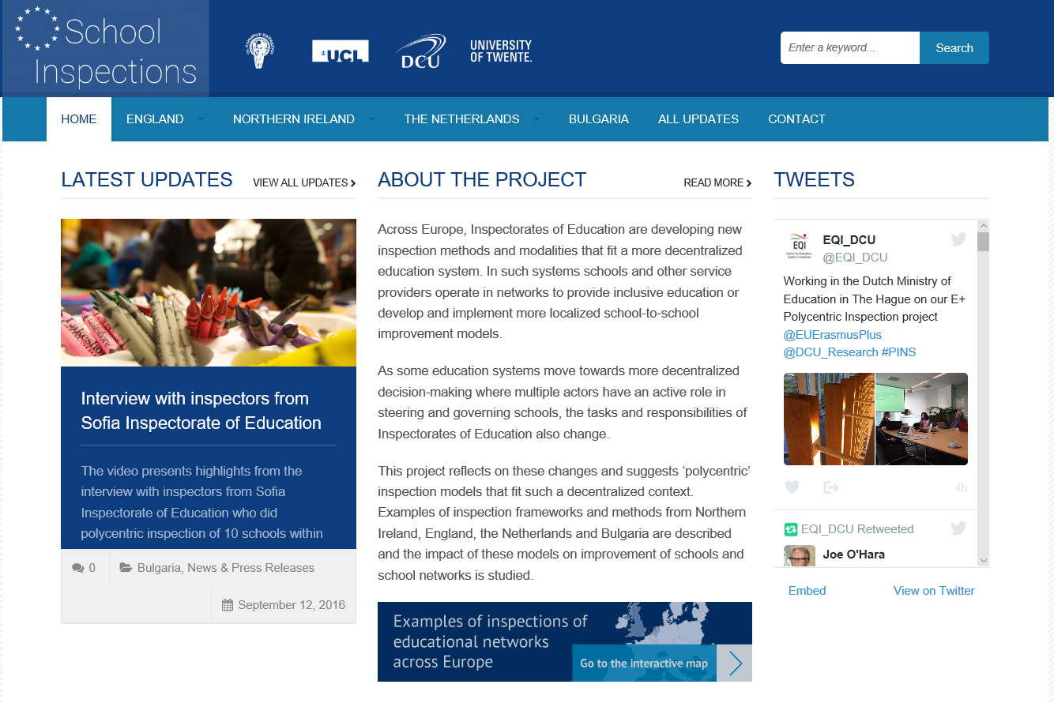
http://www.schoolinspections.eu/
Erasmus+ 2014 Key Action 2 (KA2), Strategic Partnerships Project
Project name: | Polycentric inspections of networks of schools
Reference number: | 2014-1-UK01-KA200-001798

Slide 6
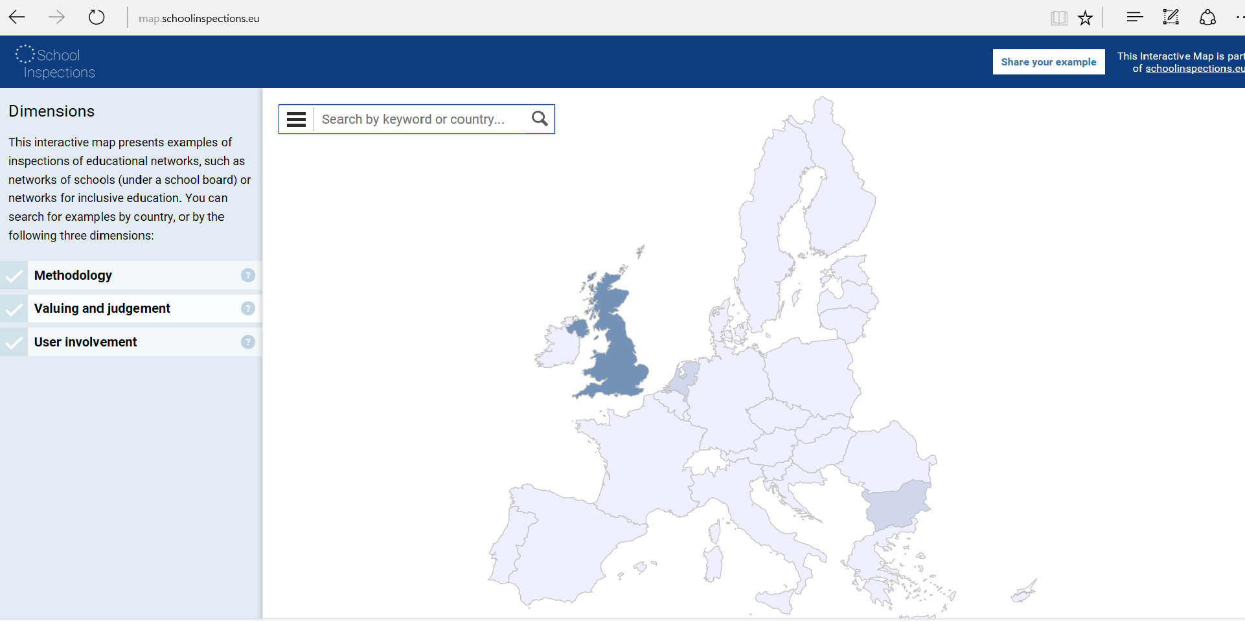
Interactive map: examples of inspections of educational networks across Europe www.map.schoolinspections.eu Submit your example!
Erasmus+ 2014 Key Action 2 (KA2), Strategic Partnerships Project
Project name: | Polycentric inspections of networks of schools
Reference number: | 2014-1-UK01-KA200-001798

Slide 7
Interactive map: www.map.schoolinspections.eu
Examples of inspections of networks are published on an interactive map according to 3 dimensions:
Methodology
Involves the collection and analysis of empirical data for the study and judgment of educational quality (e.g. quality of schools and educational networks). This section provides examples of frameworks and instruments used in the inspections of (formal and informal) networks of schools.
Valuing/judgement
Involves the making of value judgments about the quality of some object, situation or process. Here you can find examples of how Inspectorates of Education value and judge the quality of educational networks: which criteria do they use, and how do they come to an overall judgement on the quality of networks, and how are stakeholders (e.g. schools, school governing bodies) involved in deciding on those criteria?
Erasmus+ 2014 Key Action 2 (KA2), Strategic Partnerships Project
Project name: | Polycentric inspections of networks of schools
Reference number: | 2014-1-UK01-KA200-001798

Slide 8
Interactive map: www.map.schoolinspections.eu
User involvement
Involving stakeholders (e.g. parents, school staff, school governing bodies, local authorities) in developing frameworks for their inspections of educational networks, as well as in the actual inspections itself.
Involvement can range from consultations on frameworks and quality standards for the evaluation of networks, incorporating standards set by networks in their inspection frameworks, setting the agenda for the inspection with stakeholders in the network, interviewing stakeholders during an inspection to learn about the quality of educational networks, to discussing and deciding on outcomes and consequences of inspections of Educational networks.
Erasmus+ 2014 Key Action 2 (KA2), Strategic Partnerships Project
Project name: | Polycentric inspections of networks of schools
Reference number: | 2014-1-UK01-KA200-001798

Slide 9
2. PINS project’s aim and partners in Sofia
Aim: to test a new model of inspection, innovative for Bulgarian practice – inspection of network of schools (polycentric inspection mode)
Partners: Sofia University “St. Kliment Ohridski”, Faculty of Educaton (coordinator, investigator), Regional Inspectorate of Education Sofia-city, 10 schools in Sofia
Network of schools, inspectorate and university are collaborating to improve school education and management through identifying and addressing common issues, sharing good practices, developing common know-how and by introducing innovative practices. Voluntary participation, signed agreement for cooperation, non-formal network (no funding or other resources available)
Erasmus+ 2014 Key Action 2 (KA2), Strategic Partnerships Project
Project name: | Polycentric inspections of networks of schools
Reference number: | 2014-1-UK01-KA200-001798

Slide 10
3. Education system and school inspections in Bulgaria – the context of testing new modes of inspection
School networks
Associations, etc. No regulations on formal on non-formal networks of schools
School inspection system
28 Regional Inspectorates of Education
Types of inspections: total inspection of a single school, thematic inspection of a single school and of a group of schools, teacher and principal evaluation, complaints inspections, follow up inspections
Regulations spread in several documents without clear standards or standardized instruments for inspection
Inspection methods: checking of school records and documentation, interview with school principal, classroom observations, discussions with teachers, very rarely - discussions with students and parents
Recent developments and changes
Since August 1 2016 new Pre-school and school education act is in place
National Inspectorate of Education introduced, still to be established
RIE transformed into Departments of Education – their new role and functions regarding school inspections are not regulated yet
Self-evaluation of the schools is compulsory from now on as part of quality management system in education. Regulations to be published soon.
Erasmus+ 2014 Key Action 2 (KA2), Strategic Partnerships Project
Project name: | Polycentric inspections of networks of schools
Reference number: | 2014-1-UK01-KA200-001798

Slide 11
4. Project’s phases and Sofia network activities
First phase, preliminary ( 09.2014 – 08.2015)
Sofia network of schools establishment. Regular meetings of all partners, sharing good schooling practices, identifying and addressing similar problems schools are facing, cooperation for creating common know-how, trainings for improvement of professional competences, etc.
Second phase, implementation (09.2015 - 08.2016)
A model for polycentric inspection of Sofia the network tested and implemented in 3 steps:
self-evaluation of the schools within the network (01.2016)
peer-evaluation of the schools within the network (03.2016)
inspection of school network by Sofia Inspectorate of Education (04.2016)
Third phase, dissemination (09.2016 – 08.2017)
Continuing cooperation of the partners, evaluating impact of the networking and polycentric inspection on schools. Dissemination of results and good practices.
Erasmus+ 2014 Key Action 2 (KA2), Strategic Partnerships Project
Project name: | Polycentric inspections of networks of schools
Reference number: | 2014-1-UK01-KA200-001798

Slide 12
Self-evaluation and peer evaluation of the Sofia network of schools
Self-evaluation and peer-evaluation were viewed as important premise for building network cooperation, development of school leadership competences of the principals and active involvement of all stakeholders with the activities for school improvement as well as necessary preliminary step to school network inspection.
The schools choose the topic of inspection – Parental involvement – and developed Framework for self-evaluation and peer-evaluation of parental involvement , which includes: standards, indicators and norms, sources of information, methods and instruments, appendixes and definition for quality of parental involvement.
The Framework was developed with methodological assistance of Sofia University lecturers and researchers and based on the NAHT School review guidebook
Sofia University researchers as a network partner developed questionnaires and standardized forms for gathering and recording evaluation data from all stakeholders: school leadership, teaches, parents and students .
Self-evaluation and peer-evaluation findings for each school were summarized in a reports and discussed on a meetings of Sofia network partners.
Erasmus+ 2014 Key Action 2 (KA2), Strategic Partnerships Project
Project name: | Polycentric inspections of networks of schools
Reference number: | 2014-1-UK01-KA200-001798

Slide 13
Self-evaluation and peer-evaluation of the Sofia network of schools (2)
School self-evaluation in Bulgaria is a varying practice related mostly to school strategic planning implemented with divers level of principals’ competence, users involvement and methods used (for instance parental and students involvement is rather rare practice). Since 1.08.2016 self-evaluation is mandatory for all schools but detailed regulations are not punished yet. For the time being school peer-evaluation is not regulated in Bulgaria and is highly innovative practice.
Self-evaluation and especially peer-evaluation occurred as a valuable process of learning for principals and teachers involved and led to designing joint products of the network, shared know-how. The school leaders expressed highest satisfaction by peer-review participation and appreciated it as enriching professional experience despite the challenges of the new reviewer role they needed to learn and adapt to.
Erasmus+ 2014 Key Action 2 (KA2), Strategic Partnerships Project
Project name: | Polycentric inspections of networks of schools
Reference number: | 2014-1-UK01-KA200-001798

Slide 14
5. Polycentric inspection of Sofia network of schools – activities, products and results
The framework
Sofia Regional Inspectorate of Education team of inspectors designed a Framework for inspection on parental involvement topic, building up on the Framework for self-evaluation and peer-evaluation created by the school network by adding and revising its’ elements (see attached).
Methodology/inspection methods
Evaluation data is collected by school records and documentation, self-evaluation and peer-evaluation reports, and through meetings and discussions with all users: school leadership, teachers, parents and students. The sources of information and inspection methods used were the same as those used for self- and peer-evaluation of the schools in the network.
Erasmus+ 2014 Key Action 2 (KA2), Strategic Partnerships Project
Project name: | Polycentric inspections of networks of schools
Reference number: | 2014-1-UK01-KA200-001798

Slide 15
Polycentric inspection of Sofia network of schools (2)
Valuating and judging
Were made on inspection Framework designed by the Sofia Inspectorate, including standards, indicators and rating-scale for the quality of parental involvement.
Achievements of the individual schools and the network as well were taken into account while valuing and making judgments on individual school performance and in suggesting measures for improvements of the network.
The level of congruence between self-, peer-evaluation and inspection evaluations was measured and conclussions on that were included in final inspection report. For most of the standards Inspectorate’s evaluations were higher in comparison to self- and peer-evaluations.
Judging concurrence of opinions expressed by all interviewed groups - principals, teachers, parents and students.
Erasmus+ 2014 Key Action 2 (KA2), Strategic Partnerships Project
Project name: | Polycentric inspections of networks of schools
Reference number: | 2014-1-UK01-KA200-001798

Slide 16
Polycentric inspection of Sofia network of schools (3)
User involvement
The Framework developed by the inspectorate was build up on the self-evaluation and peer-evaluation framework created by the network by adding and revising its elements.
For the purposes of polycentric inspection of the network the schools and the inspectorate negotiated and agreed on the period of inspection and the dates of the visit. The principals knew what kind of information and data they need to provide prior and during the inspection visit and were familiar with the procedure, standards and methods to be used for gathering information and for valuating and judging - all written down in the Framework for inspection introduced to the principals prior to the inspection.
Evaluation data was gathered by school records and documentation and through meetings and discussions with the school leadership, teachers and representatives of students and parents. As result all relevant users are involved in providing evaluation data.
Erasmus+ 2014 Key Action 2 (KA2), Strategic Partnerships Project
Project name: | Polycentric inspections of networks of schools
Reference number: | 2014-1-UK01-KA200-001798

Slide 17
Polycentric inspection of Sofia network of schools (3)
User involvement (2)
Written reports were provided to the principals and they were able to comment on the judgments.
Inspection findings were presented during a joint meeting of Sofia partners. On a follow up meeting of the network the principals discussed the Inspectorate’s recommendations to the network and agreed on common measures and activities targeted to school - parents interaction improvements. These are planned for the third phase of the project.
Parents from the network are introduced to the inspection results through the schools websites.
Erasmus+ 2014 Key Action 2 (KA2), Strategic Partnerships Project
Project name: | Polycentric inspections of networks of schools
Reference number: | 2014-1-UK01-KA200-001798

Slide 18
5. Polycentric inspection of Sofia network of schools (4)
Records and documentation
Standardized forms for recording inspection data were used – written statement with findings for each school was provided to the principal, consisting valuing for the level of achievement of each standard from the framework and overall judgment for the quality of school - parents cooperation.
Inspection report provided to the Chief Inspector of Sofia consist information for the level of achievement of all standards by each school and recommendations for improvements to the network as well.
All inspection documents mentioned are used for traditional single school inspections as well but for the purposes of the project their format was revised and an element ‘recommendations to the network’ was added.
Both the written statement and inspection report consists judgment about the level of concurrence of the self-, peer-evaluation and inspection findings and evaluations of the standards.
Erasmus+ 2014 Key Action 2 (KA2), Strategic Partnerships Project
Project name: | Polycentric inspections of networks of schools
Reference number: | 2014-1-UK01-KA200-001798

Slide 19
5. Polycentric inspection of Sofia network of schools (5)
Procedure and inspecting team
Prior to the school visit
The Inspection framework was presented to the network on a meeting prior to the school visits. Written order for the inspection issued by the Chief Inspector was a starting point.
The principals were asked to provide self-evaluation and peer-evaluation report to the Inspectorate as preliminary information to be taken into account when valuating and making judgments for individual and school network performance.
Realization
The inspection of the Sofia network of schools took place within a two weeks period by schedule agreed by all participants.
The inspection was implemented by team of five inspectors coordinated by the deputy chief inspector of Sofia Inspectorate.
Each school was visited by two inspectors for a day.
Closure and follow up
Inspection findings were presented during a joint meeting of Sofia partners. On a follow up meeting of the principals discussed the Inspectorate’s recommendations to the network and agreed on common measures and activities targeted to school parents interaction improvements. Those are planned for the third phase of the project.
Erasmus+ 2014 Key Action 2 (KA2), Strategic Partnerships Project
Project name: | Polycentric inspections of networks of schools
Reference number: | 2014-1-UK01-KA200-001798

Slide 20
5. Polycentric inspection of Sofia network of schools (6)
Recommendations to the school network
Schools should exchange good practices and support each other in implementation of mechanism for researching parents` opinions and their involvement in development of the School development strategy and the School annual plan.
Schools should exchange good practices in implementation of mechanism for informing parents about school curricula and programs for each subject.
School councils (board of trusties) should conduct a meeting to share experiences and exchange good practices.
Student councils/Parliaments within the network should conduct a meeting to exchange experience, to support developing bodies of students’ self-governing and inclusion of lower-secondary level students
Schools in the network should exchange good practices and support each other regarding in-service and continuous education on partnership with parents and on improvement of professional competences of teachers and other staff on parental involvement
Schools in the network should exchange good practices and support each other regarding students` healthy eating habits and physical activities
Schools in the network should exchange good practices and support each other with relation to organising “School for parents“
Schools in the network should exchange good practices and support each other regarding project work on parental involvement
The network of schools should develop an internet site in order to continue exchanging information and good practices and in collaborating and supporting each other after the end of the project.
Erasmus+ 2014 Key Action 2 (KA2), Strategic Partnerships Project
Project name: | Polycentric inspections of networks of schools
Reference number: | 2014-1-UK01-KA200-001798

Slide 21
Polycentric inspection results in Sofia
Results for the inspectorate of education Sofia-city
Adapted inspection procedures and regulations for the purposes of inspection of network of schools and studying its’ effects for the network and for the Inspectorate itself.
Products/know-how: developed and successfully tested innovative framework for inspection of school network.
Improvement of professional competences of the inspection team.
Acquired new knowledge. Good practices from other European education systems and inspectorates adapted to the specific local context.
Erasmus+ 2014 Key Action 2 (KA2), Strategic Partnerships Project
Project name: | Polycentric inspections of networks of schools
Reference number: | 2014-1-UK01-KA200-001798

Slide 22
PINS project results in Sofia
3 innovative for Bulgaria practices were tested:
Self-evaluation of schools collaborating in network
Peer-evaluation of schools collaborating in network
Polycentric inspection of network of schools
Successful collaboration of schools, inspectorate of education and university for improvement of the governance and quality of education by involving all users (inspectors, principals, teachers, parents, students).
Created common know-how of the network – innovative for Bulgaria practice for evaluation and inspection of network of schools.
Enriching managerial and evaluation competences of all participants process of learning through collaboration in network.
Improved model and positive practices for parental involvement and school parents collaboration, based on results by self-evaluation, peer-evaluation and inspection of schools, working in network.
Decision making in the network based on discussions and consensus, active participation of all partners, collaboration based on mutual respect.
Established as a non-formal network for the purposes of PINS project the network has a potential and desire to continue cooperating on other topics and for achieving sustainability of the results and their dissemination.
Erasmus+ 2014 Key Action 2 (KA2), Strategic Partnerships Project
Project name: | Polycentric inspections of networks of schools
Reference number: | 2014-1-UK01-KA200-001798

Slide 23
PINS project effects in Bulgaria
Expected effects
For improvement of schooling practices:
Dissemination of created know-how and tested models, practices, instruments and records for self-evaluation, peer-evaluation and inspection of network of schools - for improving parental involvement, user involvement, schools collaboration, innovations planning and implementation and quality improvement
Regulations in education system:
Regulation of school networks for supporting their activities, provision of resources and sustainability of their work and results
Regulation of new modes of inspection such as the polycentric one
Regulation of self-evaluation and peer-evaluation of schools in network to support educational improvements
Challenges:
Sustainability of the results and institualization of innovative practices
Erasmus+ 2014 Key Action 2 (KA2), Strategic Partnerships Project
Project name: | Polycentric inspections of networks of schools
Reference number: | 2014-1-UK01-KA200-001798

Slide 24
6. Dissemination activities of Sofia network
10.12.2015: Presentation of polycentric inspections and project activities in Sofia at the Ministry of Education.
01-06.2016: Working group monthly meetings at the Ministry of Education, Inspection Department on developing new Standard for inspection of schools
5.07.2016: Presentation of polycentric inspection findings to the Sofia Public-consultation council at Sofia Inspectorate of Education
06.2016: Report with polycentric inspection findings uploaded on Sofia Inspectorate internet site - http://www.rio-sofia-grad.com/
09.2016: Polycentric inspection findings included in year report-analysis of Sofia Inspectorate of Education provided to the Secretary of Education
15-18.10.2016 : meetings with Irish partners and West Belfast Partnership Board
20.10.2016, The Hague, international research team meeting: preliminary project’s results presented to representatives of ОECD, UNESCO and Dutch Inspectorate
27.10.2016: Presentation of Polycentric inspection framework developed by Sofia Inspectorate to the Regional Inspectorates in Bulgaria – at National seminar for professional development and training of Regional departments of education (former Regional Inspectorates of Education)
15.11.2016: Presentation of project results by Sofia network partners to representatives of the Ministry of Education and Science, regional chief inspectors and school principals from Sofia – round table , organized and hosted by Faculty of Education, Sofia University
24.11.2016: Polycentric inspections in Bulgaria to evaluate and solve local and context-specific problems - presentation at SICI workshop in Tirana
Erasmus+ 2014 Key Action 2 (KA2), Strategic Partnerships Project
Project name: | Polycentric inspections of networks of schools
Reference number: | 2014-1-UK01-KA200-001798

Slide 25
Q&A session
Erasmus+ 2014 Key Action 2 (KA2), Strategic Partnerships Project
Project name: | Polycentric inspections of networks of schools
Reference number: | 2014-1-UK01-KA200-001798

Slide 26
Contacts
Dr. Rossitsa Simeonova
Associate Professor
Sofia University “St. Kliment Ohridski”, Faculty of Education
rossi.simeonova@abv.bg
Dr. Vanya Kastreva
Head of Regional Department of Education Sofia-city
v.kastreva@edusofia.bg
Erasmus+ 2014 Key Action 2 (KA2), Strategic Partnerships Project
Project name: | Polycentric inspections of networks of schools
Reference number: | 2014-1-UK01-KA200-001798

