Slide 1
Inspections as a twin vehicle for school development and National control?
Notes:
symbioses and dilemmas?

Slide 2
He who increases his knowledge, increase his pain (Ecclesiastes 1:18 - King James Bible Online)

Slide 3
Introduction
Thank you for sharing!
Inspections are one of several instruments deployed to improve the Norwegian educational system.
How does ‘inspection’ interact in combination with other measures aimed at developing our educational system?
The Norwegian context
How the inspection is positioned and works in the system

Slide 5
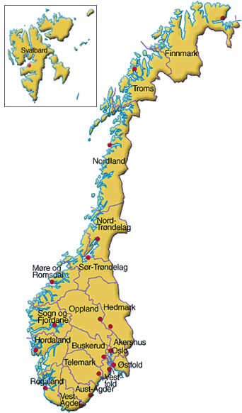
Facts and figurens
19 counties
427 upper secondary schools
199 554 pupils
22 763 teachers
428 municipalities
2957 primary and lower
secondary schools
614 894 pupils
57 460 teachers
6273 Kindergartens (53 % private)

Slide 6
Local authorities
County Governors (18)
Local Municipalities(428)
A primary and lower secondary school
Upper secondary Education and Training
Regional Counties (19)
The Directorate for Education and Training
Ministry of Education and Research
Adult Education
Owned and run by
Inspected and supported by…
National level
central regional
Supported by
Private schools and folk colleges
Inspected by…

Slide 7
We all look for an optimal mix…
Capacity- building
Standards
Assessment

Slide 8
The Norwegian Directorate for Education and Training
Ambitions: Optimize change of right mix, holistic approach, release synergies
Curriculum planning
Examinations and tests
Knowledge development
inspections, statistics, feed-back, research at all levels
International comparisons
Setting standards through assessment/feedback-systems Capacity building
Support, support, support
Governing
Supervision

Slide 9
National goals –> local implementation: Legal framework
Inspection: Governance
Guidance: Know and understand the framework
Self evaluation: Tools to «self inspect»
Inspection: Compliance
An ambulatory team of advisors
Support schools own development and initiate change through:
External evaluation
Internal evaluation
Based on analysis of schools improvement areas.
Notes:
Veilederkorps- an ambulatory team of advisers

Slide 10
Symbioses and dilemmas support and pressure
INTERNAL
EXTERNAL
Audit
Inspection
Activity
assessment
School evaluation
PRESSURE
SUPPORT

Slide 11
AN EXAMPLE OF SYMBIOSES?
Spring
Summer
Autumn
Winter
Notice of inspection
Inspection
Inspection
INSTRUMENTS
Guidance
Self
assess-
ment
Improvement
TIMEFRAME

Slide 12
Statements on impact of inspection – school leaders
80% ‘The inspection is an important corrective for guiding the school’s activities in the right direction’
72% ‘The feedback shows that the advisory inspection is of great value to the school’
58% ‘The National inspection made us aware of weaknesses we had not identified on our own.»

Slide 13
Symbioses and dilemmas
Great expectations
A common strategy: all parties pull in the same direction in a coordinated effort
Control many of the factors of input
Governance/control AND support in a ‘symbiosis’ - i.e. internal and external evaluations
Strong focus on individual rights (equality and due process) AND at the same time focus on the organizations ability to deliver
Pride and prejudice?
Strong state – weak municipalities? Who sets the agenda?
State as both whip and carrot?
One-size-fits-all?
What works?
Cannibalism? Who eats who?
New development – law and pedagogics work in unison
Notes:
Challenges and dilemmas

