Slide 1
INSPECTORS IN A CHANGING WORLD: The CASE Of Cyprus
DR Andreas theodoridis(G.I.P.E.)
Dr andri Michael(I.P.E.)

Slide 2
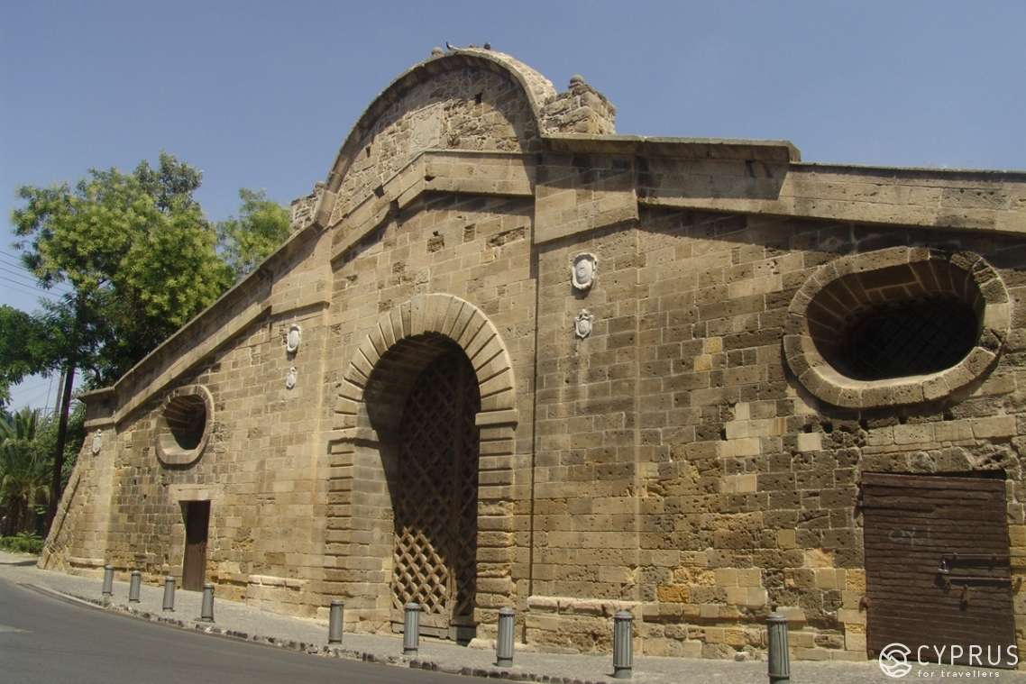
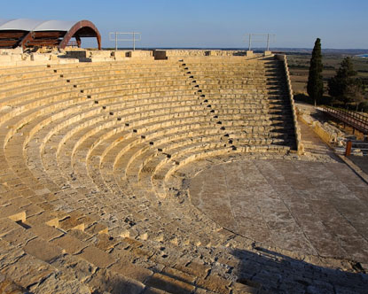
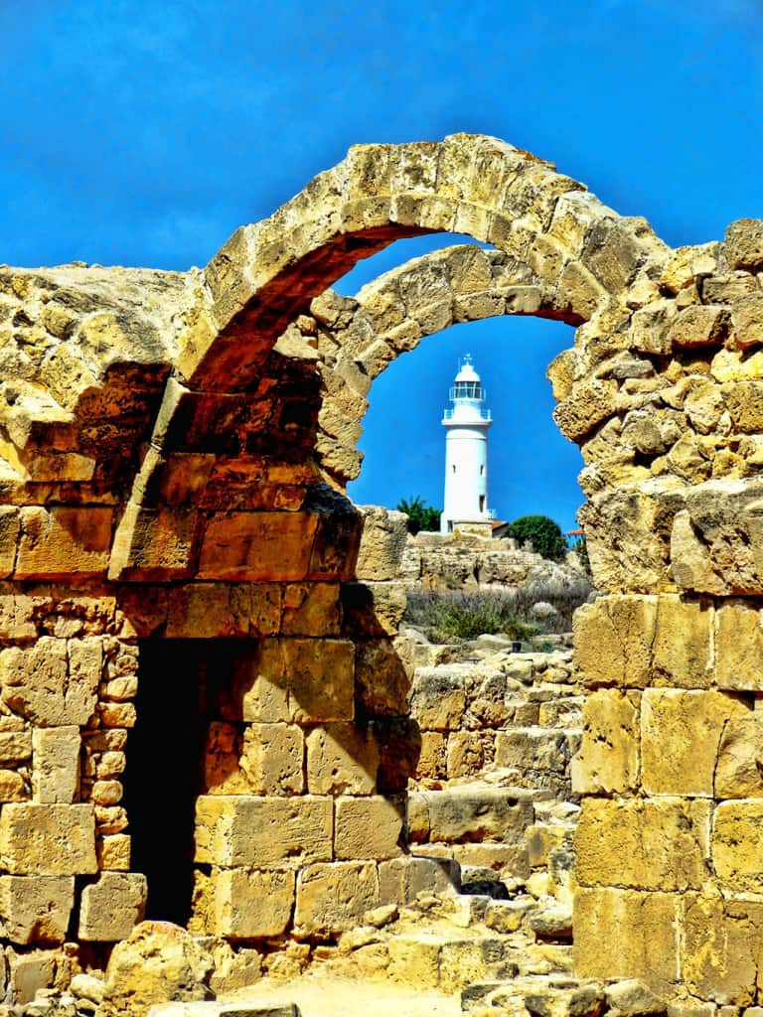
Welcome to cyprus

Slide 3
Content of the presentation
Key features of the Cyprus Education System
Centralised education governance
The evolving Landscape of Education
How the Ministry of Education deals with constant change
Inspectors’ duties and responsibilities
How inspectors are supporting schools

Slide 4
Key features of the Cyprus Education System
The right to education: Constitution (Article 20): Εvery person has the right to receive and every person or institution has the right to give instruction or education, provided that it will be in accordance with the Republic’s laws.
Compulsory education: Compulsory education lasts for at least ten years and extends from the age of 4 years (pre-primary education) to the age of 15 years (end of lower secondary education).
Free education: Public education is free for all students in the age range of 4 years (and 8 months: recently changed) to 18 years. Textbooks are also given to both students and teachers, free of charge.

Slide 5
SOME NUMBERS
PRE-PRIMARY SCHOOLS (Public and Community)
PUBLIC PRIMARY SCHOOLS
PUBLIC GENERAL SECONDARY EDUCATION SCHOOLS
PUBLIC TECHNICAL/VOCATIONAL SCHOOLS (incl. Evening schools)
SCHOOLS | TEACHERS | PUPILS
348 | 890 | 13785
SCHOOLS | TEACHERS | PUPILS
331 | 4367 | 51541
SCHOOLS | TEACHERS | PUPILS
114 | 6252 | 45360
SCHOOLS | TEACHERS | PUPILS
21 | 615 | 4849

Slide 6
Centralised education governance*(1)
Governance: National legislation sets the aims and principles of education, the regulations of operation of schools or other educational institutions, examinations, funding and staff related issues.
Education governance is centralised with the following bodies exercising control over education:
1. The Council of Ministers
2. The Ministry of Education: (Overall responsibility. Responsible for the administration of education, the enforcement of educational laws and the implementation of educational policies, the preparation of the education budget and educational bills and the construction of school buildings. It also sets out curricula, syllabuses and textbooks.)
* https://eurydice.eacea.ec.europa.eu/national-education-systems/cyprus/overview (2023)
* https://eurydice.eacea.ec.europa.eu/national-education-systems/cyprus/overview (2023)

Slide 7
Centralised education governance* (2) https://www.moec.gov.cy/
3. The Education Service Commission: (An independent, five-member body, appointed by the President of the Republic for a six-year term. Responsible for appointments, secondments, transfers, promotions and discipline (including dismissal) of teachers and school inspectors).
4. The Local School Boards: These are responsible for the maintenance and equipment of the school buildings in collaboration with the Department of Technical Services of the Ministry.
* https://eurydice.eacea.ec.europa.eu/national-education-systems/cyprus/overview (2023)

Slide 8
Autonomy:
Primary and secondary schools’ autonomy (pedagogical and administrative) has always been very limited. Teachers are free to “interpret” the curriculum guidelines according to their pupils’ needs. Head-teachers have a small budget for extra expenses of the school unit (e.g. light equipment).
The introduction of the School Development Plan is providing schools with more pedagogical autonomy.
At the higher education level, universities are academically autonomous bodies. Public universities are fully self-administered public corporate bodies. The Council of the universities is responsible for the management and control of their financial affairs.

Slide 9
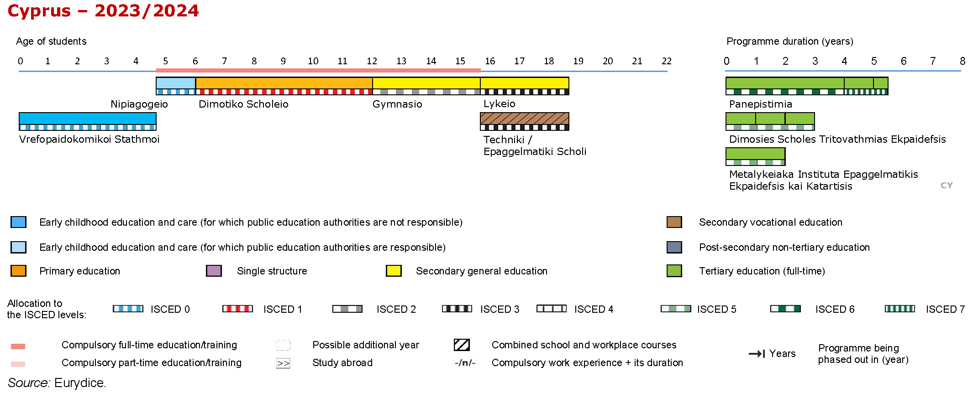
https://eurydice.eacea.ec.europa.eu/national-education-systems/cyprus/overview

Slide 10
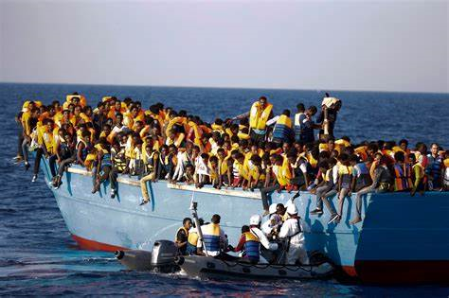
The evolving Landscape of Education(1)
Demographic changes: The pupil population is changing rapidly
(many pupils with an immigrant background)
Pupils from:
The EU
Eastern European countries (Russia, Ukraine)
Non-European countries (e.g., children of workers)
Children from asylum seekers families (mostly, Syria, Africa)
Increased mobility of students among schools or among countries
http://www.sbs.com.au/news/dateline/explainer/what-difference-between-asylum-seekers-refugees-and-economic-migrants

Slide 11
The evolving Landscape of Education(2)
Social and financial changes in Cyprus - Emotional, behavioural, social changes among pupils
Development of digital technology
Increasing pressure for accountability
Climate crisis (high temperatures affecting school conditions)
https://patch.com/massachusetts/woburn/calendar/event/20200310/757682/the-climate-crisis

Slide 12
Facing new challenges requires collective action
Educational Psychology Service (EPS)
Academics
Parents/family
Social support services
Local communities
The police
https://givingcompass.org/article/taking-collective-action-at-your-foundation/

Slide 13
ΜΑΙΝ Ongoing reforms and policy developments (2022)
Signing of the "Support Services System" Project Contract for the electronic governance of public education
Changes in secondary education curricula, in order to promote employment
Action towards smooth integration of students with an immigrant background
Implementation of a pilot program STEM in primary education
Online Learning Action on internet security
Online program for Gymnasium students on mental resilience
https://eurydice.eacea.ec.europa.eu/national-education-systems/cyprus/national-reforms-school-education

Slide 14
ΜΑΙΝ Ongoing reforms and policy developments(2023)
Regulations of 2023 for the operation of public secondary schools (Amendment No. 2)
Abolition of the service purchase regime in the DRASE+ (Social and School Integration Actions) and Optional Full-Day School programs of Primary Education
The modernization of syllabi
The Ministry promotes new regulations for the evaluation of students in the secondary education
Four-month examination of secondary general and technical and vocational students education and training
https://eurydice.eacea.ec.europa.eu/national-education-systems/cyprus/national-reforms-school-education

Slide 15
ΜΑΙΝ Ongoing reforms and policy developments(2024)
Policy for the smooth transition from primary to high school and from pre-primary to primary school.
Phase B of the PEDIA Project - Creation of green and nearly zero energy schools
Actions to tackle more effectively violence and delinquency in schools
https://eurydice.eacea.ec.europa.eu/national-education-systems/cyprus/national-reforms-school-education

Slide 16
DRA.S.E.+ for strengthening and effective integration of immigrant students
School and Social Inclusion Actions+ (DRA.S.E.+)
Teaching Greek as a second language
Second teacher in the class (for a number of teaching periods in a week)
Psychologist for students and their parents
Subsidized alternative learning programme

Slide 17
Remedial teaching program for students at risk of illiteracy
National literacy assessment: the identification of pupils ‘at risk’ in Cyprus
The program seeks targeted reinforcement of specific students at increased risk of literacy in Language and Mathematics
According to data gathered from schools, a number of them are selected to participate in the above program

Slide 18
Policy for the smooth transition from primary to high school
Educational Psychology Service (EPS), provides training workshops on a nationwide basis, within the framework of the policy for the smooth transition from primary to secondary school. Ιt marks the transition from childhood to adolescence.
They are addressed to principals and sixth grade teachers. Participants are asked to transfer knowledge and good practices to other teachers of their school.

Slide 19
Actions to tackle more effectively violence and delinquency in schools
1. Strengthening the management team and teachers
2. Simplification of crisis management procedures and cooperation protocols between schools, the Immediate Intervention Team and the Educational Psychology Service.
3. Implementation of a protocol for reporting incidents of violence and delinquency on an electronic platform of the Observatory for Violence in schools of the Pedagogical Institute.
4. Introduction of preventive programs at younger ages (preschool).
5. Implementation of programs for the development of a culture of acceptance of diversity.

Slide 20
PEDIA Project - Creation of green and nearly zero energy schools
The PEDIA project seeks to promote energy efficiency and develop innovative approaches in schools. It is the first time that on such an expanded scale attempts are made to transform Cyprus school buildings into green and sustainable ones.
162 schools applied to be evaluated by the program, of which 144 were eligible. 55 schools were selected for the first phase and 25 of them are receiving a total energy upgrade.

Slide 21
pilot S.T.E.M. programme in Primary Education
A pilot STEM (Science, Technology, Engineering, and Mathematics) Programme has been introduced in eight primary schools. It is also planned to be implemented in Secondary Education. It promotes an integrated interdisciplinary approach to the learning process. Children are involved in activities that provide them with opportunities to utilize knowledge, concepts, processes and practices in the fields of Science, Technology, Engineering and Mathematics to address situations and issues related to the world of everyday life.

Slide 22
Other reforms:
School Improvement Plan, including School Professional Learning Plan
(A very significant innovation that was introduced mainly due to inspectors’ suggestion. It increases teachers’ pedagogical autonomy and professionalism).
The utilization of digital technology throughout all levels of education
Greater emphasis on sexual education and prevention against sexual abuse (New Law, 2023)
The adoption of free breakfast to elementary student beneficiaries according to set criteria
https://eurydice.eacea.ec.europa.eu/national-education-systems/cyprus/national-reforms-school-education#2022

Slide 23
Special education reforms:
Currently, a dialogue is taking place with all stakeholders for important and radical changes in Special Education (Early identification and treatment of children's problems)
Adoption of a plan for strengthening and reorganizing Special Education
Increase of the number of teachers in schools, especially in Special Education
Continuance and intensification of the efforts to integrate the children of Special education equally into regular classes
https://eurydice.eacea.ec.europa.eu/national-education-systems/cyprus/national-reforms-school-education#2022

Slide 24
Inspectors (the law)
Inspectors carry out the policies of the Ministry of Education
According to the current educational Law in Cyprus, Inspectors of Primary Education have three main duties:
To advise teachers
To help them develop professionally
To assess them (Cyprus Republic, 2008, Law Κ.Δ.Π. 223/76 Ν.223).
Notes:
Inspectors carry out the policies of the Ministry of Education and are considered co-responsible with headteachers for their implementation. According to the current educational Law in Cyprus, Inspectors of Primary Education have three main duties: To advise teachers, To help them develop professionally, To assess them. That is, as we are going to analyse further on, on one hand inspectors are expected to be involved in schools’ internal evaluation and on the other hand they are responsible for the school’s external evaluation as well.

Slide 25
Inspectorate as a body of educational policy(1)
Inspectors act as a bridge between the schools and the superior authority.
They convey the opinions, the views, and suggestions of teachers to the decision-making centre.
Inspectors are a significant part of the Ministry’s decision making process.
Notes:
Inspectorate acts as a body of educational policy connecting the bridges between the schools and the superior authority, that is the Ministry of Education, Culture, Sports and Youth. Inspectors can convey (transmit) the opinions, the views, and suggestions of the teachers on various issues of an educational nature to the Decision-making centre. They act as the link between the schools and the superior authority.

Slide 26
Inspectorate as a body of educational policy(2)
Inspectors identify problems and challenges and suggest innovations
They promote accountability within schools.
They encourage schools to share good practices
Inspectors play an important role in teachers’ in-service training.
Notes:
Inspectorate acts as a body of educational policy connecting the bridges between the schools and the superior authority, that is the Ministry of Education, Culture, Sports and Youth. Inspectors can convey (transmit) the opinions, the views, and suggestions of the teachers on various issues of an educational nature to the Decision-making centre. They act as the link between the schools and the superior authority.

Slide 27
Purposes of the inspection
According to the Law, the main purpose of the inspection is to guide and assist the teaching staff, to coordinate the teaching work and to contribute to the evaluation of teachers.
Inspector as a mentor and as a consultant
Inspector as an evaluator
Notes:
One of their main roles of inspectors is to became a mentor, an advisor, a consultant, and an animator (animating spirit) for their teachers, their HTs, for their schools .. to guide and assist the teaching staff, to coordinate the teaching work. On the other hand inspectors are expected to be the evaluators. In other words, inspectorate contributes to the selection of the best education executives for promotion.

Slide 28
“According to relevant instructions an Inspector:
1. Undertakes the inspection of primary education schools and the inspection and guidance of the their teaching staff and works with school HTs to address administrative and educational issues of schools
2. Actively participates in the organization and conduct of educational conferences and training courses for the teaching staff.
3. Undertakes administrative and/or other specific tasks
4. Performs any other tasks assigned to him/her”
Notes:
According to relevant instructions and/or based on the relevant programme an Inspector:1. (a) Undertakes the inspection of primary education schools and the inspection and guidance of their teaching staff and works with school HTs to address administrative and educational issues of schools, as well as with the Inspectors of Special Subjects concerning matters of their specialty.
(b) Actively participates in the organization and conduct of educational conferences and training courses for the teaching staff.
2. Undertakes administrative and/or other specific tasks, e.g. coordination, planning, development programs, educational studies, researches, examinations, answering and/or discussing issues raised by parents, politicians or any other stakeholder etc.
3. Performs any other tasks assigned to him/her

Slide 29
focus of inspectors the Current School Year :
DRA.S.E.+ program, for strengthening and effective integration of immigrant students
Teaching Greek as a second language, in non DRA.S.E.+ schools
Remedial teaching program for students at risk of illiteracy
Schools’ improvement plan
Differentiation of teaching (Teachers’ workshops on “Differentiation of teaching”)
Modernization of Syllabi aiming at defining indicators for teaching differentiation and improving the achievement of each and every child

Slide 30
The modernization of syllabi
Rationalization of the curriculum,
Updating, limiting it to the necessary, to the core knowledge, aiming at a modern, new educational system, which promotes the abilities, skills and knowledge of each child
Committees: academics, qualified teachers on secondment, teachers’ union representative. Chaired by inspectors.

Slide 31
assessment and feedback
Inspectors assess the quality of teaching, learning and school management
Provide constructive feedback to school leaders, teachers, and staff.
Recommendations for improvement are based on evidence gathered (mostly through observation) during inspections.

Slide 32
identifying areas for improvement
Inspectors identify strengths and weaknesses in various aspects of the school.
Pinpoint areas, where academic performance can be enhanced.
This includes lesson design, teaching methods, and student support.
Help build the capacity of schools, by providing guidance on effective teaching methods, leadership, and organizational management (capacity building).

Slide 33
promoting school’s self-evaluation and improvement
Inspectors encourage schools to engage in self-evaluation.
Schools reflect on their practices, identify areas for improvement, and develop and apply action plans.
Self-assessment process contributes to better academic outcomes.
It is aligned with the effort to formulate a school self-evaluation plan as recently decided by the Council of Ministers (ongoing process) and self-improvement.
Establishing the culture of school self-evaluation and self-improvement, is the goal.
Encourage schools to connect the self-improvement process with in-service training.
Notes:
Inspectors act as critical friends.

Slide 34
accountability and pressure
Two-year probation period for teachers. Permanent position after that. Numerical assessment: 12 years, 13, 15, 17 years etc.
Every inspector (indirectly) promotes the sense of accountability for schools.
A pool of data gathered from each school (first, third, sixth grades)
In most cases the pressure to meet inspection criteria motivates schools to improve, since everyone knows each other in Cyprus (issue of maintaining the reputation and name of teachers, directors etc).
Notes:
Schools face limited sanctions for failing to meet standards and limited rewards for performing well.

Slide 35
INSPECTORS and student achievement
Inspectors’ recommendations directly impact teaching practices and student learning.
Support for Neglected Students, by highlighting areas where schools can better support students.
Additional support, such as Committees to Support specific students, collaboration with other parties/stakeholders, psychology counselling and one-on-one assistance, can help neglected children improve their behaviour and academic performance.

Slide 36
evaluation of school- educational work
Evaluation of the whole-school educational work is accomplished through the evaluation of the School Head Teacher (once in every three years)
A team of inspectors spend a whole school day within the school.
Among other things, the evaluation process includes:
1. discussion with the Head Teacher. Additionally, inspectors discuss with the management team and the Central Student Council.
2. observation of teaching and evaluation by the School Head and
3. participation in a staff session (meeting).
LONG AND SYSTEMATIC PREPARATION OF SCHOOLS (School Improvement Plan, Documentation and Files, Collaboration and Joint Observations etc)

Slide 37
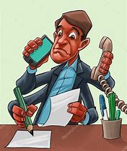
https://depositphotos.com/16779235/stock-photo-comic-cartoon-of-a-man.html

Slide 39
Thank you

