Slide 1
Summary: Quality Assurance by Enhancement-led Evaluation
SICI Workshop in Helsinki
14th and 15th October 2021

Slide 2
Summary
The culture of trust is an intrinsic part of the Finnish education system. Underlying this is the change of the political atmosphere in the 1990’s, which led to the devolution of power in the Finnish basic education and in general upper secondary education.
From norm-based steering and external inspection, there was a shift onto a system where it is the education providers’ responsibility to evaluate their activities and to participate in external evaluations conducted by the FINEEC (Finnish Education Evaluation Centre).
The evaluation system of FINEEC is based on enhancement-led evaluation. This means that the different parties, such as education providers, teaching staff, students, working life, participate in planning the evaluation, producing evaluation data and interpreting the results.
The overarching aim of the evaluations is to produce educational knowledge. The methods applied in enhancement-led evaluations are inclusive, interactive and tailored according to the objectives and the theme of the evaluation. After every evaluation, the quality is controlled by systematic feedback gathering.

Slide 3
Quality management in basic and general upper secondary education is underpinned by self-evaluations and external evaluations
As school inspections were discontinued, self-evaluation was highlighted in Finnish general education from the 1990s on. → In 1998, education providers’ obligation to evaluate the education they deliver and to participate in external evaluations of their activities was laid down in the legislation on basic and general upper secondary education. The idea is that education providers use the self-evaluation data produced by them to assure and improve the quality of their operations and teaching.
External evaluations produce information on the state of teaching and education at the national and international level. In addition to this, the local level education providers and schools receive more detailed information to support their development work.
External evaluations include FINEEC’s evaluations of learning outcomes and evaluations of how the education system functions. National evaluations of learning outcomes produce information on the achievement of objectives set in curricula as well as the level of students’ knowledge and skills and any differences in them.

Slide 4
In addition to self-evaluations and external evaluations, the means used to maintain the quality of Finnish basic and general upper secondary education include teachers’ evidence-based higher education and statutory eligibility requirements; teachers are required to have a Master’s degree.

Slide 5
Efforts to strengthen quality management
The situation of general upper secondary education providers changed in 2018: the statutory obligation related to quality management was laid down on the new act.
In 2021, the Ministry of Education and Culture launched a quality and accessibility programme for general upper secondary education (Ministry of Education and Culture 2021). The objectives of this programme include producing a quality strategy for general upper secondary education, striving for systematic and sustained improvements in the quality and accessibility of general upper secondary education, and supporting general upper secondary education providers in strengthening quality management, continuous improvement of quality and developing an operating culture that supports continuous improvement of quality.
An effort is also being made to improve quality management in pre-primary and basic education. The Education Policy Report of the Finnish Government (2021) stated that clear, binding quality targets and indicators describing their attainment should be set for the organisation of pre-primary and basic education. The purpose of the quality targets is to specify the target level of services equally throughout Finland.

Slide 6
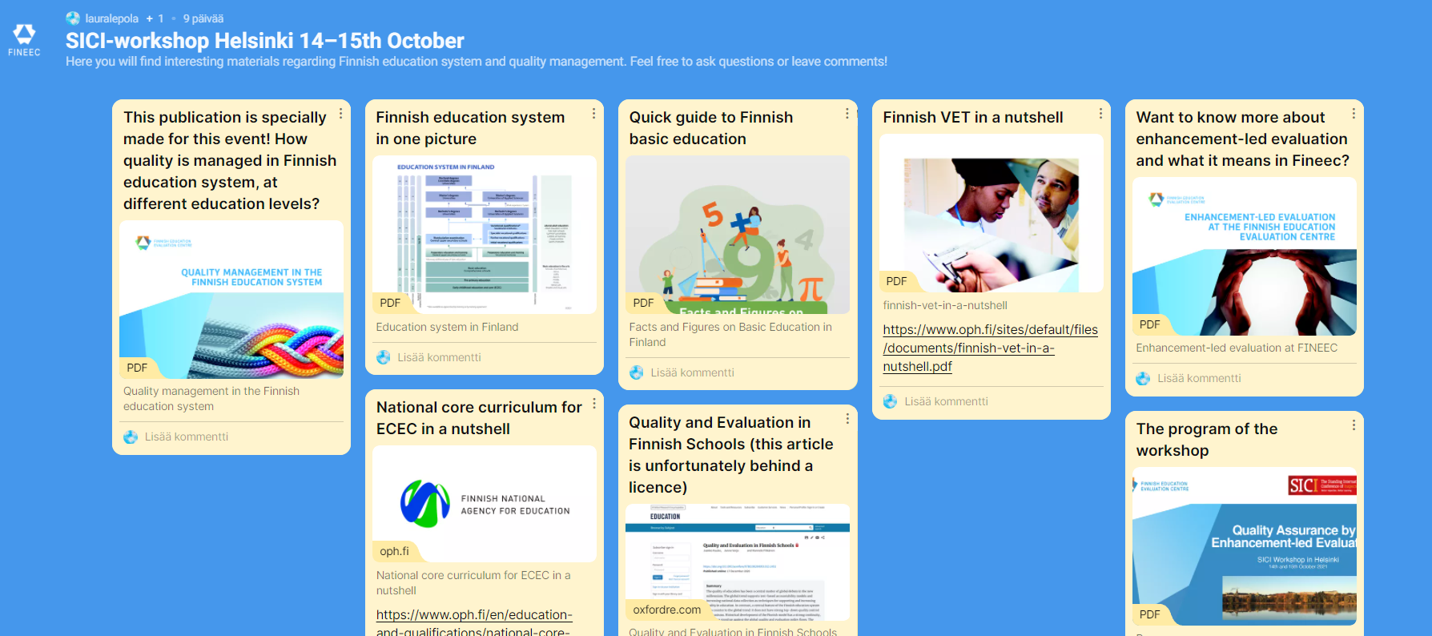
Padlet-platform, still open! ☺ https://padlet.com/lauralepola/eiti2u15mcevuksl

Slide 7
