Slide 1
Title Welsh point 45
Embedding innovative inspection practice
Sefydlu arferion arolygu dyfeisgar
SICI
Dulyn Medi 2019
Dublin September 2019

Slide 2
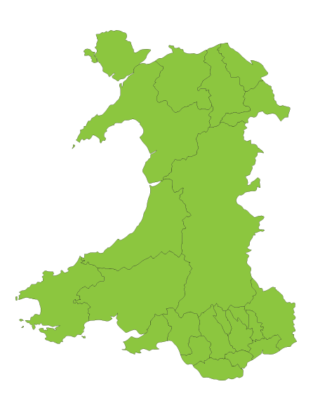
Estyn – national inspectorate for education and training in Wales.
Wales is part of the United Kingdom. It shares a land border with England.
Education in Wales is devolved to the Welsh Government.
Wales has a bilingual education system:
Welsh medium
English medium (Welsh taught)
Bilingual
200 km

Slide 3
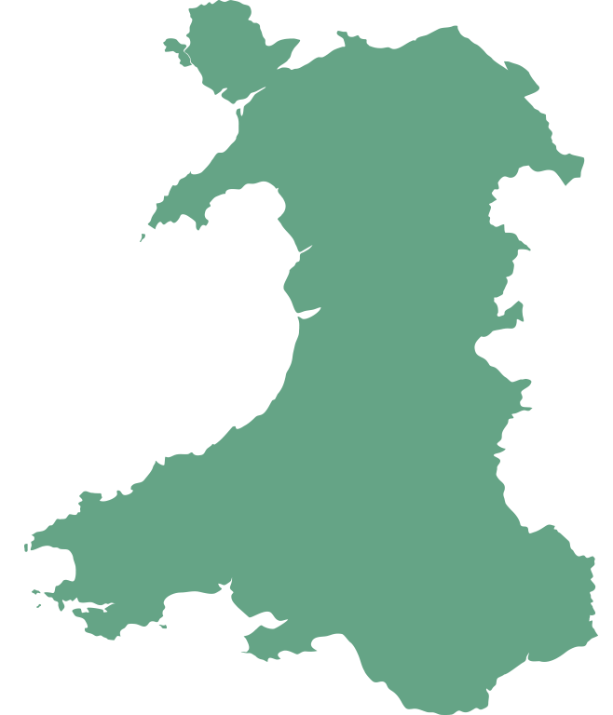
1,261 Primary schools
404 Welsh-medium, 857 English-medium
195 Secondary schools
18 Welsh-medium, 29 bilingual, 148 English-medium
There are also:
22 local authorities
4 regional consortia
600 non-maintained nursery settings
13 all age schools
41 special schools
74 independent schools/colleges
12 further education colleges
19 work-based training contract holders

Slide 4
Innovative inspection practice:
The role of peer inspectors
Inspection tools and approaches

Slide 5
Peer inspectors:
Development of the peer inspector role since early 2000s
Initial training and annual update training
Deployment – on inspection and to support thematic work
Benefits for us and for the individual and their school/provider
Challenges

Slide 6
Developing new tools and approaches:
Inspection practice – tools and approaches adopted during the inspection week

Slide 7
Inspection tools

Slide 8
Developing new tools and approaches:
The role of the nominee
Inspection reports
Meeting middle leaders with books
Challenges

Slide 9
Future developments
Currently developing new inspection arrangements for September 2021
Consultation for autumn 2019
Establishing a headteacher reference group
Follow up arrangements have evolved particularly since 2017
PIAP visits
Improvement conferences
Transition year
Engagement visits
Conferences and training events

Slide 10
Questions?
Diolch yn fawr

