Slide 1


Analysis of Attainment during Inspection in Schools in Scotland
SICI Conference Prague 2017
Sadie Cushley Lead Officer Primary Inspections
Carol McDonald Lead officer Secondary Inspections

Slide 2
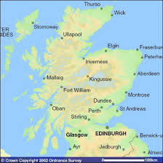
The Learning Journey in Scotland
Inspection programmes in
Primary Schools 5 – 12 years
Secondary Schools 12 – 18 years
Statistical sampling to enable reporting to Scottish Government

Slide 3
Attainment Measures used in our Schools
In the Broad General Education (age 3 to 15)
Across Early Years and Primary Stages and in first 3 years of Secondary
Use Curriculum for Excellence “levels”
In 2016 Scottish Government started collecting data for “achievement of a level”
In the senior phase (age 15 to 18)
Years 4 to 6 in the secondary
External Qualifications (most from the Scottish Qualifications Authority (SQA))

Slide 4
Levels of Achievement in the Broad General Education (BGE)
Early Level In pre-school and in Primary 1
First Level By end of P4, but earlier for some
Second Level By end P7, but earlier for some
Third Level In S1-S3, but earlier for some
Fourth Level Specialisation in subjects

Slide 5
Organising Learning, Teaching and Assessment
8 Curriculum Areas
Health & Well being
Languages
Mathematics
Sciences
Social studies
Expressive Arts
Technologies
Religious and moral education

Slide 6

Planning learning, teaching and assessment using
Experiences & Outcomes (Es and Os) and Benchmarks
Group Es and Os together in ways which best suit learners
Do not ‘tick off’ the Es and Os separately
Take a collegiate approach to moderation of planning learning, teaching and assessment
Work together with colleagues to review and reduce unnecessary bureaucracy

Slide 7
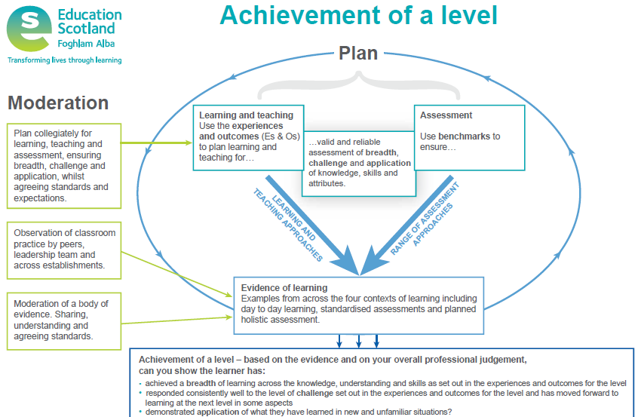

Slide 8


Key Resources to Ensure Shared Standard

Slide 9
Achievement of a Level
Achievement of a level is based on teachers’ overall professional judgement, informed by evidence.
Assessment judgements should be based on the Benchmarks for each curriculum level.
The Benchmarks are designed to support teacher professional judgement of both, progress towards, and achievement of a level.

Slide 10
Achievement of a Level
It is not necessary for learners to demonstrate evidence of every aspect of learning within the Benchmarks before moving on to the next level. However, it is important that this is interpreted in ways which ensure no major gaps in children's and young people's learning, for example with respect to the relevant organisers in each curriculum area.

Slide 11




Slide 12

National Improvement Framework
Our priorities:
Improvement in attainment, particularly literacy and numeracy
Closing the attainment gap between the most and least disadvantaged children
Improvement in children and young people’s health and wellbeing
Improvement in employability skills and sustained, positive school leaver destinations for all young people.

Slide 13
“ A passionate commitment to social justice, equality, wellbeing and learning for sustainability is a moral imperative for every teacher in Scotland” HGIOS?4 p.6
“Making sound judgements about the impact on learners should be central to self-evaluation” HGIOS?4 p.10

Slide 14
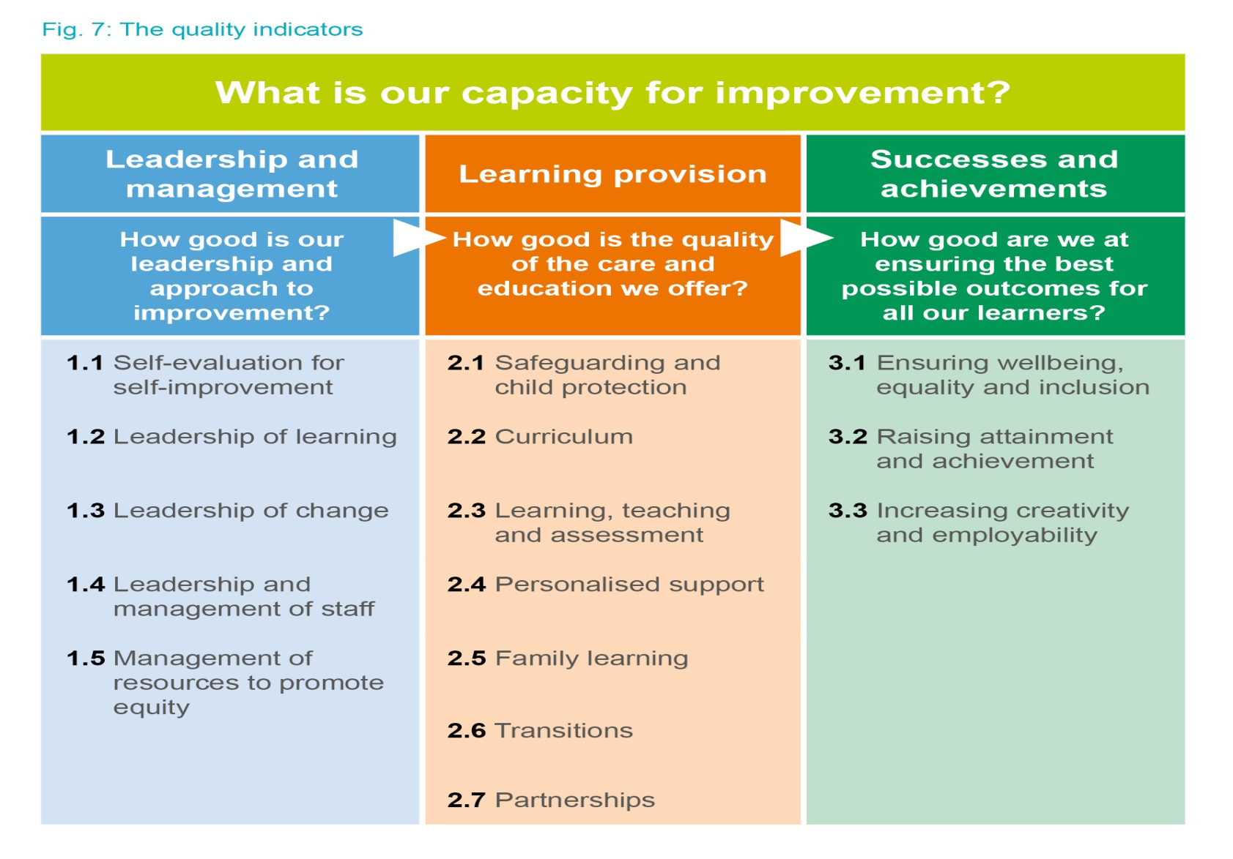
Notes:
You get out what you put in!

Slide 15
We will evaluate these QIs using the 6 point scale:

Slide 16

Quality Indicators used on all school inspections
1.3 Leadership of Change
2.3 Learning, teaching and assessment
3.1 Ensuring wellbeing, equality and inclusion
3.2 Raising attainment and achievement

Slide 17
Evaluations
4 Quality Indicators are evaluated on each inspection
6 point scale
Excellent
Very Good
Good
Satisfactory
Weak
Unsatisfactory

Slide 18

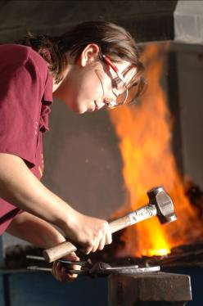
Purposes of inspection continues to be
provide assurance to users on the
quality of education
promote improvement
provide evidence to inform national
policy development
Letter to parents with
Strengths
Aspects for Development
Grades for the 4 Q.I.s
Summarised Inspection Findings published

Slide 19
Primary Inspections
Number of Primary Schools: 2033
Locations: Rural, Urban, Islands
Roll varies from 5 to 1,000+

Slide 20
Main sources of Evidence : Primary Inspections
Class observations
Attainment Groups
Children’s work
Discussion with children in class
Planning of Learning, Teaching and Assessment
Assessment files
Discussions with staff

Slide 21
Learning, Teaching and Assessment
Class Observations
Motivation and engagement of learners
Effectiveness of assessment strategies and extent to which they are improving learning.
To what extent does this build on prior learning
Is assessment informing decisions about learning and teaching approaches.
Differentiation
Support for Learning ( In class /extraction)
Deployment of support staff

Slide 22
Learning, Teaching and Assessment cont’d
To what extent are children taking responsibility /aware of what they are learning.
Learning across 4 contexts of learning
Active learning versus text book driven learning
Learning through play in early years

Slide 23
Quality of Teaching
Clear instructions and explanations
Range and type of questions
Promote children’s thinking skills
Strong relationships with class
Appropriate use of praise
Children appropriately challenged and supported
Timing and quality of feedback
Children’s work ..is it reflecting motivating learning? Feedback

Slide 24
How is assessment evidence used by class teachers?
Are staff using assessment appropriately to inform learning and teaching?
Is assessment information being used to improve attainment ?
Are decisions about assessment decided when planning learning and teaching?
Staff understanding of assessment
Staff awareness of progress through level and achievement of a level.
How does it contribute to whole school assessment information?
Peer and self assessment
Variety of assessment approaches summative and formative

Slide 25
Effective use of Assessment
Planning, Tracking and monitoring.
Lessons appropriate to level and standard expected . Use of Benchmarks
Arrangements for moderation within school and cluster.
Effectiveness of Moderation
In class tracking of children’s progress resulting in appropriate timely interventions to raise attainment
In class tracking inform whole school tracking and monitoring of attainment
SMT. CT meet regularly to plan interventions and review progress of individuals

Slide 26
What’s Changed?
From June 2016, teachers of P1, P4, P7 and S3 classes are being asked at the end of every school year whether children have achieved the relevant CfE level for their stage in reading, writing, talking and listening (literacy) and numeracy.
The Scottish Government publish the information received from teachers, to show the percentage of children who have achieved CfE levels
From August 2017, new, national standardised assessments will be introduced in all schools in Scotland. These assessments will provide an additional source of nationally consistent evidence for teaches to use when assessing children’s progress.

Slide 27
Raising Attainment and Achievement
In class
Lessons appropriate to the level
Are staff able to accurately articulate where children are on the level.
In class – number of children on track to achieve the level in literacy and numeracy and across the curriculum.
At whole school level
No of children at P1, P4 and P7 having achieved level in literacy numeracy
No of children on track to achieve the level across all stages.
Progress of children with Additional Support Needs (Individual Educational Plan)

Slide 28
Evidence of progress and achievement
Observing day-to-day learning within, and outwith, the classroom
Coursework, including tests
Learning conversations
Planned periodic holistic assessments
Information from standardised assessments
Notes:
It is important to remember that evidence of progress and achievement is gathered from a range of sources and all of these are valid and will contribute to supporting teacher professional judgement.

Slide 29
Q,I Raising attainment and achievement
To evaluate attainment inspectors:
Look at staff and school assessment records
Formative / Summative Assessment information
Children‘s work
Tracking of children’s wider achievements/skills
Planning of learning teaching and assessment
Progression pathways
ATTAINMENT GROUPS in primary schools

Slide 30
Attainment Groups
Responsive to the context of the school
Usually P4 and P7 children identify who have achieved the level
Focus mainly on literacy and numeracy
Oral questions based on benchmarks (no written test )
Purpose to assess skills as well as knowledge and understanding
Adds to evidence collected in class/documentation
Inspection Advice note on inspecting English Language and literacy for our teams

Slide 31
Secondary schools in Scotland
Number: 340
Locations: Urban, Rural, Islands
Roll: varies from under 100 to 2,000

Slide 32
Attainment in Secondary Schools
BGE
Curriculum for Excellence “levels”
Senior Phase
Qualifications
Insight (a Scottish Government benchmarking tool)

Slide 33
Senior phase attainment
It is what you leave school with that matters
How schools “benchmark” themselves
  Virtual Comparator
  Dashboard
  Destination on leaving
  20:60:20
  Scottish Index of Multiple Deprivation
  Literacy and numeracy
  How many and at what level

Slide 34
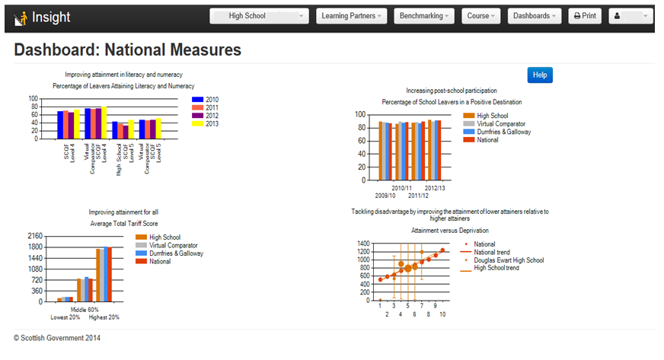
The Dashboard

Slide 35
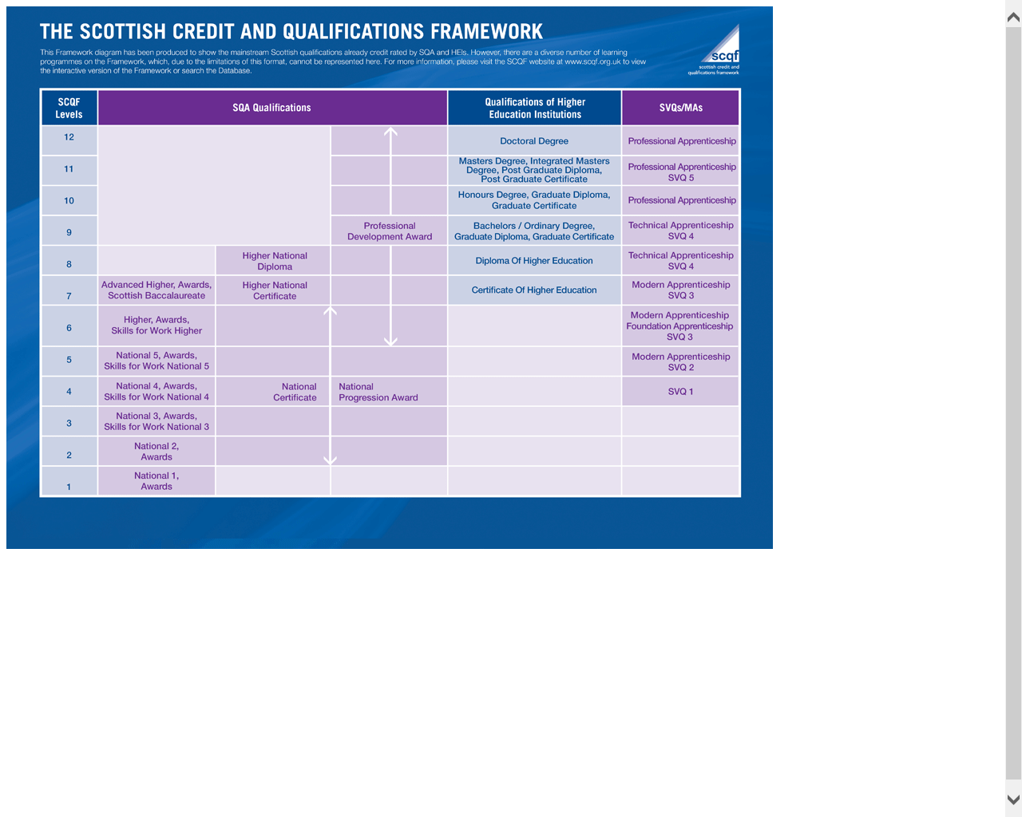
Scottish Qualifications Framework (SCQF)

Slide 36
Virtual Comparator
For each pupil in the year group 10 matching pupils are randomly selected from other local authorities based on the following characteristics:
Gender
Additional support needs
  No additional support needs
  Additional support needs but spend 80% or more of their time in mainstream education
  Additional support needs and spend less than 80% of their time in mainstream education
Stage of leaving /stage of qualification
Scottish Index of Multiple Deprivation.

Slide 37
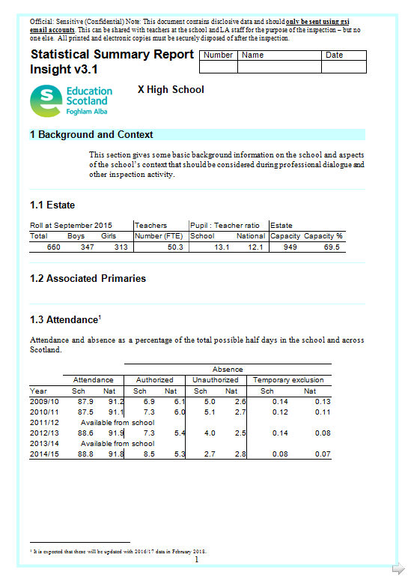
HMI – use a Statistical Summary Report (SSR)

Slide 38
SSR
Managing inspector gets a day before the inspection to analyse data
Data used as part of evaluation of Q.I. 3.2 Raising attainment and achievement after discussion with school
Schools can be “in line”, “significantly higher”, “significantly lower” than the virtual comparator across the different measures

Slide 39
Q.I 3.2 Raising attainment and achievement
Attainment in literacy and numeracy
Attainment over time
Overall quality of learners’ achievement
Equity for all learners

Slide 40
Sadie Cushley(Sadie.Cushley@educationscotland.gsi.gov.uk)
Carol McDonald (Carol.McDonald@educationscotland.gsi.gov.uk)
Notes:
Handover slide

