Slide 1
How Does the Legal Framework Support and Restrict the Effectiveness of Inspectorates?
Petr Drábek
Head of Central Bohemian Inspectorate
petr.drabek@csicr.cz
Tirana, Albania, November 2016

Slide 2
How Does the Legal Framework Support and Restrict the Effectiveness of Inspectorates?
Basic Information
On the Czech Republic

Slide 3


How Does the Legal Framework Support and Restrict the Effectiveness of Inspectorates?
the Effectiveness of Inspectorates?
Welcome in the Czech Republic

Slide 4


How Does the Legal Framework Support and Restrict the Effectiveness of Inspectorates?
Welcome in Prague

Slide 5
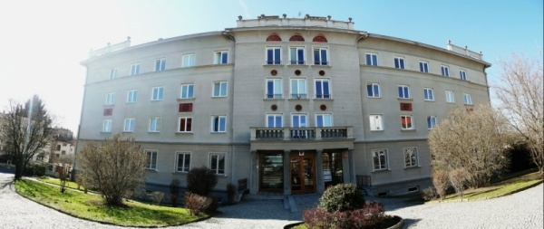
How Does the Legal Framework Support and Restrict the Effectiveness of Inspectorates?
Welcome in the Czech School Inspectorate

Slide 6
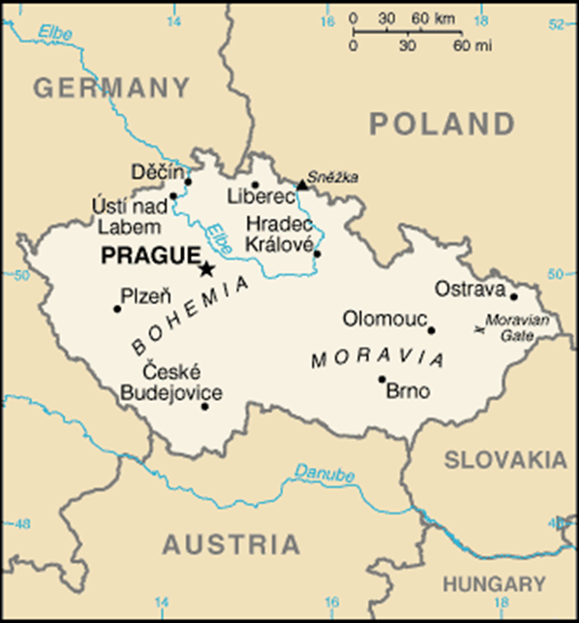
How Does the Legal Framework Support and Restrict the Effectiveness of Inspectorates?
10 564 900 inhabitants (June, 2016)
78 866 sq km
School Year 2015/2016 (except universities)
10 799 schools in total
1 699 505 pupils
152 136 teachers

Slide 7
How Does the Legal Framework Support and Restrict the Effectiveness of Inspectorates?
More Numbers to Compare
The Czech Republic | 6-year inspection activity cycle | Czech School Inspectorate
10.56 million inhabitants |  | 258 school inspectors
10 799 schools |  | 68 control workers (auditors)
1 918 421 pupils |  | 132 administrators
152 136 teachers |  | 458 TOTAL

Slide 8
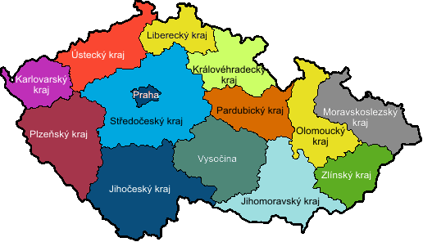
How Does the Legal Framework Support and Restrict the Effectiveness of Inspectorates?
Czech Regions
14 regions
14 regional inspectorates
From 14 to 46 inspectorates

Slide 9
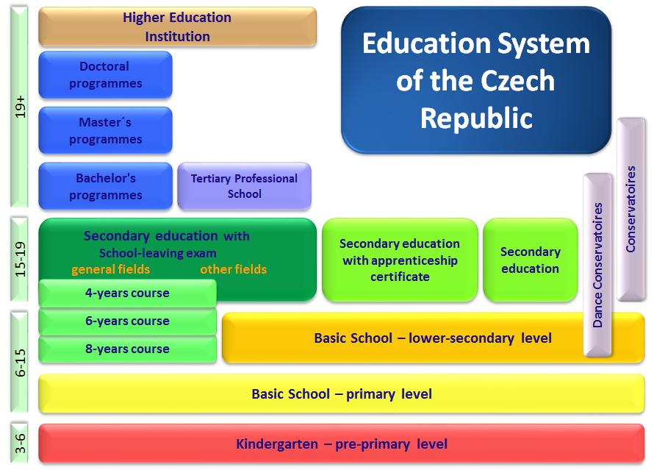
How Does the Legal Framework Support and Restrict the Effectiveness of Inspectorates?
Structure of the Czech Education
age

Slide 10
How Does the Legal Framework Support and Restrict the Effectiveness of Inspectorates?
Inspection Systems
Evaluative (monitors a school as a whole)
SCHOOL and SCHOOL FACILITY IS A BASIC ELEMENT OF THE SYSTEM
(Scotland, England, Flanders, Czech Rep…)
Administratively controlling (monitors individual teachers)
TEACHER IS A BASIC ELEMENT OF THE SYSTEM
(German Lands, Austria, France…)

Slide 11
How Does the Legal Framework Support and Restrict the Effectiveness of Inspectorates?
Position of the Czech School Inspectorate
Governmental department established by the Law
Administrative authority with a nation-wide power
(Headquarters + 14 regional inspectorates)
Plan of principal assignments
Evaluation criteria

Slide 12
How Does the Legal Framework Support and Restrict the Effectiveness of Inspectorates?
ACT No. 561/2004 Coll. The Education Act
Section 174, subsection 2), letter b)
The Czech School Inspectorate shall determine and assess the conditions, course and results of education in accordance with relevant school educational programmes

Slide 13
How Does the Legal Framework Support and Restrict the Effectiveness of Inspectorates?
Competences of the CSI
Section 174 (2) Act No. 561/2004 Coll.
  Acquire and analyse information on education
  Determine and asses the conditions, course and results of education
  Determine and assess to what extent the school educational programme is met and whether it is in compliance with legal regulations and the framework educational programme
  Execute state checks of adherence to school legislation (Act No. 552/1991 Coll.)
  Ensure public-legal audit (Act No. 320/2001 Coll.)

Slide 14
How Does the Legal Framework Support and Restrict the Effectiveness of Inspectorates?
Activities and Competences of the CSI
2. Attendance in the commissional re-examination, resits of a pupils
3. Drawing up strategic and evaluation documents
Conceptual objectives of inspection activities
System for evaluating the educational system
4. Attendance in applicant interview committee for a head teacher of a school or a school facility
5. Processing of offences
6. Suggestions, complaints, petitions

Slide 15
How Does the Legal Framework Support and Restrict the Effectiveness of Inspectorates?
Activities and Competencies of the CSI
Based on its findings the Czech School Inspectorate also:
Provides proposals to relevant state authorities
Submits a proposal to announcement of an open competition
Submits a proposal for dismissal of the head-teacher
Submits a proposal to erasure school from the register of schools and school facilities

Slide 16
How Does the Legal Framework Support and Restrict the Effectiveness of Inspectorates?
International Activities of the CSI
SICI
OECD
Inspectorate of European Schools
International reviews on educational results (PISA, PIRLS, TIMSS, ICILS, TALIS etc.)

Slide 17
How Does the Legal Framework Support and Restrict the Effectiveness of Inspectorates?
School Inspector
Section 174 (9) Act No. 561/2004
University educated
At least 5 years of pedagogical or pedagogical-psychological work professional experience
Satisfies further prerequisites

Slide 18



How Does the Legal Framework Support and Restrict the Effectiveness of Inspectorates?
Auditor
Section 174 (9) Act No. 561/2004
University educated + at least of 5 years professional experience
Or person with the final maturita exam + at least 20 years of professional work experience
Invited person
Section 174 (9) Act No. 561/2004
Expert assessment
Mostly head-masters, deputy head-masters
Works under the supervision of a school inspector or an auditor

Slide 19
How Does the Legal Framework Support and Restrict the Effectiveness of Inspectorates?
Inspector´s Key Skills
Work with information; analytic-synthetic approach
Team work
Communication
Reports writing and their structuring
Work with ICT

Slide 20
How Does the Legal Framework Support and Restrict the Effectiveness of Inspectorates?
Czech School Inspectorate
What Do the Inspectors Monitor?

Slide 21

How Does the Legal Framework Support and Restrict the Effectiveness of Inspectorates?
Evaluation Criteria and Scale
Evaluation Scale
Excellent – example of inspirational practise
Expected
Need for improvement
Insufficient

Slide 22
How Does the Legal Framework Support and Restrict the Effectiveness of Inspectorates?
Criteria for Evaluation of Conditions, Course and Results of Education for the School Year 2015 / 2016
Framework and conception of the school
Pedagogical leadership in the school
The quality of teachers
Learning and Teaching
Educational Outcomes of Pupils
Support of pupils in the education process (equal opportunities)

Slide 23
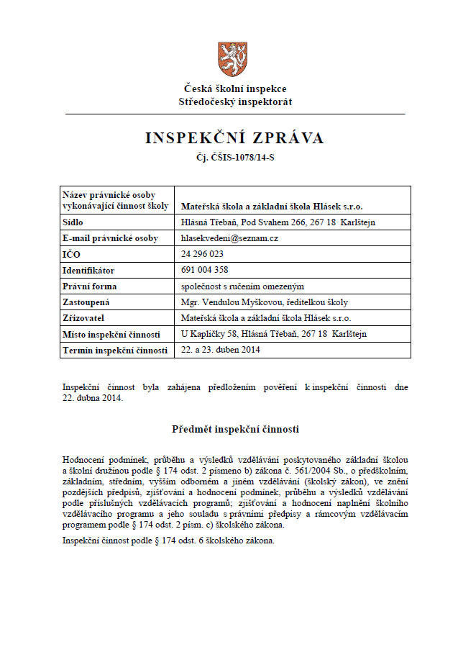

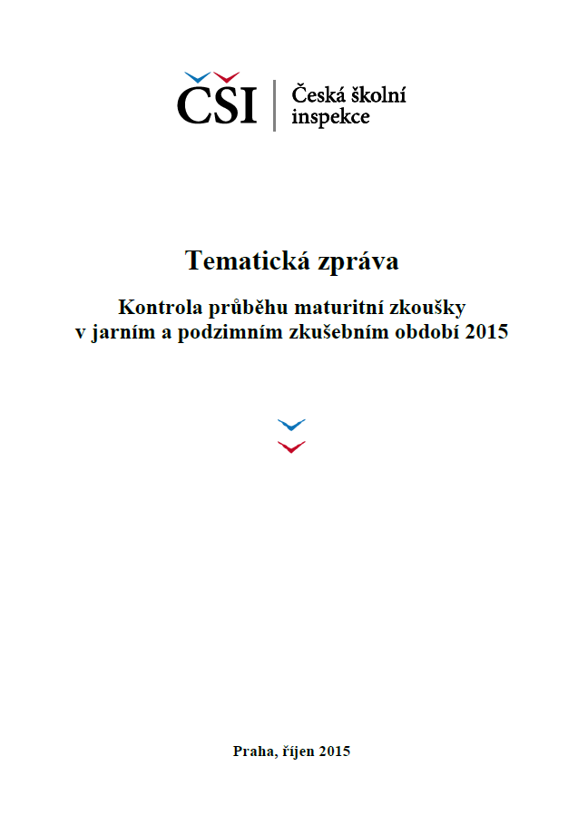
How Does the Legal Framework Support and Restrict the Effectiveness of Inspectorates?
Outcomes of the Inspection Activity
Inspection report (public document)
Protocol (not a public document)
Topical report
CSI annual report
Result of the complaints investigation

Slide 24
How Does the Legal Framework Support and Restrict the Effectiveness of Inspectorates?
How to Ensure Inspection Credibility and Reliability?
Legal Framework
Team work
Inspection activity methodology
Various types of inspection activities
Inspection reports
New instruments for evaluation
Database
Publicity; public control

Slide 25
How Does the Legal Framework Support and Restrict the Effectiveness of Inspectorates?
How to do it?

Slide 26
How Does the Legal Framework Support and Restrict the Effectiveness of Inspectorates?
Added Value of the Inspectorate
Reliable information
Comparative data about schools, learning and teaching
Data instead of hasty and groundless judgments
Materials for policy making
Materials for school decision
International comparison

Slide 27

How Does the Legal Framework Support and Restrict the Effectiveness of Inspectorates?
How Much We Spend a Year per Capita on Education in the Czech Republic

Slide 28
How Does the Legal Framework Support and Restrict the Effectiveness of Inspectorates?
How Much We Spend a Year per Capita on Education in the Czech Republic
Ministry of Education Youth and Sports
Expected spending for the year 2016:
141 179 305 846 CZK
Number of inhabitants in 2016: 10 564 900
Costs per one person: 13 363 CZK
Four member family: 53 452 CZK

Slide 29
How Does the Legal Framework Support and Restrict the Effectiveness of Inspectorates?
How Much We Spend a Year per Capita on Education in the Czech Republic
Czech School Inspectorate
Budget for 2016: 320 155 500 CZK
Number of inhabitants in 2016: 10 564 900
Costs per one person: 30,30 CZK
One small espresso per year (or one beer)

Slide 30

How Does the Legal Framework Support and Restrict the Effectiveness of Inspectorates?
How Much We Spend a Year per Capita on Education in the Czech Republic
One Czech citizen pays: 13 363 CZK
Quality assurance: 30,30 CZK

Slide 31
How Does the Legal Framework Support and Restrict the Effectiveness of Inspectorates?
Inspection is a Very Cheap and Effective Tool
Understanding of effectiveness and efficiency of education
Budget monitoring
Supervision over the safety of children, pupils and students
Improvement of quality of instruction and education

Slide 32

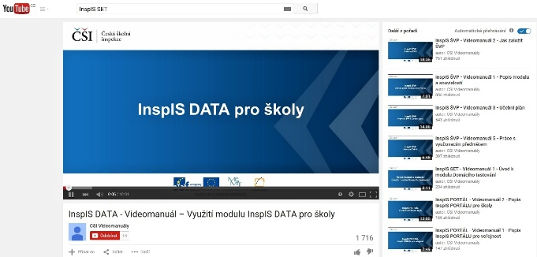
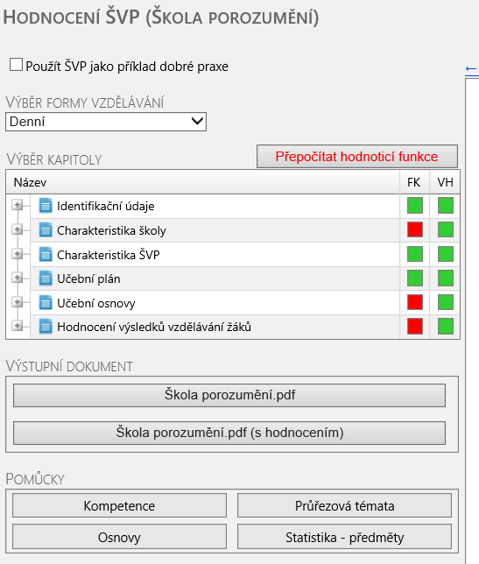



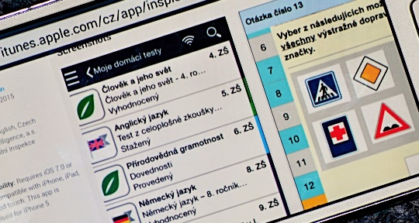


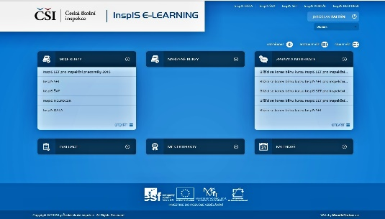

How Does the Legal Framework Support and Restrict the Effectiveness of Inspectorates?
Information Systems

Slide 33
Petr Drábek
Head of Central Bohemian Inspectorate
Arabská 683, 160 66 Praha 6
Tel.: +420 235 091 033
Email: petr.drabek@csicr.cz ǀ www.csicr.cz

