Slide 1
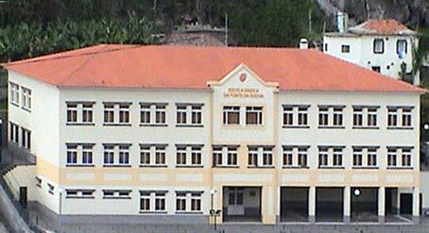
A S.W.O.T. analysis: A school’s reality and inspection’s contribution
António Cerdeira
Noema Barbosa
30-31 May - Funchal – Madeira Island - Portugal

Slide 2
sUMMARY
1. School’s location
2. Strutural organization – 3 levels
3. A S.W.O.T analysis – profile
4. The involvement of the different Educational Staff
4.1. The school improvement progress
5. School’s work methodology - dynamics
6. Inspection’s intervention – A co-creator?
6.1. Inspection´s contribution
6.2. Main obstacles
7. Reflections
7.1. Education nowdays - Challenges
8. Conclusion
9. A school...a window open to the world…

Slide 4
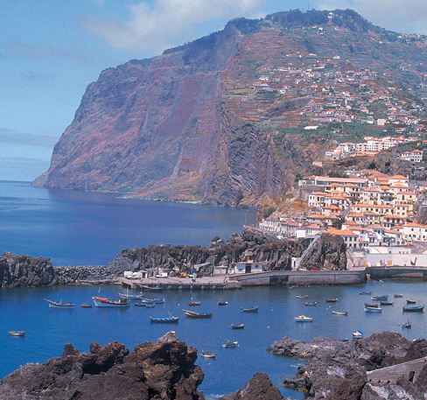
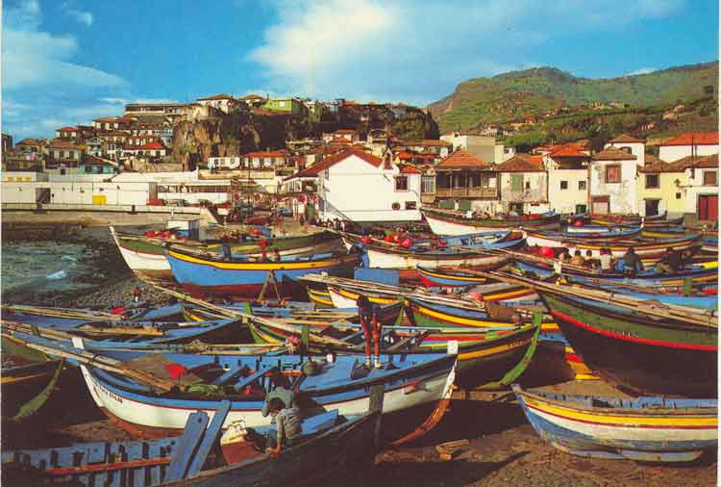
Câmara de lobos
1. School’s location
In Social housing districts
SOCIAL AND ECONOMICAL CARACTERIZATION
Pupil’s Parents:
Some are unemployed, fisherman;
working in construction(men);
Some of the Women are unemployed as well, living from social benefits, and a small number are housewives,

Slide 5
2. Strutural organization – 3 levels
Primary school
Pre-primary
Lifelong learning
2 classrooms: Orange and Blue;
Children from 3 to 6 years old;
Timetable from 08:30 a.m. to 06:30 p.m.
4 classes: 1st, 2nd, 3rd and 4th grade;
From 6 to 11 years old pupils;
Timetable from 08:30 a.m. to 06:30 p.m.
2 classes;
Students with 35 to 45 years old;
Starting at 02:30 p.m. and ending at 05:00 p.m.
Full time school

Slide 6
3. a s.w.o.t analysis – profile
STRENGTHS - Curiosity; - Sports; - Drawing; - Music and dance; - Like to listen and talk about stories read, lived or related to History moments; - Role plays; - Science and social studies; - Experiences; | WEAKNESSES - Very distratcted and get bored very easily; - Behaviour – agressif; - Indecisive; - Writing and solving problems; - Lack of follow-up and monotoring of school life in parents behalf;
OPPORTUNITIES - Show off the skills learnet; - To work in groups or pairs; - Plan ahead; - Colaborate, share ideas; | THREATS - Lost of enthusiasm, motivation; - Take too long to make a start on a work; - Put rush before work quality; - Lack of initiative; Family: - Low life perspectives towards the future; - resistance in following rules or accepting them

Slide 7
4. THE INVOLVEMENT OF THE DIFFERENT EDUCATIONAL STAFF
TEACHER/EDUCATOR
Creativity
Context
METHODOLOGY
EVALUATION
Parents
Child / Student
School
Local
National
Community
Connections
Care
Coherence
Curiosity
Challenge
CURRICULUM
MATERIALS
EDUCATIONAL & CULTURAL CONTEXT

Slide 8
4.1. tHE SCHOOL IMPROVEMENT PROCESS
Gather
Get ready,
Collect school data and
Build school profile
Do
Implement plan
Monitor and evaluate the plan
Study
Analyze data
Set goals
Set measurable objectives/targets
Research best pratice
Plan
Develop school
Improvement plan

Slide 9
“The concept of “curriculum” should be developed from “ predetermined and static” to “adaptable and dynamic”.
Schools and teachers should be able to update and align the curriculum to reflect evolving societal requirements as well as individual learning needs.”
(OECD, 2018, P.7)

Slide 10
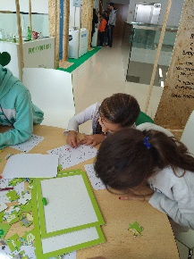
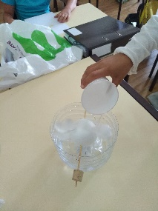
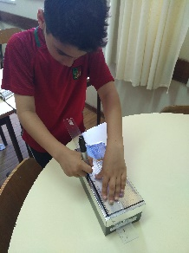
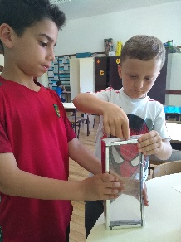
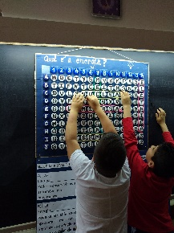
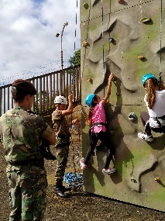
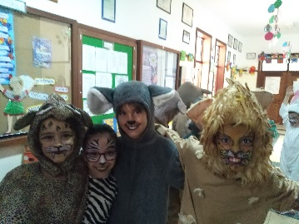
5. School work methodology - DYNAMICS
stage1:
Planning
stage 2: Development
stage 3: Communication/
divulgation
stage 4: Evaluation
Stage 5
Work/project
Formative evaluation – along the process with feedback.
- Questions
And at the end of each term.
Dialogue with pupil’s parents; school and teacher/educators assemble (meetings); Students work exhibitions, as well as the participation in homework and projects or other means of communication.
- Definition of the problem
The planning of communications.
- Experiences and previous knowledge
Presentation.

Slide 11
6. Inspection’s intervention – a co-creator?
Purpose of the Study
Meeting Development Goals …
…meetings with teachers, staff, parents …
… the interviews…
… documents analysis…
… legal procedures
Improvement plan
Recommendations

Slide 12
6.1. contribution’s
Constructive advice
Monitorization and improvement of Teaching and Learning skills
Supervision of the implementation of Curriculum and gave suggestions
Provided Guidance
Simplified procedures

Slide 13
6.2. Main obstacles
- Lack of time to do all tasks and very time-consuming.
- Incompatibility of schedules and working teams.
- Teachers resistance to change or innovate.
- Little information and poor teacher training necessary to improve practices.
- The political changes and willingness.
- The late announcement of documents.
- The parent’s and pupils unacceptance.
- School and Community Climate…

Slide 14
7. REFLECTIONS…

Slide 15
7.1. Education nowadays – Challenges
Please see the “BRIDGE” short animated film in the link below…
https://www.youtube.com/watch?v=_u1vQ7Mh4Sk

Slide 16
8. CONCLUSION
Society is evolving so fast, as well as technology, and the needs aren’t the same from those in the past.
Challenges are everywhere: in education, society, family structures, their roles.
Collaboration is essential now times in order to try to find accurate answers.
And as teachers/educators, we have a special task: to prepare our children, future citizens of tomorrow, to be participative, interventive, and adaptive to all circumstances.
So that they can embrace the future successfully, we have to allow them the opportunity to try, to develop as many skills as they can, through the articulation between subjects, contents, the diversification of activities, strategies, materials, and resources.

Slide 17
Any strategy implemented concerning education has to be thought and viewed in a collaborative way, as making part of a process of constant learning, interactive relationships, partnerships, sharing and profound knowledge of the educational, social, historical, political, cultural context, in order to maintain the identity of cultures, people and its roots but also opened to the world.
Co-creating and opening up schools to new ideas, strategies, methodologies, and sharing them can be scary, but rewarding as well, since it puts us in contact with new ways of thinking, new energy benefits due to sharing perspectives and collaborating.
Unfortunately, co-creation is not a fail-proof innovation process: there’s no guarantee, though we can always get great meetings of minds, fresh perspectives, and inspiring ideas, that may guide us in finding more accurate answers and the right direction.

Slide 18
8. A SCHOOL…A WINDOW OPEN TO THE WORLD…

Slide 19
PEACE RUN EVENT
The video is available (from 1:57 to 3:28) in…
https://www.youtube.com/watch?v=xkw9KOCQoso

Slide 20
