Slide 1
Balancing School Internal and External Evaluations: a New Zealand perspective
Presentation to
SICI General Assembly Malta
3 October 2017
Sandra Collins
Senior Education Evaluator
Evaluation Services
Education Review Office

Slide 2
ERO in the NZ education system
Parliament
Tertiary Education
Commission
Ministry of Education
Policy
Funding
Education NZ
Minister of Education
New Zealand Qualifications Authority
Education Council
Education Review Office
Schools and Early Learning Services
Parents and the community

Slide 3
Who we are and what we do
A government department established in 1989
We evaluate the performance of schools and early childhood services and publicly report our findings
142 designated review staff
80% of staff are field reviewers
National office and 7 regional offices
650-840 school evaluations per year
1200-1460 early childhood evaluations
Up to 20 national evaluation reports produced each year

Slide 4
ERO’s external evaluation focus has shifted 1990-2017
Assurance Audits
Compliance with legislation
1990-1996
Accountability Reviews
Improvement & Accountability
1997-2002
Education Reviews
Increased focus on self review
2002-2016
Education Reviews
Equity and Excellence
2016 ->
Programme review
Internal review
Quality review
Self review
Internal evaluation
The way we talk about internal evaluation has also shifted (especially in ECE)
1990 1996 1999 2002/2008 2016

Slide 5
In ECE ERO is interested in:
what the early learning service knows about the quality of what it does for children – its own effectiveness
how it knows this – the nature and quality of its internal evaluation processes and evidence
what it does with what it knows, to bring about continuous improvement in outcomes for children

Slide 6
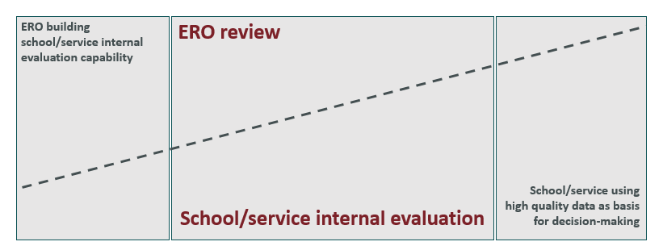
ERO external evaluation – school/service internal evaluation
An evaluation approach that balances ERO’s external evaluation with internal evaluation, according to each school/service’s circumstances.
Schools/services experiencing difficulties with very limited internal evaluation
Schools/services operating well with established processes of internal evaluation
Schools/services sustaining high quality performance and continuous improvement through effective internal evaluation

Slide 7
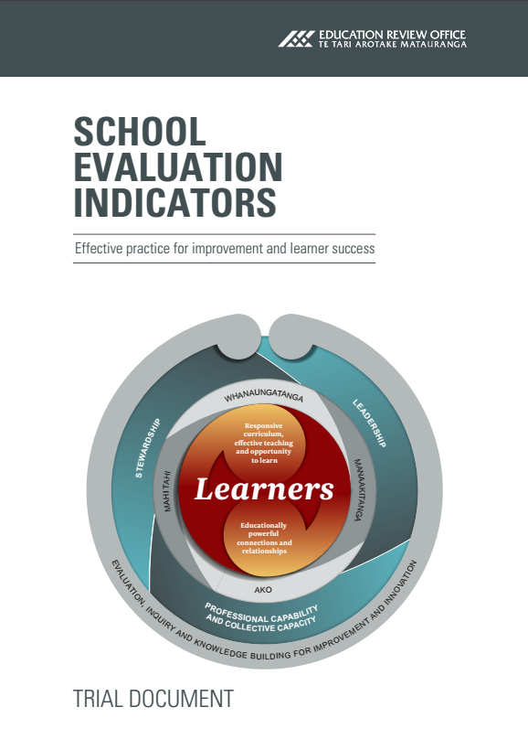
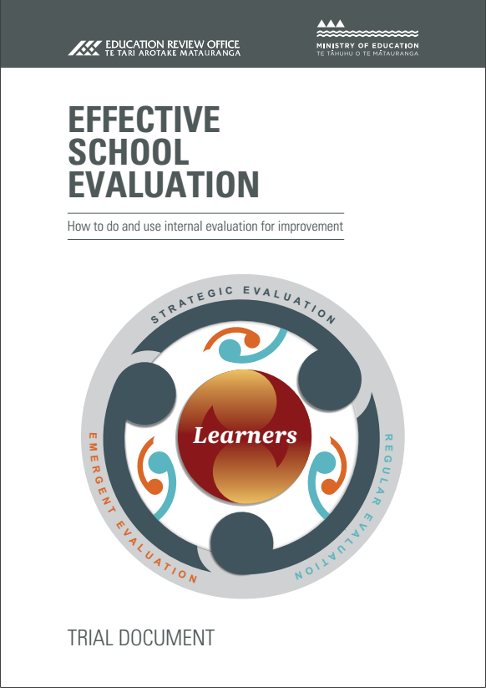
the evaluation resource package
School Evaluation Indicators: Effective Practice for Improvement and Learner Success
Effective School Evaluation How to do and use
internal evaluation for improvement
Effective School Evaluation for Improvement Good Practice Report
http://www.ero.govt.nz/videos/
www.ero.govt.nz

Slide 8
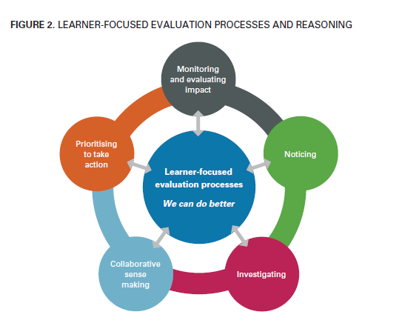
Internal evaluation requires those involved to engage in deliberate, systematic processes and reasoning, with improved outcomes for all learners as the ultimate aim.
Those involved collaborate to:
investigate and scrutinise practice
analyse data and use it to identify priorities for improvement
monitor implementation of improvement actions and evaluate their impact
generate timely information about progress towards goals and the impact of actions taken.

Slide 9
Effective internal evaluation
enables leaders, teachers, parents, families and the wider community to better understand:
impacts of actions on outcomes for learners
changes and further actions needed
patterns and trends
practices likely to make the most difference/result in the most value for learners
how improvements promote the service’s vision, values, strategic direction, goals and priorities for equity and excellence.
Effective School Evaluation page 28

Slide 10
Internal vs External Evaluation
Everybody seems to hate external evaluation while nobody trusts internal evaluation.
David Nevo (1995)

Slide 11
For more information
sandra.collins@ero.govt.nz
www.ero.govt.nz
https://twitter.com/EducationRevNZ

