Slide 1
EMBEDDING INNOVATIVE INSPECTION PRACTICE
SETTING THE SCENE
DUBLIN-September 23-2019
Notes:
Or this one, more expected

Slide 2
What did we learn?
Driving forces and goals-Sofia
Strategies and obstacles: a system-wide approach, co-creation-Funchal
Notes:
Or this one, more expected

Slide 3
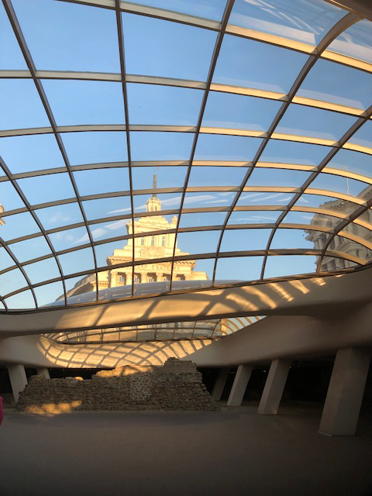
SOFIA
Driving forces and goals
Notes:
Or this one, more expected

Slide 4
Innovation vs Change
Innovation requires a human brain/ hand
Etymology: INNOVARE : introduce something new in something established
Notes:
Innovation requires action/ novelty/ positive connotation

Slide 5
Innovation vs Change
A process: from an idea to an experimentation to generalisation
Innovation leads to change… sometimes
If….nurtured, encouraged, assessed.
Innovation-change-improvement.
Notes:
Needs to be nurtured in incubators; start up… needs to grow, to meet other people’s interest

Slide 6
Innovation: Goals
Education : driving force is not to sell but to improve
School evaluators’ goals : to improve education systems, to lead students to success and employement

Slide 7
Driving forces
External drivers
Internal drivers
Innovation comes from teachers and schools
It is also a necessity imposed by external factors
Notes:
External drivers: changing environment; changing students; pressure put on schools
Internal drivers: we want to make a difference; to be more efficient; to succeed; to adapt and to survive

Slide 8
Innovation: Driving forces and Goals
Two levels of innovation for inspectors/ linked
-Identify and encourage good ideas in schools / classrooms
-to be on the look out for innovations which can bring about positive change
Implies that we are able to have renewed approaches, criteria, frameworks…

Slide 9
FUNCHAL
Strategies and obstacles: system-wide approach

Slide 10
Fucnchal : strategies and obstacles-system-wide approach
Strategies :
Convince : strong political support,all stakeholders around the table
Monitor: évolution of method and image of inspection
Don’t Forget the human touch!
Co-creation and system wide approach.

Slide 11
Fucnchal : strategies and obstacles-system-wide approach
Obstacles :
Main source identified: Fear of change: where do you want to lead me?
How about anticipation the risks inherent to innovation and taking the necessary precautions beforehand?

Slide 12
Fucnchal : strategies and obstacles-system-wide approach
Overcoming Obstacles :
Indirect approach: using research as a means of observation, not jugement- start small experiment-
Direct approach: training, explaining, convincing, sharing expertise with researchers and academics- regular dialogue with schools and teachers.

Slide 13
EMBEDDING INNOVATION
How to transform this pocket of innovation into a systemic change?
DUBLIN

Slide 14
EMBEDDING INNOVATION
Highest stake
Innovation not embedded risks oblivion and endless repetition if not assessed and impact measured.
A few questions come to mind :

Slide 15
EMBEDDING INNOVATION
How do we identify an innovative practice?
How do we define a good innovative practice?
What method (s) do we adopt to promote, share, disseminate?
How do we evaluate its impact ? Its efficiency ?
How do we recognise innovations? Does everybody need to be an innovator ?

Slide 16
EMBEDDING INNOVATION
DUBLIN September 2019-
Let us start !

