Slide 1


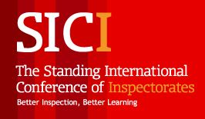
Internal and external evaluation system

Slide 3

Internal evaluation
External evaluation=Inspection

Slide 4


Students: 143 713
Schools: 535 > teachers 14 581
Nursery schools: 635 > teachers 7927

Slide 5
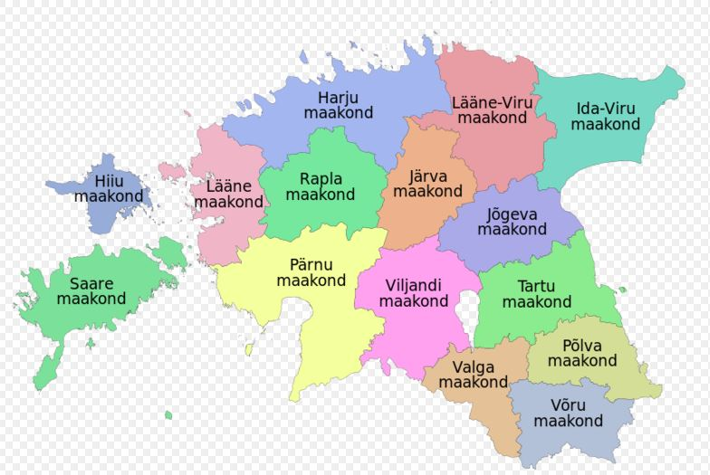
About Estonia
15 counties
more than 200 local governments

Slide 6
Reform
State and administrative reform – since 1st January
county governments will finish activity
79 local governments

Slide 7

Evaluation and
inspection system

Slide 8
Evaluation system
Estonian Ministry of Education and Research
Policy, strategy, standards, support, inspection
carry out, organizes the inspection and analyses its result
School
Internal evaluation
Owner
Support, inspection
inspect management, staff work and economic activities.

Slide 9
Inspection
Ministry of Education and Research
Individual matters
Thematic
Licences

Slide 10

Main objective
The main objective is to ensure the accessibility of basic and secondary general education, also organisation of education and schooling, its quality and efficiency on equal bases.

Slide 11

Inspection
Inspection is exercised by the Ministry of Education and Research.
We only inspect education activities.
We inspect lawfulness.

Slide 12

The inspection and the management of financial resources of an educational institution are exercised by the owner.
Administrative control

Slide 13

The results of inspection are documented in a report.
The results of inspection are public and the report of inspection is published on the website of the county or Ministry.
Summaries of the results of inspectorate composed each academic year at the state level.
The results of inspection

Slide 14
We would like to go over from thematic inspection to risk based inspection.
It means that we inspect schools when there are problems, complaints or low students results.
Changes

Slide 15

Internal evaluation

Slide 16
Internal evaluation (1)
Internal evaluation is compulsory since 2006.
The criteria of internal evaluation:
leadership and management
personnel management
cooperation with interest groups
resource management
the education and schooling process
results related to a child/student, personnel and interest groups and statistics of the educational institution

Slide 17

Counselling
From 2006 to 2009 – obligatory
From 2009 to 2013 – optional
From 2013 – the ministry does not organize counselling

Slide 18
Internal evaluation < inspection
Internal evaluation
Development plan
Inspection

Slide 19
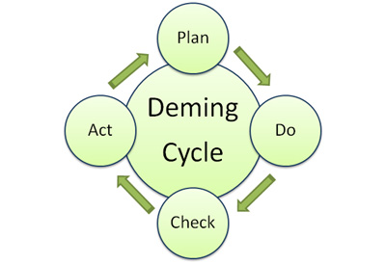
Internal evaluation
The methods for carrying out internal evaluation are chosen by the educational institution.
The management is responsible for carrying out internal evaluations.
The procedure of internal evaluation is imposed by the headmaster.

Slide 20

Thank you!

