Slide 1
THE ITALIAN NATIONAL EVALUATION SYSTEM:
OBSTACLES AND OPPORTUNITIES
Donatella Poliandri
SENIOR RESEARCHER,
HEAD OF DEPARTMENT ‘SCHOOL EVALUATION’
Funchal – 30-31 May 2019
INVALSI
National Institute for the Evaluation of Educational Instruction and Training
Italy

Slide 2
THE ITALIAN NATIONAL EVALUATION SYSTEM

Slide 3
Self Evaluation
All Italian schools are involved in self-reflection
External Evaluation
A sample of 5-10% of Italian schools
EVALUATION PROCESS: 4 PHASES
Social Accounting
Publication and dissemination of the achieved results
Improvement actions
Schools define priorities in order to improve
INVALSI
National Institute for the Evaluation of Educational Instruction and Training
Italy

Slide 4
INVALSI
National Institute for the Evaluation of Educational Instruction and Training
Italy
A centralized model for school evaluation
Context: Italy has a centralized school system, a tradition of top -down reforms, a high number of schools (about 10.000), most of them without experience in self-evaluation.
Italy has developed a “turnkey package” to support schools in self-evaluation (Data-driven evaluation):
a national regulation has introduced self-evaluation, external evaluation and improvement plans for all schools (2013 Act concerning the National Evaluation System)
A national framework for internal and external evaluation has been developed, considering three different aspects (school context, school processes, student results) each divided into sub-areas
a set of 50 indicators and 147 descriptors has been defined
a self-evaluation form has been designed. The form is composed by:
“guiding questions” that help self-evaluation teams in their analysis
open text boxes where schools describe strengths and weaknesses of each area of the framework
evaluation rubrics that help schools assign a score on a 7-point scale in each area
a final section in which schools define the improvement objectives for the examined areas
an online platform that allows schools to view indicators and complete self-assessment forms

Slide 5
INVALSI
National Institute for the Evaluation of Educational Instruction and Training
Italy
A centralized model for school evaluation
External evaluation: under this pillar INVALSI select almost 10% of Italian schools based on defined criteria.
External evaluation is conducted by an external evaluation team composed of one inspector and two expert evaluators selected and specifically trained by INVALSI.
The external evaluation visit is realized according to the program and the evaluation guidance-tool (in Italian known as “the protocol”) adopted by the National Evaluation System’s General Conference that oversees the National Evaluation System itself.
According to the outcomes of the analysis conducted by the external evaluation team, school institutions redefine their improvement plans.

Slide 6
Schools are invited to reflect on the main educational, instructional, organizational and technical aspects of their activity
A COMMON FRAMEWORK BETWEEN SELF-EVALUATION AND EXTERNAL EVALUATION
Common framework
External Evaluation
Self-Evaluation
INVALSI
National Institute for the Evaluation of Educational Instruction and Training
Italy

Slide 7
SELF-EVALUATION OF ITALIAN SCHOOLS
A SCUOLA DI NEWSLETTER, LA NEWSLETTER PER LA SCUOLA

Slide 8
THE COMMON FRAMEWORK
Background and resources
Geografical context
Results
National standardised test
Processes
Economic and material resources
Structures and infrastructures
European key competences
Long-term results
Inclusion and differentiation strategies
Continuity of Learning and counseling
Management and leadership
School’s curricula
Results achieved by students
Relations with context and families
Development of human resources
Learning environment
INVALSI
National Institute for the Evaluation of Educational Instruction and Training
Italy

Slide 9
THE COMMON FRAMEWORK – Self-evaluation report (RAV)
Strengths and weaknesses
Self-Evaluation rubric (7 point scale)
Priorities and goals
Analysis on the results achieved by the school in each specific sector
Scores range from “Very Critical” (1) to “Excellent” (7)
General objectives that the school intends to achieve in the middle term
INVALSI
National Institute for the Evaluation of Educational Instruction and Training
Italy

Slide 10
THE SCHOOLS’ EXTERNAL EVALUATION VISIT:
WHAT IT IS AND HOW IT IS CONDUCTED

Slide 11
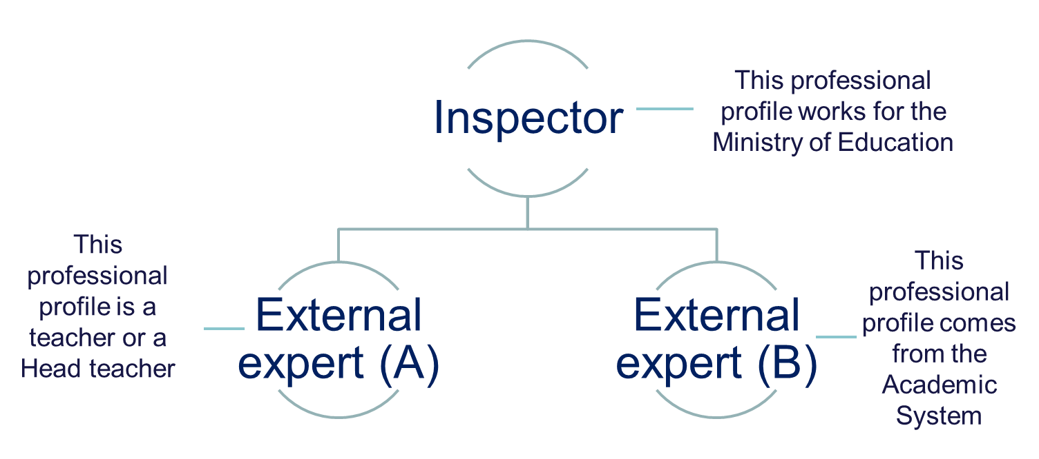
External evaluation team
(3 members)
LA NEWSLETTER…
INVALSI
National Institute for the Evaluation of Educational Instruction and Training
Italy

Slide 12
EXTERNAL-EVALUATION REPORT
Preliminary study of the school
School visit
External Evaluation Report
Return meeting (Professional Dialogue’s approach)
Study of schools’ documents regarding setting, students’ performance and learning outcomes
Three days of meetings aimed at encountering schools’ personnel, students and parents
Return meeting to discuss the document on the main results of three-day visit
INVALSI
National Institute for the Evaluation of Educational Instruction and Training
Italy

Slide 13
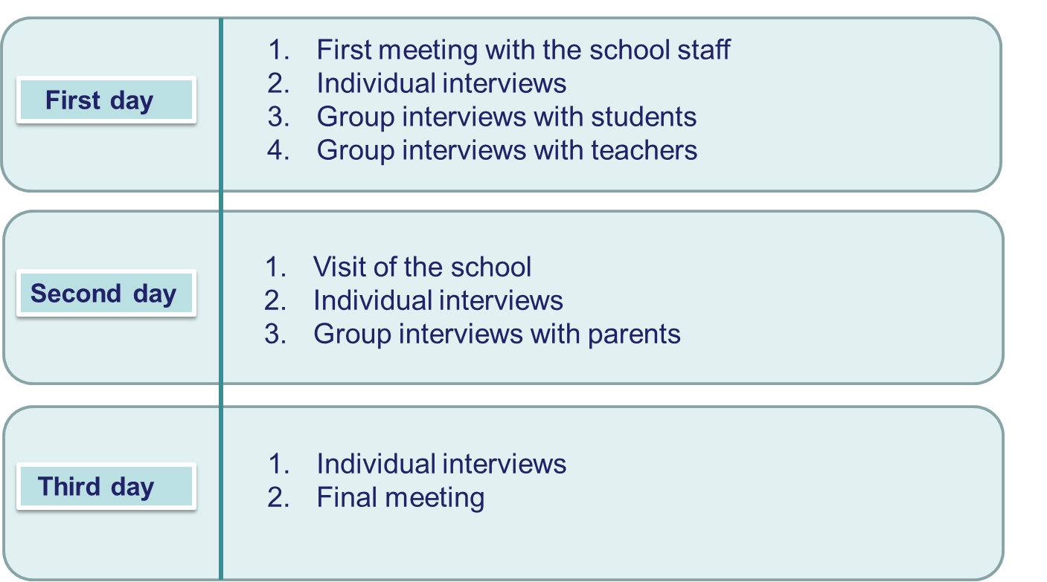
THE SCHOOL VISIT
INVALSI
National Institute for the Evaluation of Educational Instruction and Training
Italy

Slide 14
OBSTACLES AND OPPORTUNITIES

Slide 15
INVALSI
National Institute for the Evaluation of Educational Instruction and Training
Italy
The functioning of the model in the very first years of implementation 1/1
Focusing on the same direction
Themes for reflection
There is a national vision of school quality
The common framework, the indicators and the evaluation rubrics define the perimeter within which internal and external teams should analyze the schools
The judgments of the schools are confirmed by the external evaluation teams
We have high correlation indexes between internal and external scores assigned with evaluation rubrics (indexes ranging from 0.60 to 0.75 for students’ results areas and 0.50 - 0.65 for school processes areas)
(Source: data from a sample of 375 schools that performed self-evaluation in 2015 and received external evaluation in 2016)
The evaluation rubrics and the "guiding questions” direct the analysis carried out by the schools
schools add very few themes to those suggested in the self-evaluation form
(Source: textual analysis on a sample of 725 self-evaluation reports written in 2015)
Schools show difficulties in defining improvement objectives
about 30% of the objectives are rejected by external evaluation teams (about 20% are adjusted; about 50% are accepted)
(Source: data from a sample of 375 schools that performed self-evaluation in 2015 and received external evaluation in 2016)

Slide 16
INVALSI
National Institute for the Evaluation of Educational Instruction and Training
Italy
The functioning of the model in the very first years of implementation 1/2
Focusing on the same direction
Themes for reflection
A favorable attitude towards self-assessment positively influences the perception of internal self-assessment teams about the effects produced by self-assessment.
(Source: data from a sample of 725 schools that performed self-evaluation in 2015, 532 schools principals and 2625 teachers)
External evaluation teams operate as an authentic collegiate structure
(Source: data from a sample of 172 external evaluators who conducted the external evaluation of schools in 2017).
Every Regional Administrative Office of Instruction promote different actions to support schools showing a lot of differences in engage of human and financial resources in projects:
A policy promote at a national level receive different attention at the local one. Different support around Italy could produce - indirectly - differences between schools' approach at evaluation
(Source: textual analysis of all the Italian Regional Administrative projects to support schools in the process of evaluation - Local level)
External evaluation teams consider triangulation, negotiation and collegiate - the judgment – very difficult to transform in actions. These processes depend on the different evaluator’s attitudes and skills
(Source: data from a sample of 172 external evaluators who conducted the external evaluation of schools in 2017).

Slide 17
Purpose of engaging schools in the evaluation: Who and How
Capacity building: Building decentralized assessment skills (Internal evaluation team and External evaluation team - agency)
Evaluation: social practice connecting citizens
and public sphere in the practical field of projects and programs
INVALSI
National Institute for the Evaluation of Educational Instruction and Training
Italy

Slide 18
WALK THE TALK

Slide 19
INVALSI
National Institute for the Evaluation of Educational Instruction and Training
Italy
A participatory process concerning self-evaluation in
Lifelong Learning Centres
In Italy there are 132 Centres for Lifelong Learning (LLC) that belong to the national school system and are called to do self-evaluation. 18 of LLC (one in each region) are also Research Centres.
VALUE, an INVALSI project funded by European Funds, aims to increase the evaluation culture in the Italian school system and to support the development of the National Evaluation System.
Within the VALUE project, INVALSI has involved the Research Centres in a participatory process to revise the self-evaluation framework developed for the schools. The framework has been adapted and customized for LLC.
Thematic working groups of teachers, school principals and INVALSI researchers have defined the aspects to be evaluated
The Research Centers are working on the construction of a glossary, in order to define a common language for the evaluation of LLC (examples of words are “core skills" and "stakeholders")
An online platform has been developed for LLC. The centres can:
manage the access of self-evaluation team members (add and remove members)
enter data that will be automatically transformed into indicators by an algorithm
consult indicators coming from different sources
fill in the self-evaluation form
receive technical assistance

Slide 20
INVALSI
National Institute for the Evaluation of Educational Instruction and Training
Italy
Developing partnerships and local networks
for supporting self-evaluation
The literature highlights the usefulness of some measures to support the school self-evaluation processes, such as promoting networks among local organizations and opportunities for comparison and exchange in horizontal mode - peer to peer - between paired schools (OECD, 2013).
The aim of the VALUE project is to overcome a standardized approach for supporting school self-evaluation, favoring tailored interventions and as close as possible to the specific needs of the schools.
With VALUE project, INVALSI acts as a link between schools and agencies with experience in supporting self-evaluation processes (universities, training and research centres, teacher associations, school networks).
INVALSI is going to finance three training proposals concerning self-evaluation, according to one of the following lines of action:
Peer Learning between schools (Topping, 2007)
Case study research (Stake, 1995)
Situated learning as a model of learning in a community of practice (Lave & Wenger, 1991)
Expected outcomes of the project are:
define contextualized training models
foster the culture of self-evaluation
development of networks and decentralized forms of support

Slide 21
Exploring data use in school inspection process to empower skills and capacity of external evaluation teams
1/1
INVALSI
National Institute for the Evaluation of Educational Instruction and Training
Italy
Several national accountability systems are based on multiple measures (e.g. cognitive and non cognitive outcomes, educational and organizational practices in schools) to hold schools to account for broader goals (Ladd, 2007) and for the use of different types of data for school improvement (Schildkamp, 2017).
Multiple measures are also less incentivize to engage schools in strategic behaviors that can distort data than just one single indicator. According to this perspective, adding school inspections to test-based evaluation should mitigate the focus of schools on test results. On the other hand, the use of test results to measure output of schools can facilitate schools' focus on producing data on learning and teaching processes (Ehren & Swanborn, 2012).
In these systems, school inspections are expected to have an impact on data use and improvement of schools. Schools generate data as part of the inspection processes (e.g., self-evaluation reports) and inspections generate data for school improvement too (e.g., external evaluation reports).
Furthermore, the inspection procedures attempts to incorporate a professional discourse into a data-driven evaluation that shaping the process of pre-inspection, of inspection visit itself and of reporting (Ozga, 2016).

Slide 22
Exploring data use in school inspection process to empower skills and capacity of external evaluation teams
1/2
INVALSI
National Institute for the Evaluation of Educational Instruction and Training
Italy
What forms of knowledge does the school inspectors prioritize, and what is the relationship between professional judgment and evidence?
We need to better understand the data use in school inspections process and its potential strengths and drawbacks on educational system in terms of: schools as organizations, schools’ management, educational research, and policy making.
Potential topics:
Combining data in internal and external evaluation;
What count’s as data? Inspectors’ perception of data;
External evaluation: what’s next? School improvement and follow-up studies;
The perception of external evaluation results among stakeholders;
The interaction of data and professional judgement within school inspection.

Slide 23
donatella.poliandri@invalsi.it
INVALSI
National Institute for the Evaluation of Educational Instruction and Training
Italy

