Slide 1


Strategies and obstacles for innovation, co-creation
An original experience in a follow up project:
“Development of learning”
Jorge Morgado
Funchal – May 2019

Slide 2

Regional Inspectorate of Education
2019 is the third year of the Regional Inspectorate of Education as a department directly dependent of the Madeira Regional Secretary for Education.

Slide 3

Mission
To safeguard the public education service, with inspective actions that promote the pedagogical and organizational quality of schools.

Slide 4
Vision
To assure the quality of education for children and students in a perspective approach of education for all, human rights and inclusion.

Slide 5
Values
Respect for people;
Improvement of the organization;
The school centrality as an educational organization;
The public interest.

Slide 6
Programmes and activities
Monitoring
Audit
Control
Ombudsman and disciplinary proceedings
Education, national and international, meetings and workshops
And also training that joins inspectors, headmasters, teachers from pre-primary, primary, middle and secondary levels and teachers from universities with recognized merit in these domains.

Slide 7
A new vision… a new approach
A new framework
of basic and secondary
education curriculum.

Slide 8
A new vision… a new approach
Common framework for all schools and educational offerings in the scope of compulsory schooling, namely curriculum, planning, teaching and learning
and in the internal and external assessment of student learning.

Slide 9
A new vision… a new approach
The Student Profile points to a humanistic-based school education, in which the students of this generation build up a scientific and artistic culture. With this purpose, they mobilize values and skills that allow them to intervene in the history of individuals and societies, to make free and informed decisions on natural, social and ethical issues, and to develop a conscious and responsible capacity for civic and active participation.

Slide 10
A new vision… a new approach
Essential Learnings
"The common set of knowledge to be acquired ... indispensable ... relevant and significant, as well as the capacities and attitudes that must be developed by all students ..."

Slide 11
A new vision… a new approach
National strategy for citizenship education

Slide 12
A new vision… a new approach
The autonomy and flexibility of curriculum:
"The curricular autonomy is granted to schools within a range of between 0% and 25% (of the total workload) is locally built at the initiative of each school."
An inclusive school:
“where each and every student, regardless of their personal and social situation, obtains responses that enable them to acquire a level of education and training to facilitate their full social inclusion”.

Slide 13
A new vision… a new approach
The Regional Inspectorate of education has to develop a new culture of cooperation between inspectors and all the members of the educational community, in order to promote a new and better response of school organization and the quality of education of our children and students.

Slide 14
A new vision… a new approach
Innovation
Co-creation
Strategies and obstacles

Slide 15
Conditions for innovation
1- Planning:
1.1. leadership, vision and strategy;
1.2. resources and socio-educational action.
2- Operationalization:
2.1. planning at group and class level;
2.2. implementation and monitoring.

Slide 16
Conditions for innovation
3- Evaluation:
3.1. verification of compliance with the plan and the objectives.
4- improvement:
4.1. action plan for improvement.

Slide 17
PDCA cycle - Cycle of Deming (USA, 1900-1993)
Plan
Do
Check
Act
Continuous
improve-
ment

Slide 18
Monitoring project:
“Development of learning”

Slide 19
The Full Time School in Madeira
The Full Time School in 1st. cycle of basic education, progressively implemented in the Autonomous Region of Madeira, since 1994/1995, is a model of school-time organization that ensures children occupation at school in extended hours dividing the daily time in curricular activities and activities to enrich the curriculum. The enrichment curriculum activities seek to provide students with broader competencies, such as social, linguistic, digital, artistic and sportive skills, aiming their preparation for future competent citizens. Furthermore, this scheme provides occupation of children safely, allowing parents to perform their professional duties.

Slide 20
The Full Time School in Madeira
Primary school (6 – 10 years old)
Since 1994/ 1995
Curricular activities
Enrichment activities
Enrichment activities
Curricular activities

Slide 21
The Full Time School in Madeira
To provide students with:
Social
Linguistic
Digital
Artistic
Sportive
SKILLS
Provides safe occupation of children;
Allows parents to comply with their professional duties;
Equal opportunities for all

Slide 22
“Development of learning”: aims
Observe and analyse:
    the school planning, implementation and evaluation of the students´ learnings.
    the measures adopted by the school to improve the results of learning.
    Improve organizational and operational practices that lead to the development of students' learning and achievement.
To assure the constitutional rights of citizens
regarding equal opportunities on accessing school success.

Slide 23
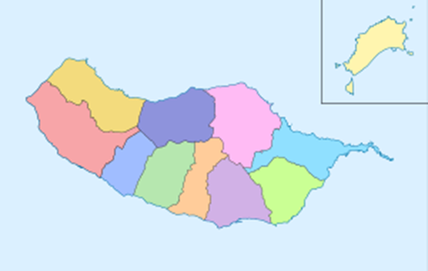
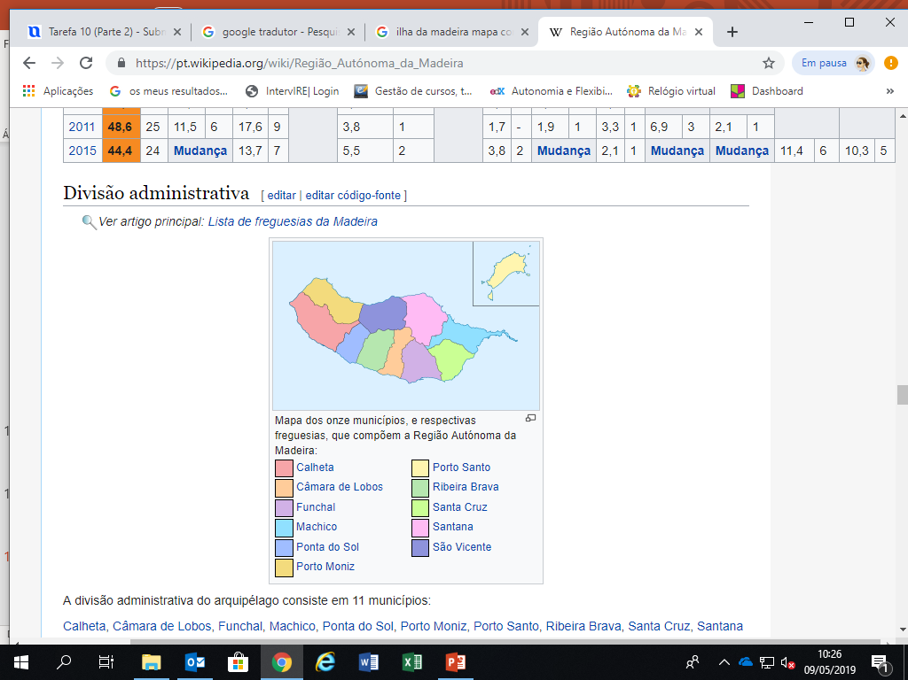
Scope
9 of 11 counties involved;
6 inspectors;
10 schools;
10 headmasters;
914 children;
1081 students;
359 teachers;
270 non-teachers;
and parents.
Soon!

Slide 24
Procedures
The projet begins with a public presentation to the educational community such as teachers, non-teachers, parents, students and other representatives of regional, local, social and economic interest.
Meetings with the headmasters.
Interviews with members of the educational community.

Slide 25
Procedures
Data collection and analysis of planning documents:
  medium and short terms;
  external and internal school results;
  performance reports;
  evaluation of the planning.

Slide 26
Procedures
The results of the intervention are presented, by the team of inspectors, in a synthetic report:
    Most successful results;
    Results that needs improvement.

Slide 27
Procedures
Based on the synthetic report, school draws its own action plan for improvement:
    Strategies and obstacles for innovation;
    To promote a new and better response of the school organization;
    To assure the quality of education of our children and students.

Slide 28
Procedures
The action plan is monitored by the team of inspectors;
Final report with the participation of the school
Co-creation and cooperative work
(with the inspectors, headmasters, teachers, non teachers, students, parents and other representatives of the educational community).

Slide 29
Procedures
There will be a final report regarding the schools involved in the project which will be presented to all schools of Madeira.
We expect to…

Slide 30
We expect to…
contribute to improve schools educational response;
promote students´ school success;
change the culture of students retention;
promote the critical spirit;
foment the assumption of the ethical commitment;
… transform socio-educational reality!

Slide 31
The final report
The final report will contribute with essential information to the Regional Secretary of Education in order to (re)formulate education and training policies.

Slide 32
“Development of learning”, a regional experience, points strategies and obstacles for innovation, in order to improve the education and learnings of the children and students of Madeira`s education system.

Slide 33
Thank you for your attention!

