Slide 1



Better Inspection for Better Social Inclusion
Strategic Partnership for school education
November 19th 2021
Stockholm

Slide 2









Partners

Slide 3




Erasmus+ / KA2
Key Action 2: Cooperation for Innovation and the Exchange of Good Practices is all about enabling organisations to work together in order to improve provision for learners and share innovative practices within and beyond the participating organisations.
Under Key Action 2, organisations can apply for funding to work in partnership with organisations from other participating countries.
The projects funded under this Key Action 2 will focus on sharing, developing and transferring innovative practices in education, training and youth provision between participating countries.
Key Action 2 aims to increase the positive impact of European activities at all levels to ensure benefits for the individuals, organisations and countries involved in projects.

Slide 4
Why this project ? ‘BIBESOIN’
‘BIBESOIN’ focuses on the European priority of ‘Social inclusion’.
Priority is given to actions that help address diversity and promote and stimulate social inclusion in mainstream schools, through transnational project meetings and training activities for school inspectors, external school evaluators, directors and teacher and inspector educators.
Strengthening the profile(s) of the teaching profession

Slide 5
Why this project ? ‘BIBESOIN’
The objectives are in line with the priority themes of SICI:
1. Strengthen 'the impact of inspection’ (2018) on social inclusion (How can inspections and external evaluation help to promote social inclusion in mainstream schools?)
2. ‘Innovate practices of inspections’ (2019) about social inclusion (Which are the different methods used?)
3. Optimise the ‘Internal quality assurance of inspectorates’ (2020) concerning social inclusion. (How can we create together a strong European model for promoting and stimulating ‘social inclusion’ in mainstream schools?)

Slide 6
Why this project ? ‘BIBESOIN’
The three strategic objectives of SICI are closely aligned with the priorities chosen for this project:
1. Support improvement of inspectorates and the professional competences of inspectors
2. Promote and support partnership and cooperation between inspectorates and other organizations
3. Actively participate in the international debate about evaluation and quality improvement in education.

Slide 7
Why this project ? ‘BIBESOIN’
The 'training events' and the 'meetings' focused on the 3 sub-objectives of our chosen priority of social inclusion:
Foster the development of social and civic and intercultural competences
Enhance the access, participation and learning performance of disadvantaged learners
Support and assess new approaches to reducing disparities in access to and engagement with digital technologies

Slide 8
Why this project ? ‘BIBESOIN’
The ambitions of this strategic partnership is to reinforce the interaction between practice, research and policy.
Our aim is to create a 'voice' in the European debate for inspectorates and their stakeholders.

Slide 9
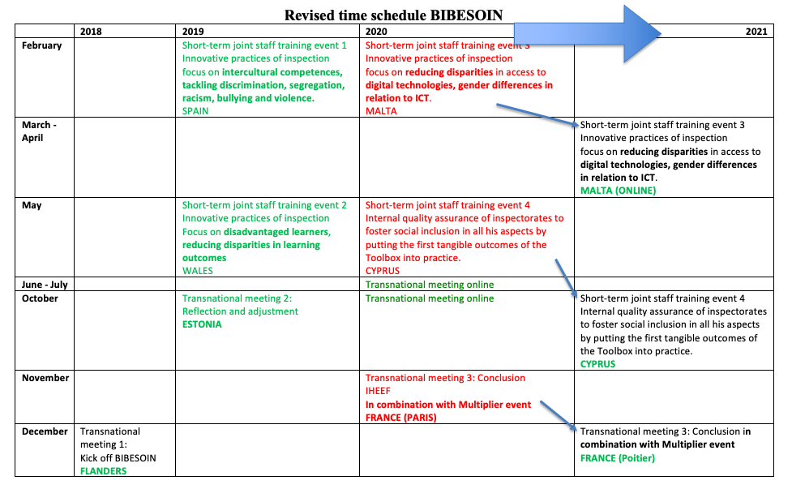

Slide 10
Structure of short-term joint staff training eventS
Each training consisted of 3 days effective working days.
Content:
  National inspection system of the host as ‘friendly consultants’
  Focus on a specific topic (nnovative practices of inspection, internal quality assurance of inspectorates)
  Different sub objectives of 'social inclusion' in regular education

Slide 11
Intellectual Output: TESSIE
The tangible output: the provision of (online) resources for the professional development of inspectors, evaluators, directors as well as for inspector and teacher educators to evaluate and stimulate social inclusion. All information is integrated in a 'Toolbox for Evaluating and Stimulating Social Inclusion in Education' (TESSIE).

Slide 12


Dissemination
https://www.sici-inspectorates.eu/Activities/Projects

Slide 13


Slide 14


Slide 15
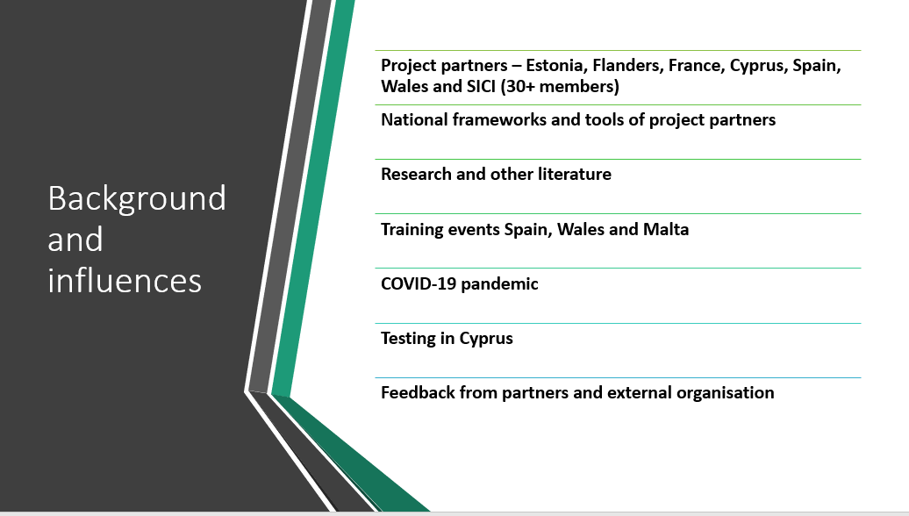

Slide 16
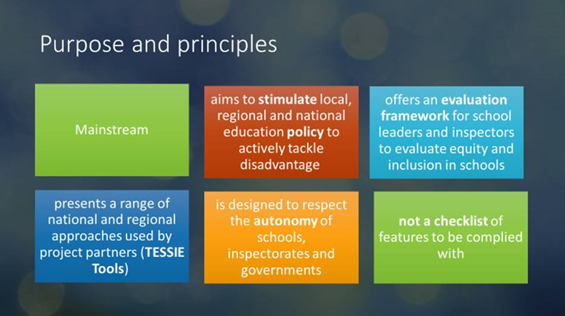

Slide 17
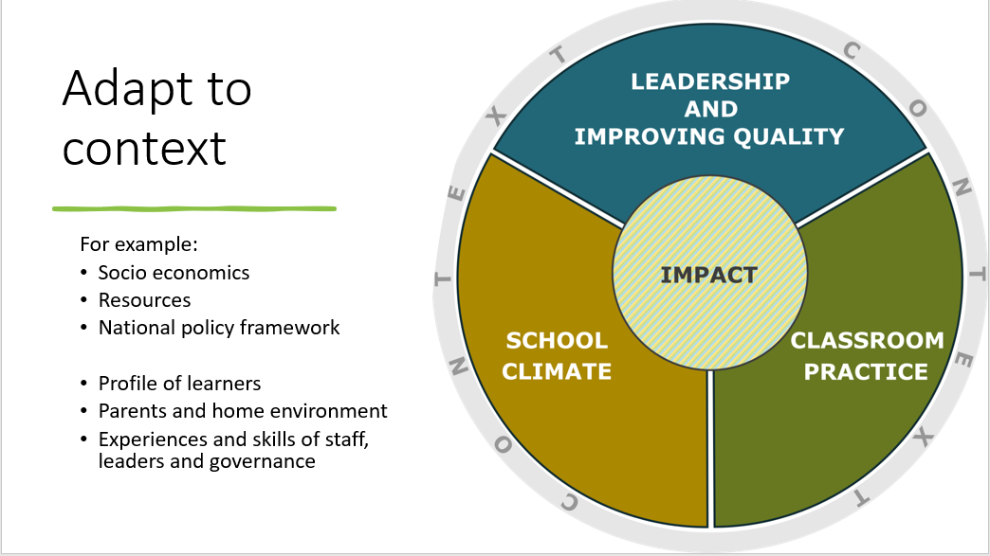

Slide 18
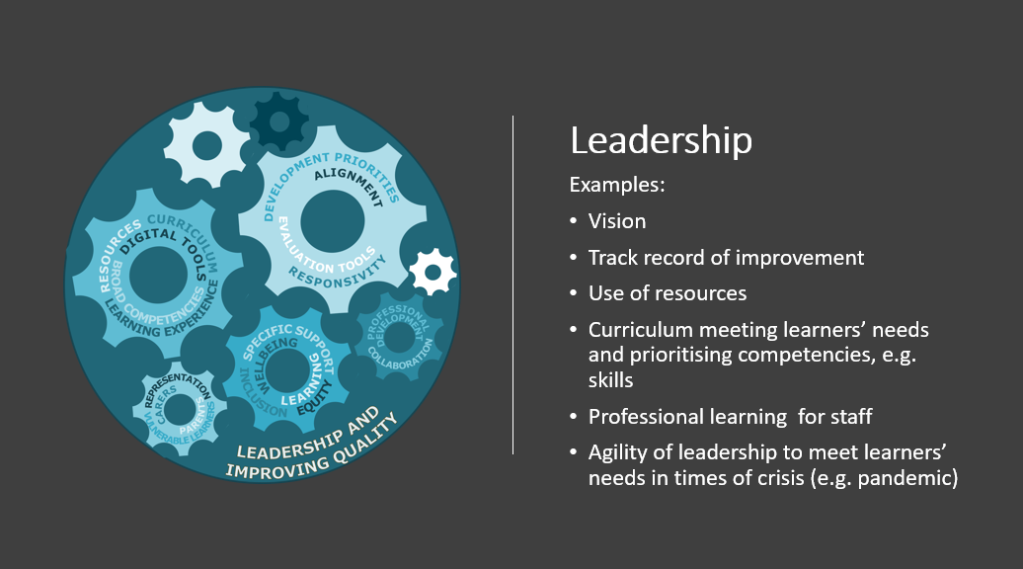

Slide 19
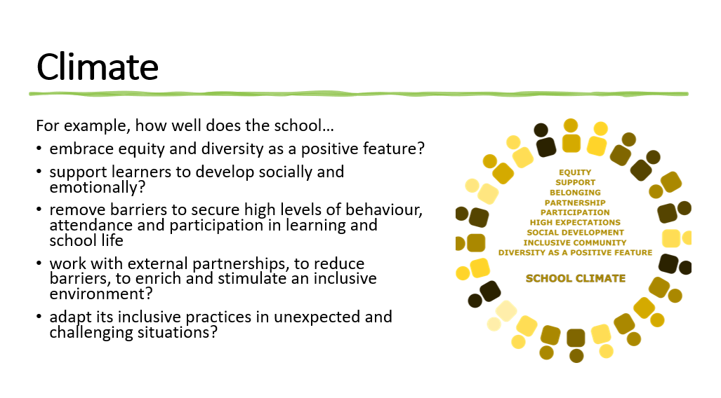

Slide 20
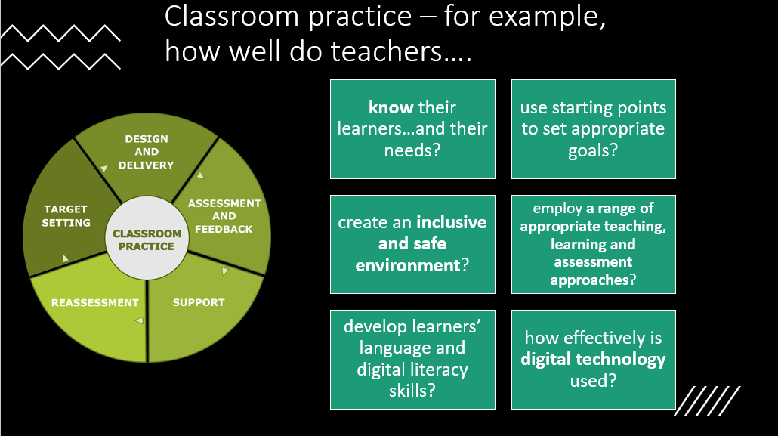

Slide 21
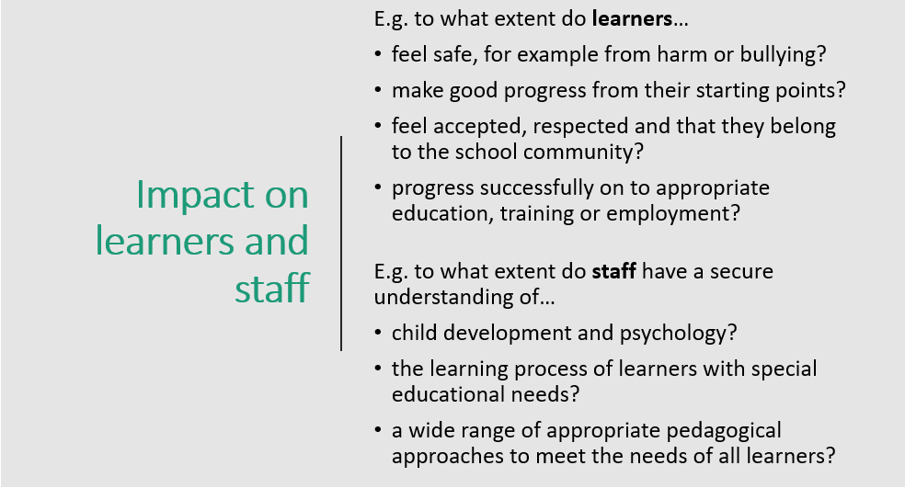

Slide 22


Slide 23
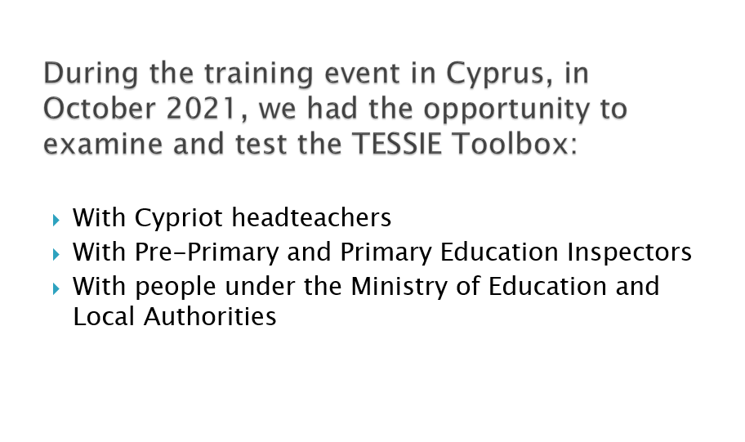

Slide 24
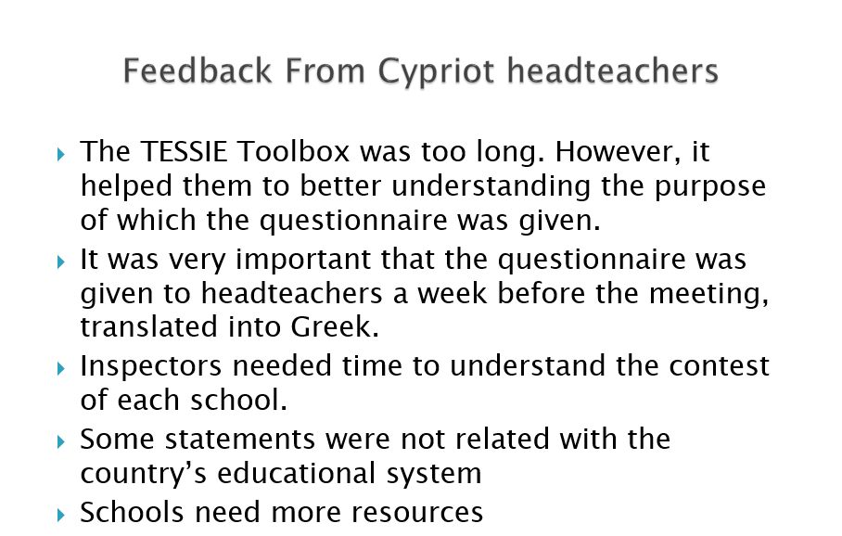

Slide 25
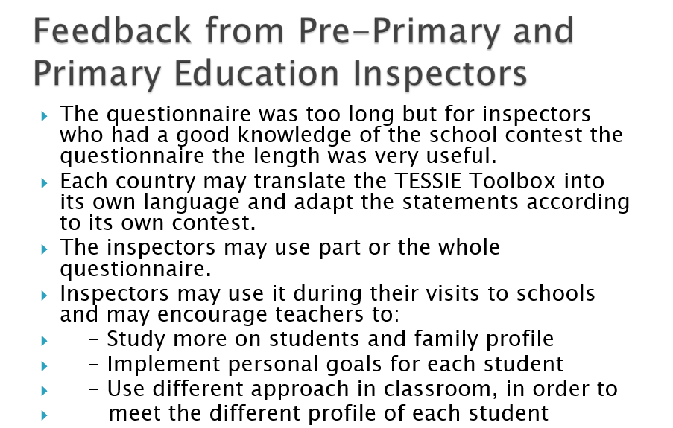

Slide 26
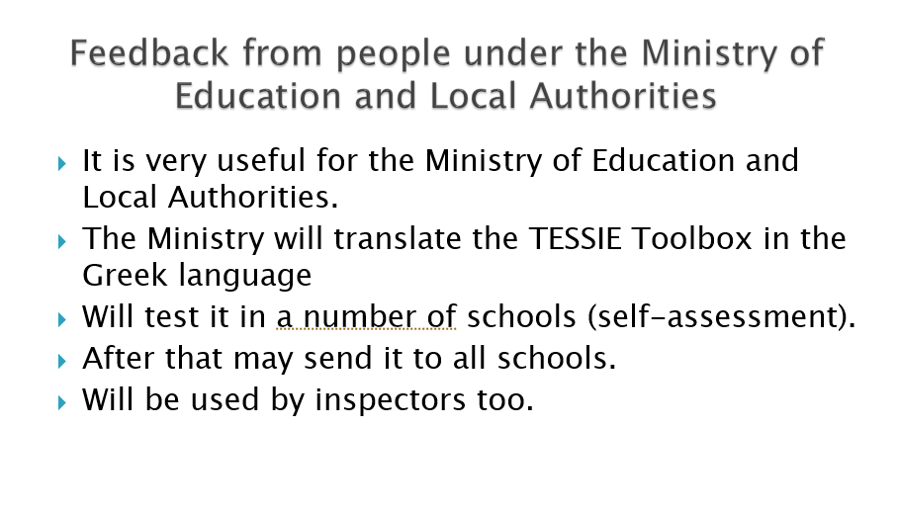

Slide 27


Slide 28


Slide 29


Slide 30
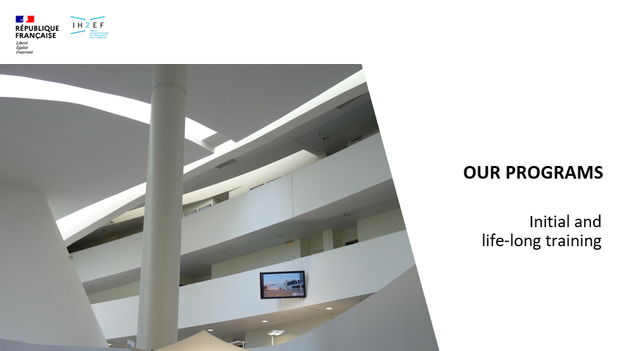

Slide 31
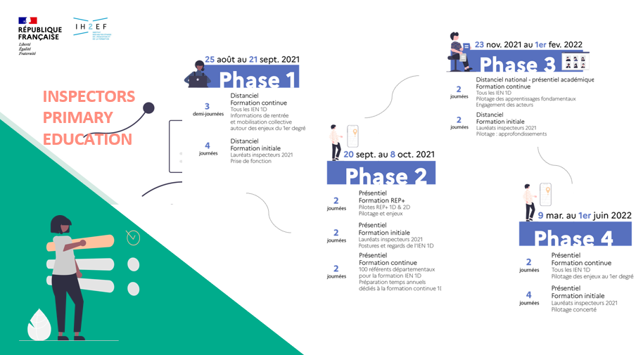

Slide 32


Slide 33
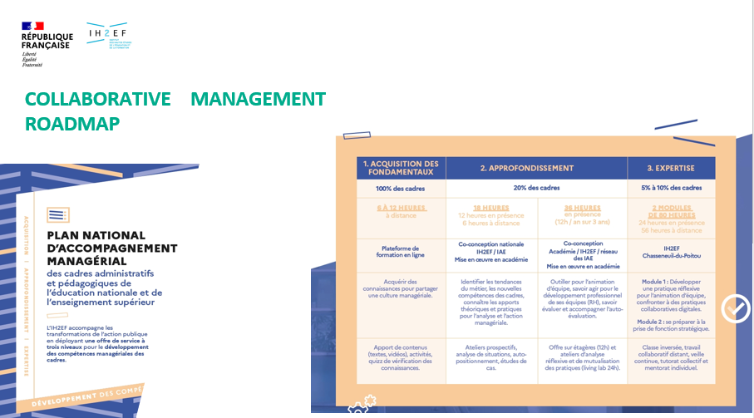

Slide 34


Slide 35
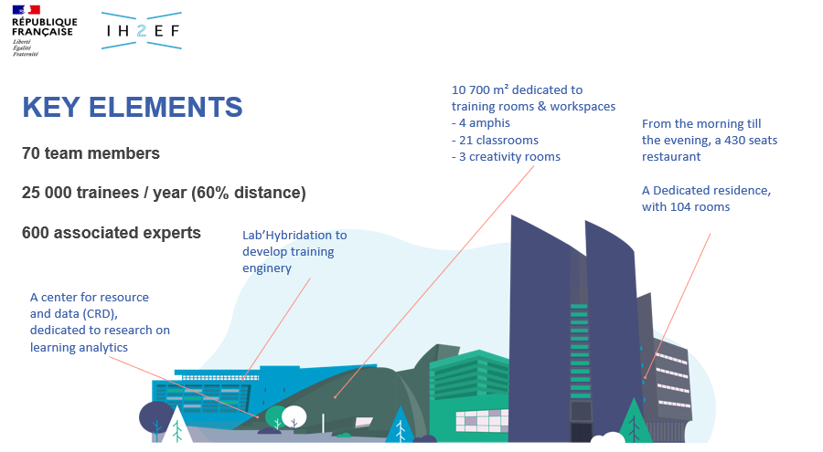

Slide 36
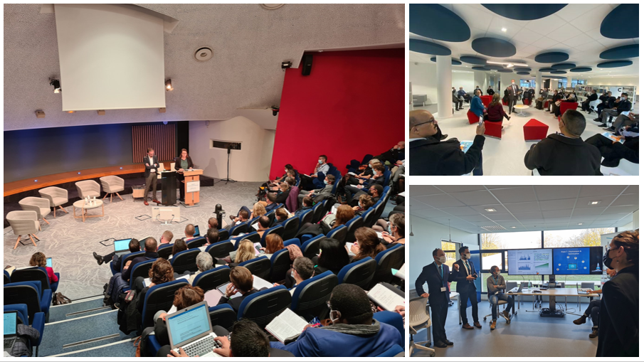

Slide 37
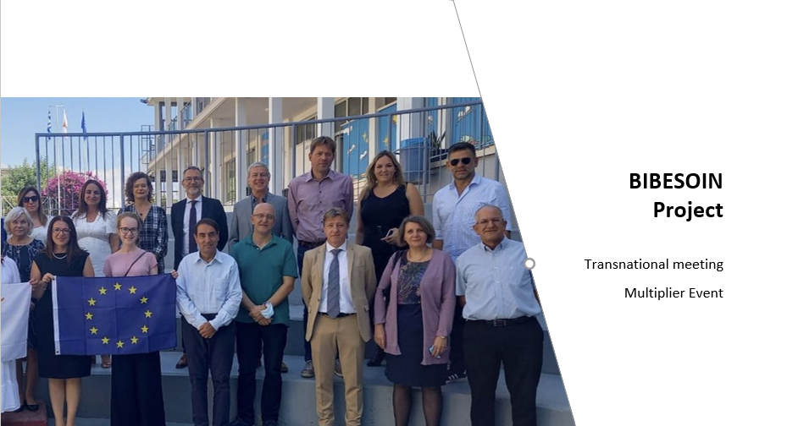

Slide 38


Slide 39
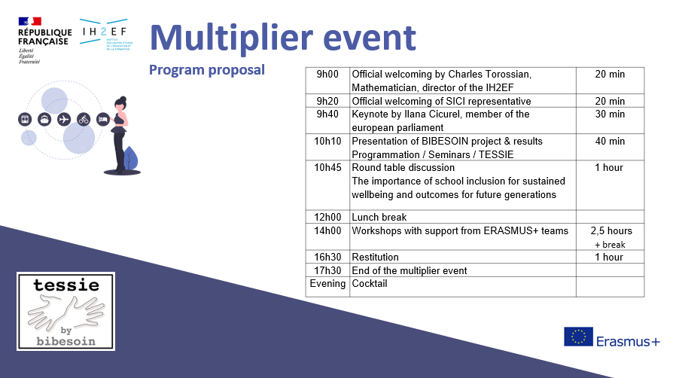

Slide 40
